Slide 1
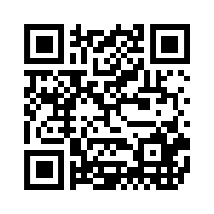
Government Blockchain Association (GBA)
Blockchain Foundations for Healthcare
Certified Course
Gerard R. Dache
Common Sense Solutions
GBA Licensed Training Partner

Slide 2
Course Outline
Lesson 0:
Lesson 1:
Lesson 2:
Lesson 3:
Lesson 4:
Lesson 5:
Lesson 6:
Lesson 7
Introduction
Introduction to blockchain & why it is Important
Cryptocurrency basics
How blockchain technology works
Blockchain benefits, risks and use cases
Real-world use and adoption of blockchain technology
Introduction to smart contracts
Introduction to data storage and blockchain

Slide 3
Lesson 0
Introductions

Slide 4

Who Are We…
Name
What is your professional background?
What knowledge or interest do you have in blockchain?
What do you want to get out of this course?
What do you plan to do with the knowledge gained from this course?
What defines you as a person?

Slide 5


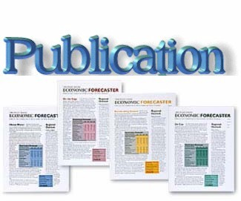
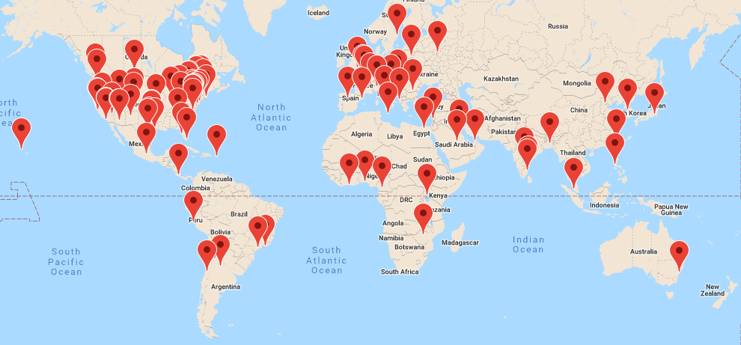

About the Government Blockchain Association
Working Groups
Contract Management
Financial Oversight
Cryptocurrency Economic Analysis
Cybersecurity
Education
Land Titling
Government Ontology
Legal & Legislative
Working Groups
Healthcare
Software Product & License Management
Smart City
Supply Chain
Voting

Slide 6

About this Course:
Government Blockchain Consulting
  Blockchain Foundations
  Blockchain Specialist
  Blockchain Executive Consultant
Domain Specific Courses
  Healthcare
  Legal
  Financial
This Course

Slide 7
Lesson 1
Introduction to Blockchain
& Why it is Important

Slide 8
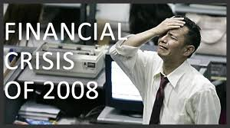
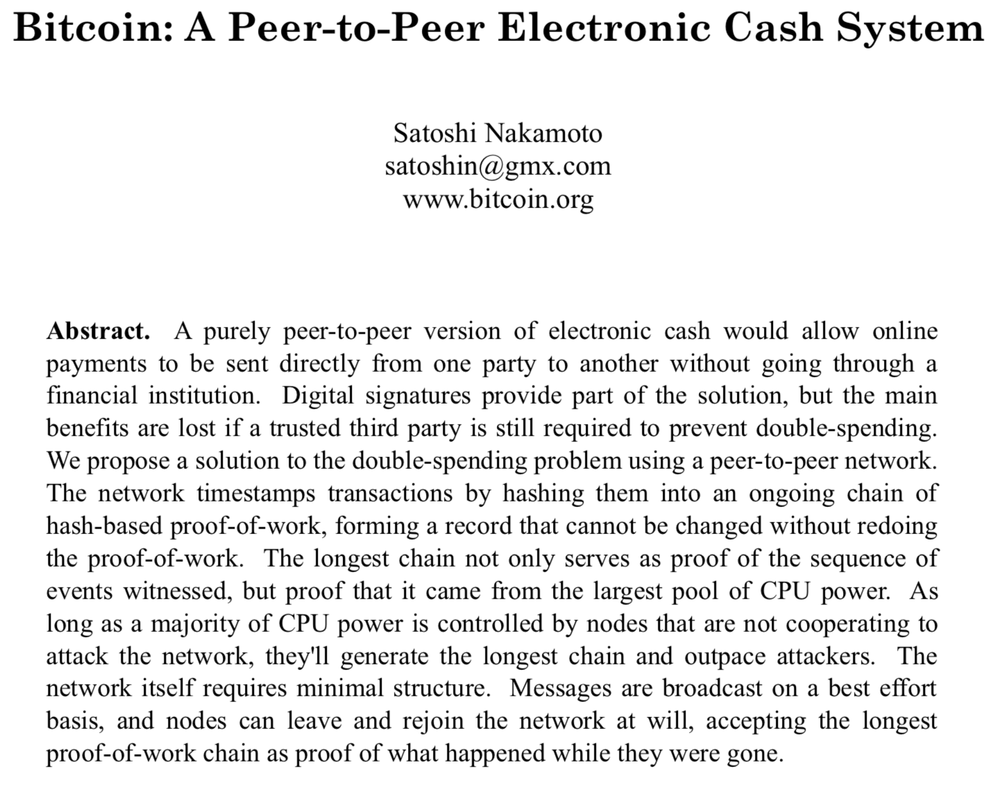
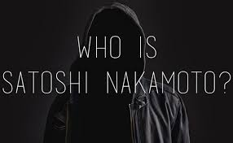
The Bitcoin Whitepaper
Notes:
Interest in blockchain technology developed after the launch of Bitcoin by Satoshi Nakamoto in 2009. Bitcoin utilizes a blockchain as a transaction ledger to securely record transfers of bitcoins from one party to another.
However, Nakamoto’s original paper does not mention the term ‘blockchain’, which first appears as ’block chain’ in a comment in the original Bitcoin client C++ source code.
The paper focused on Bitcoin as an alternative currency and store of value, with much less attention given to the many different ‘non-currency’ uses of blockchain technology (e.g., serving as a voting system).

Slide 9
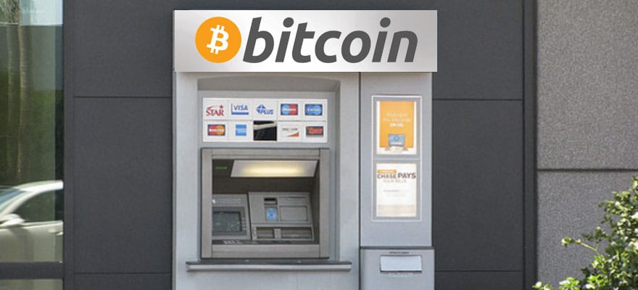
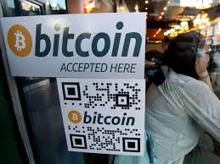
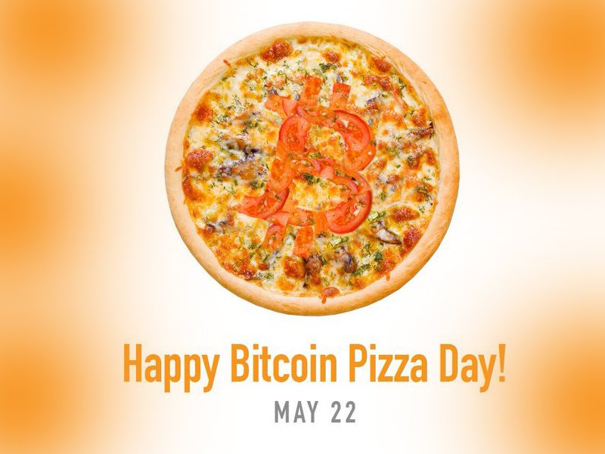
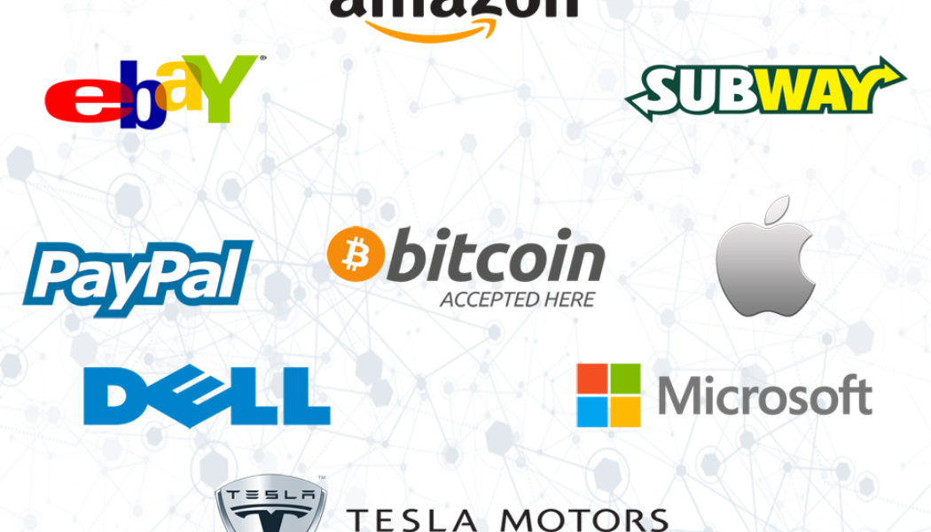
Cryptocurrency Adoption

Slide 10
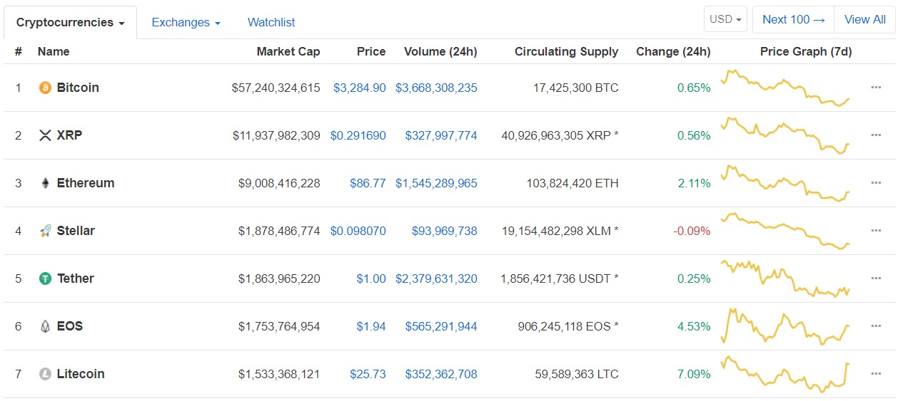
But, Bitcoin Was Just The First

Slide 11
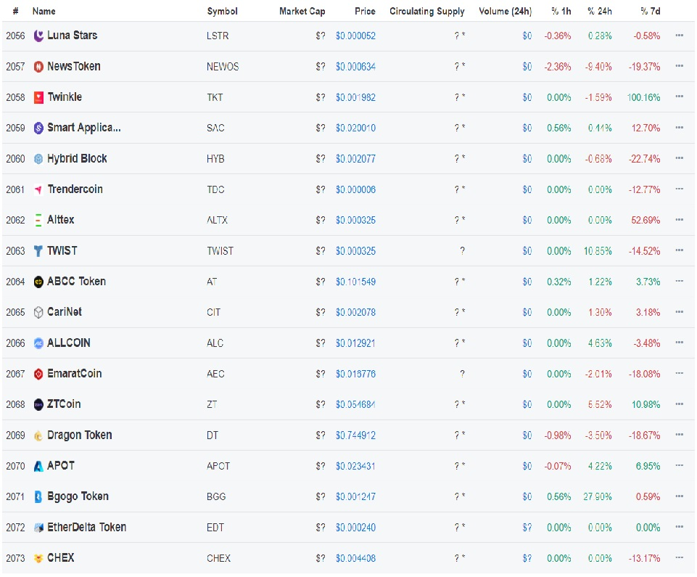
But Wait, There is More
Today there are over 2,000
Anyone can create a token
  Creating tokens is easy
  The difficult part is:
    Compliance with regulation
    Adoption
    Tokenomics
    Legitimacy

Slide 12
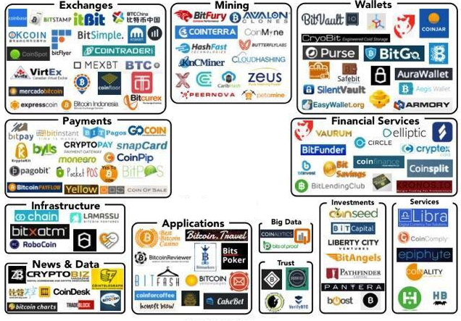
Today – The Blockchain Ecosystem
Applications
Associations
Exchanges
Financial Services
Infrastructure
Investments
Mining
News & Data
Payments
Services
Wallets

Slide 13
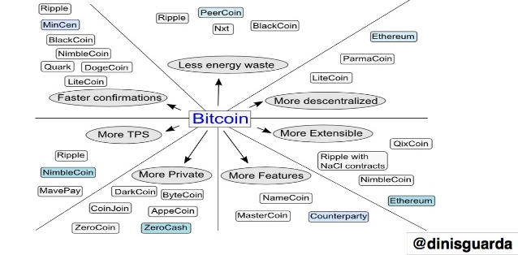
Bitcoin Gave Birth to Blockchains

Slide 14
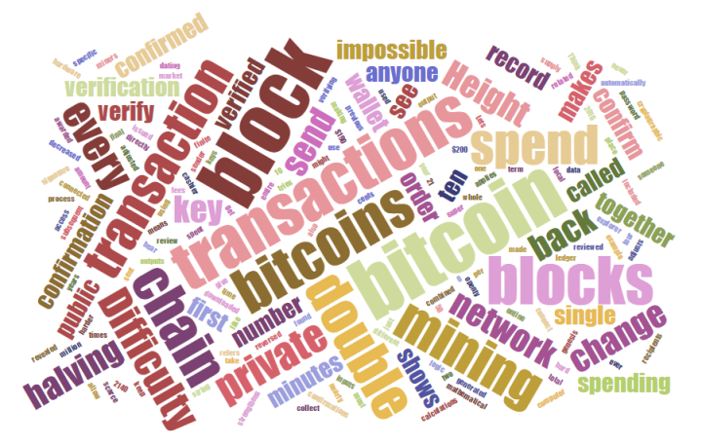
How Blockchain Works
A deeper dive into how the Blockchain actually works
A bit technical
The “Nuts and Bolts”
Play Video
https://www.youtube.com/watch?v=r43LhSUUGTQ
14

Slide 15
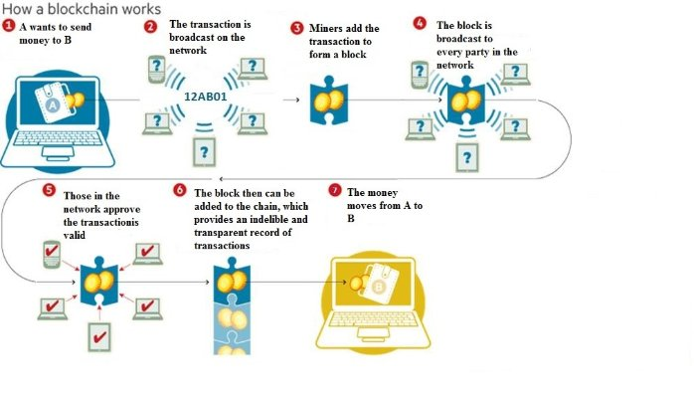
How Blockchains Work

Slide 16
Vocabulary
Distributed database:
type of database where data is stored across multiple computing devices
Distributed ledger:
type of distributed database that assumes the possible presence of malicious users (nodes)
Blockchain:
type of distributed ledger that is composed of a chain of cryptographically linked ‘blocks’ containing batched transactions; generally broadcasts all data to all participants in the network

Slide 17
Venn Diagram for Distributed Data
“Blockchains and distributed ledgers are types of distributed databases”
Distributed databases
1
.
ADVERSARIAL MODEL
Presence of malicious nodes assumed
Distributed ‘ledgers’ (DLT)
2
.
DATA STRUCTURE AND DIFFUSION
Chain of cryptographically linked blocks,
and/or global data broadcast
Blockchains
3
.
PERMISSION MODEL
-
:
public vs. private
Read
-
:
Write/Commit
permissionless vs. permissioned
Permissioned
blockchains

Slide 18
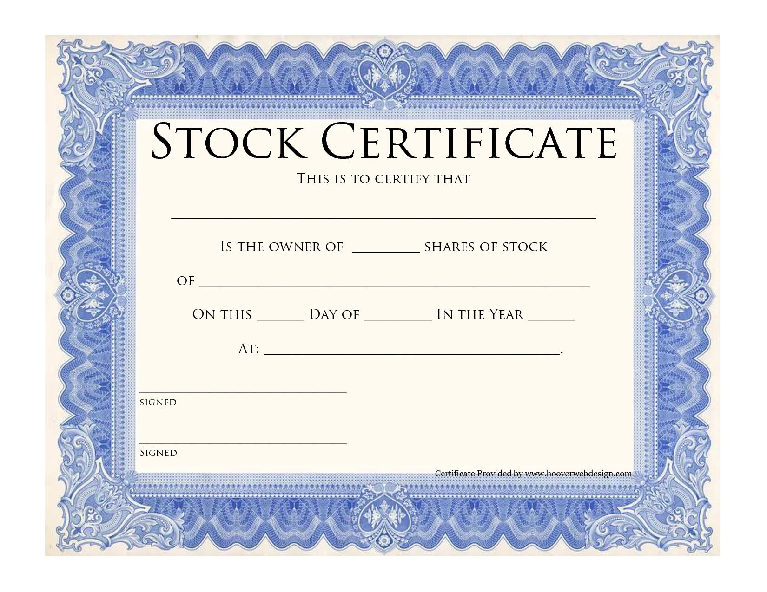
Digital Assets
A digital asset is anything that exists in a binary format and comes with the right to use. Data that do not possess that right are not considered assets. Digital assets include but are not exclusive to:
Intellectual property
  Video
  Audio recording
Financial Instruments
  Stocks
  Bonds
  Currencies
Records
  Certificates
  Ownership
  Education
  Permits
Notes:
In summary….
A digital asset can be anything that is stored electronically on a device such as a computer, phone or in the cloud. The value is not related to the storage device, it is related to the information, not any physical product.

Slide 19
Applications & Uses of Blockchain Technology
People all over the world are developing blockchain solutions
Cryptocurrency is the most common use
However, there are many other uses of blockchain technology.
Blockchain enables new capabilities that were not possible before
  Shared ledger
  Trust broker
  Peer-to-peer

Slide 20
Why Are Cryptocurrencies & Blockchain Technology Important

Slide 21
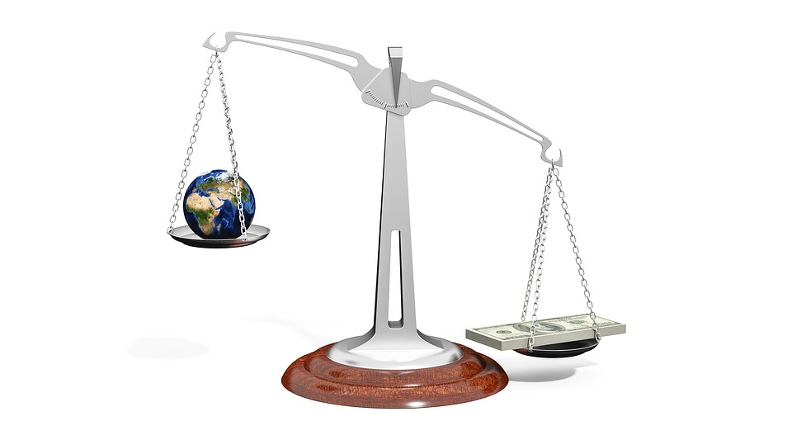
Network Communications (Internet) impact
The Internet allows for the peer-to-peer movement of information
The internet impacted:
  Information and communication brokers
    Mass Media (Traditional)
      Television
      Radio
      Newspapers
    New Media Organizations
  What did the internet do to these organization?
    Travel agencies vs. travel sites
    Hotel chains vs. travel sites
    Auto dealerships
  What about Government Organizations
    US Postal Service (USPS) – Loss
    United States Cyber Command (USCYBERCOM) - Gained

Slide 22
Cryptocurrencies – Why so important?
The internet allows for the peer-to-peer movement of information
Blockchain allows for the peer-to-peer movement of value
Prior technologies facilitated the communication, coordination and control of people by larger & larger groups.
Understanding the history of this technology and the impact is critical

Slide 23
History of Technology & Impact
New Technology Results in Changes to
  Organizational Structures
  Paradigms
    Power
    Technology
    Control

Slide 24

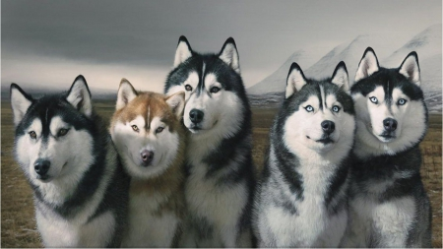

Why Does Power Concentrate?
Social Creatures
Like order & structure
Seek safety
Seek the path of least resistance
Self organized into basic categories
  Leaders
  Followers

Slide 25
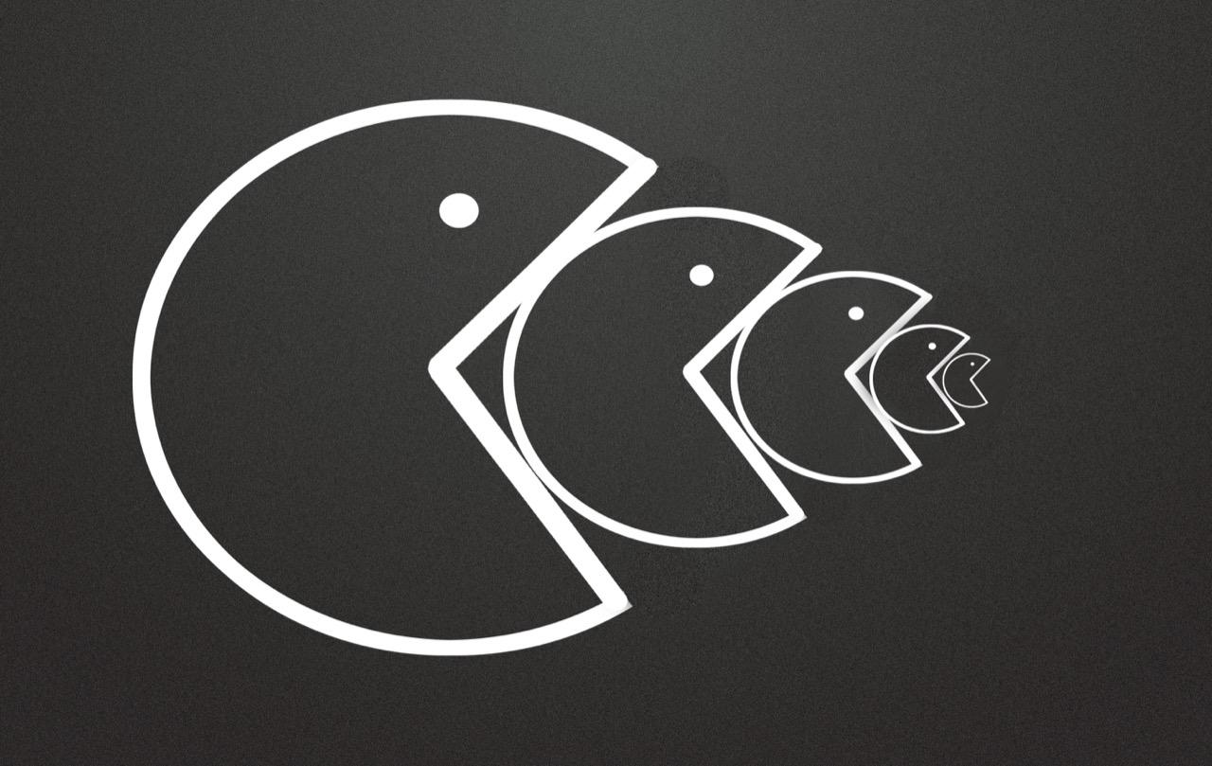
Paradigm of Power
Concentration of Power Over Time
  Tribal
  Villages
  Kingdoms
  City States
  Nation States
  Global Institutions
    Political (UN)
    Financial (Banks)
    Commercial (News Organization, Google, Amazon)

Slide 26
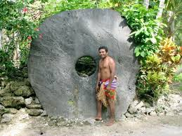
Technology – Organizational Structures
Communities (Villages, Tribes, Towns)
  Language (Oral & Written)
Kingdoms, Nations
  Written Communications
  Paper Currency
  Vehicles & Roads
  Ships & Trade Routes
Global Powers / Alliances
  Printing Press
  Wire Communications
  Telephone
  Broadcast Communications (Radio & Television)
Movements (Transcends Borders)
  Mass Media
  Computers / Internet

Slide 27
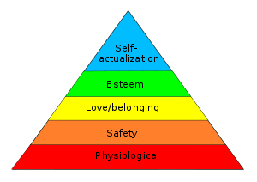

Why Do People Surrender Power?
People’s needs for security are more fundamental than their need for freedom (Self-actualization)
“Those who would give up essential Liberty, to purchase a little temporary Safety, deserve neither Liberty nor Safety”
--Benjamin Franklin
Maslow's Hierarchy of Needs
The exchange of liberty for security typically happens slowly.

Slide 28
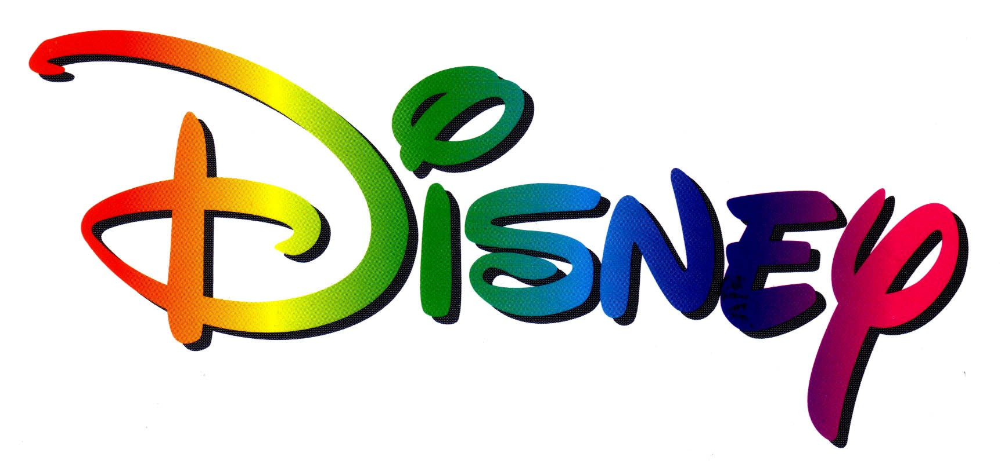
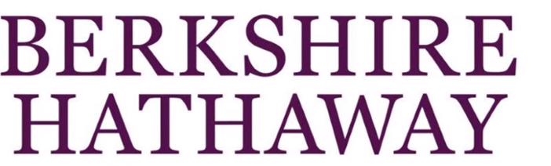

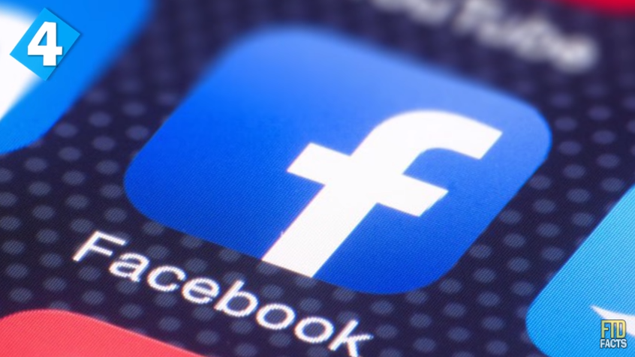

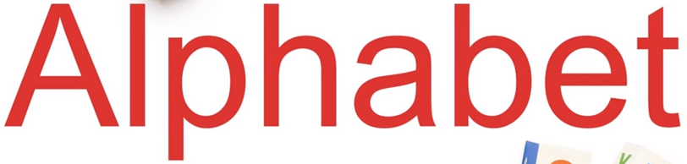
How Much Power Do These Companies Have?
Compared to Government…..

Slide 29
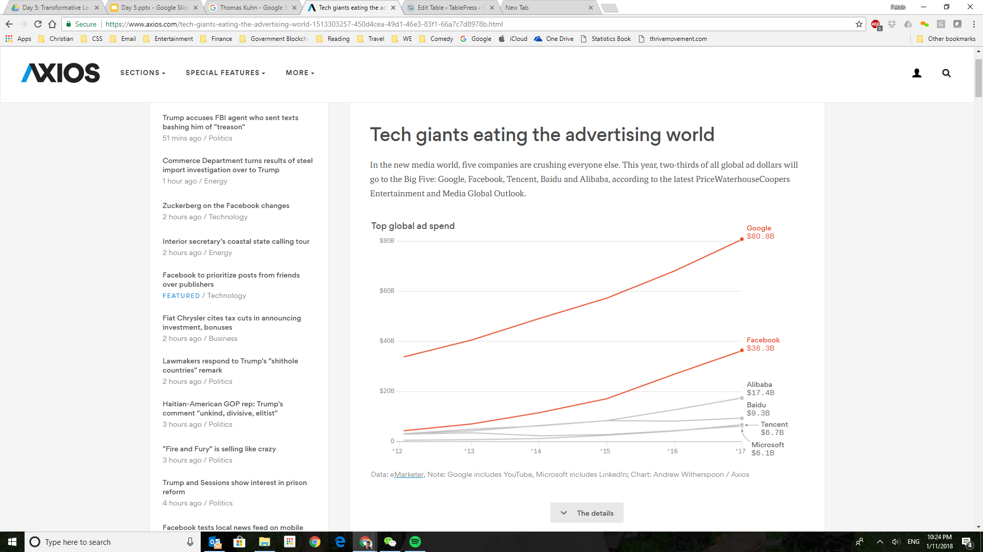
The Monopoly for Your Mind
One Third of all Advertising $ spent on five companies

Slide 30
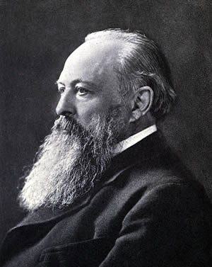
Traditional Power Paradigm
People Organize Into Institutions
People Subordinate to Institutions
Institutions Make Rules
Institutions Enforce Rules With Power
Technology Facilitates the Concentration of Power
Powerful Institutions Are Corrupt
"Power tends to corrupt, and absolute power corrupts absolutely. Great men are almost always bad men.“
- Lord Acton

Slide 31
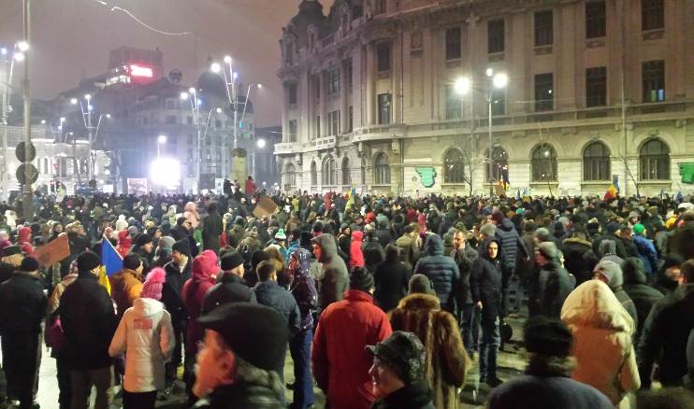
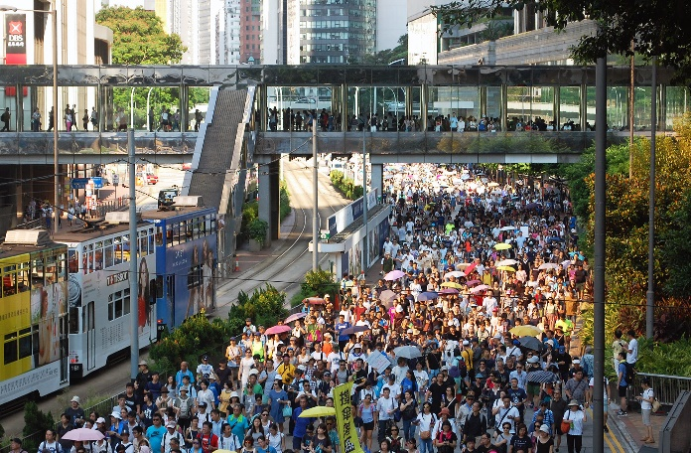
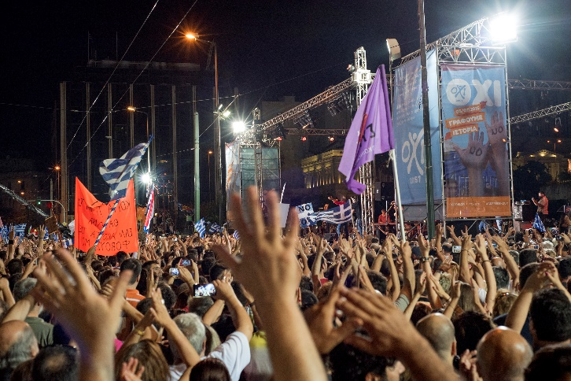
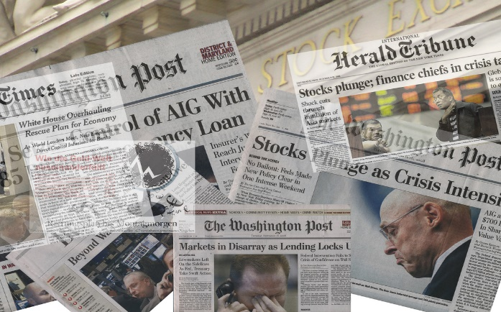
2008 – People Wanted Changes
Global Financial Crisis
  worst financial crisis since the Great Depression of the 1930s
  Subprime mortgage crisis
  International banking crisis
  European debt crisis
Financial Institutions were
Responses
  Occupy Wall Street
  Massive bail-outs of financial institutions and other palliative monetary and fiscal policies were employed to prevent a possible collapse of the world financial system.
Followed by:
  A global economic downturn
  The Great Recession.
Too Big To Fail

Slide 32
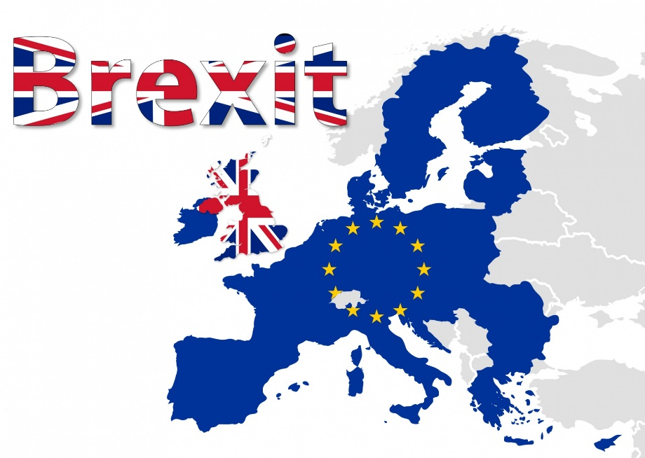
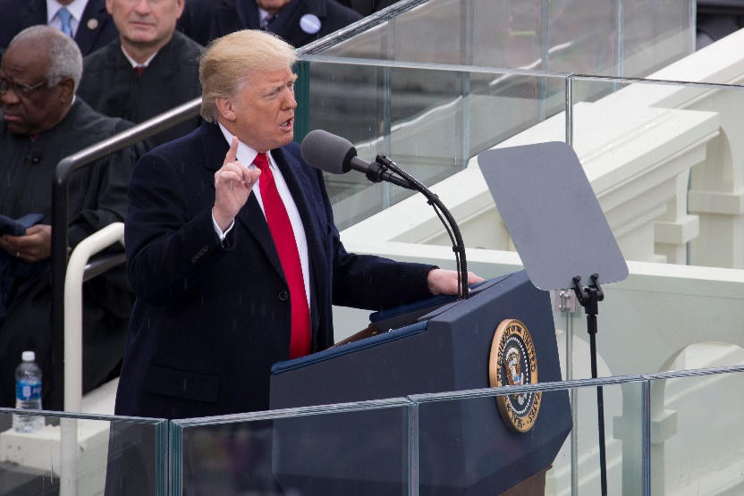
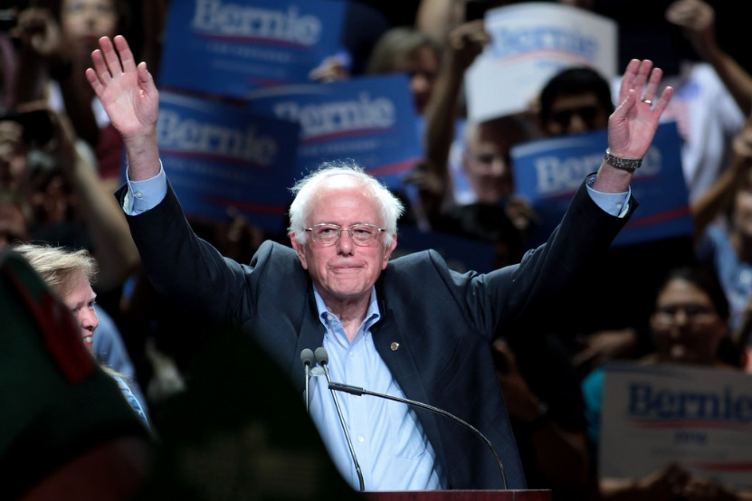
Sweeping Populist Movements - Globally
Populism - A political approach
seeks to disrupt the existing social order by:
  solidifying and mobilizing the animosity of the "commoner" or "the people"
  against "privileged elites" and the "establishment"
Major messages:
Traditional Powerful Elites must be weakened
Power distributed back to individuals

Slide 33
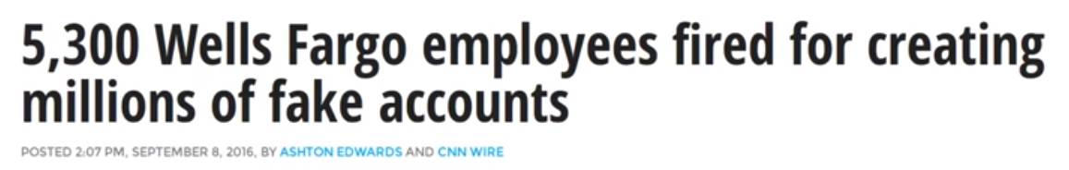

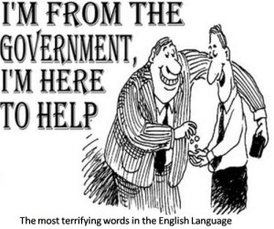
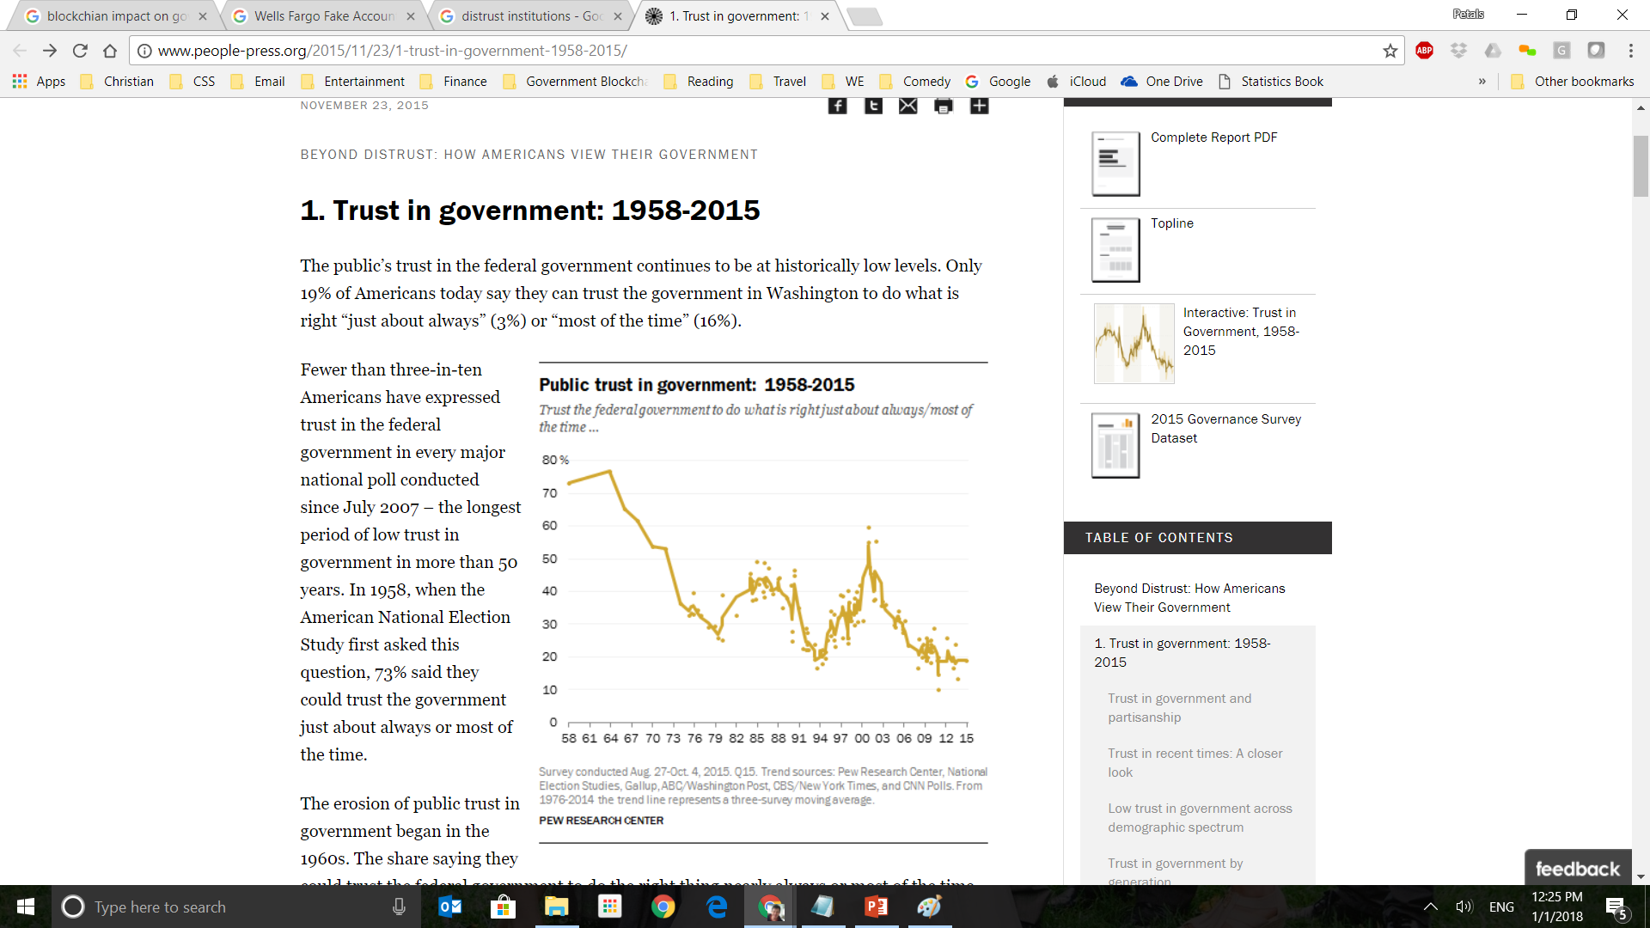

Distrust of Large Institutions
Notes:
Public Trust in Government Source: http://www.people-press.org/2015/11/23/1-trust-in-government-1958-2015

Slide 34

Distrust of Large Healthcare Institutions
4.9 million military clinic and hospital patients had their personal data stolen from a contractors' car (2011)
Studies in 2009 indicated that distrust of patient privacy data resulted in
  586,000 Americans did not seek earlier cancer treatment.
  2,000,000 Americans did not seek treatment for mental illness.
  Millions of young Americans suffering from sexually transmitted diseases do not seek treatment.
  150,000 soldiers suffering from PTSD do not seek treatment because of privacy concerns.
  The lack of privacy contributes to the highest rate of suicide among active duty soldiers in 30 years.
  Source: www.healthcareitnews.com/news/top-3-issues-facing-patient-privacy

Slide 35
The Sharing Economy
Cultural & Attitude Changes
Traditional Economy
Privacy
Proprietary
Exclusive
Validations:
3rd Parties
Sharing Economy
Music (Napster)
Open Source Software
Ride Sharing
Couch surfing
Small Business Support / Anti-Big Business
Validations
Community Ratings

Slide 36
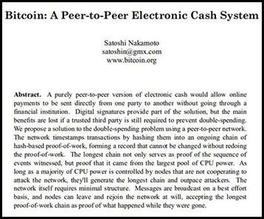
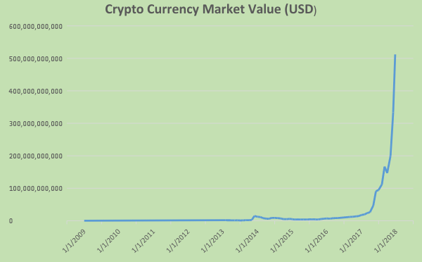
2008 – Eight Pages That Would Changed the World

Slide 37
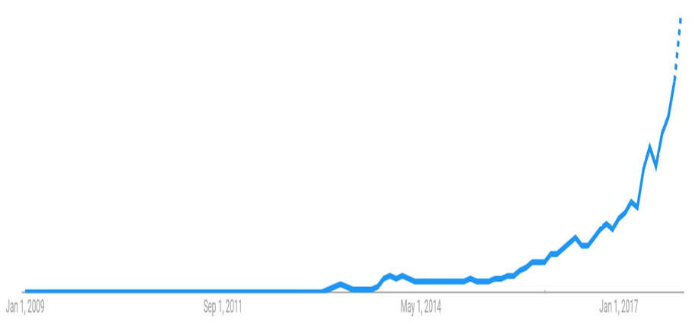
Global Searches for Blockchain on the Rise
Lesotho | Malta | Iceland | Guernsey | Armenia | Portugal | Montenegro | Puerto Rico
Ghana | Netherlands | Latvia | Benin | Bangladesh | Croatia | Poland | Nicaragua
Nigeria | Cambodia | Botswana | New Zealand | Rwanda | Guam | Albania | Chile
St. Helena | United Arab Emirates | Andorra | Bolivia | Finland | Kyrgyzstan | Uruguay | Congo - Kinshasa
Liechtenstein | Monaco | Cameroon | Brunei | Lithuania | Thailand | Ecuador | Syria
Singapore | Uganda | Canada | Israel | Uzbekistan | Spain | RÃ©union | Angola
Luxembourg | Kosovo | United Kingdom | Vietnam | Czechia | Sri Lanka | Oman | El Salvador
Gibraltar | Estonia | Malaysia | Belarus | France | Azerbaijan | Senegal | Mexico
Antigua & Barbuda | Ukraine | Belgium | Haiti | Algeria | Taiwan | Peru | Sudan
Zimbabwe | Barbados | Georgia | Aruba | Bulgaria | Lebanon | Hungary | Honduras
CÃ´te dâ€™Ivoire | Cyprus | Nepal | Suriname | Jamaica | Paraguay | Zambia | Ethiopia
Papua New Guinea | Slovenia | Pakistan | French Polynesia | Morocco | Serbia | Iran | China
South Africa | Mauritius | Norway | Venezuela | Macedonia (FYROM) | Bahamas | Kuwait | Saudi Arabia
CuraÃ§ao | Austria | Laos | Kazakhstan | Trinidad & Tobago | Romania | Fiji | Japan
Hong Kong | Australia | Mongolia | Madagascar | Panama | Qatar | Libya | Guatemala
Switzerland | India | Myanmar (Burma) | Philippines | Namibia | Costa Rica | Bosnia & Herzegovina | Iraq
Bermuda | Ireland | Russia | Denmark | Tanzania | Italy | Egypt
Cayman Islands | Dominican Republic | Moldova | Colombia | Macau | Slovakia | Turkey
Isle of Man | Kenya | Germany | Sweden | Indonesia | Greece | Argentina
Jersey | Tunisia | South Korea | United States | Bahrain | Brazil | Jordan

Slide 38

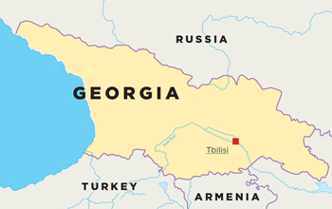
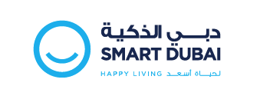
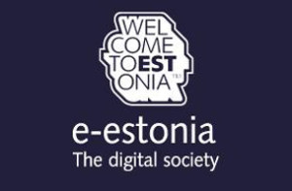
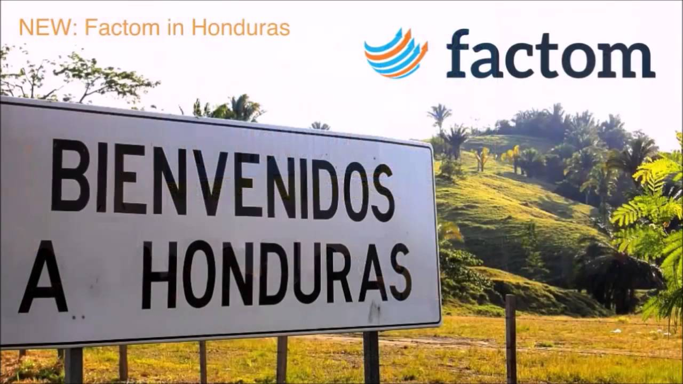


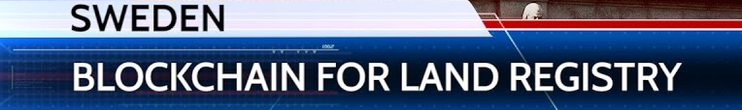
Global Adoption & Blockchain Initiatives
Notes:
Dubai – This imitative focuses on smart city technology and the impact on the happiness of the residents.
200 smart initiatives
345 Smart City Services

Slide 39
Cryptocurrencies – Why so important?
Blockchain & cryptocurrencies reverse the concentration of power
  Governments use centralized institutions to monitor, influence and control
    Financial Institutions
    Insurance companies
    Licensing & accreditation bodies
  Peer-to-peer movement of value erodes government visibility, influence and control
Governments perform vital functions to maintain orderly societies
Cryptocurrencies use non-governmental models to maintain order
  Bitcoin has hundreds of billions in transactions without a central bank, government regulators, auditors or any third party.
  New consensus models, algorithms and technology may perform government functions in the future.

Slide 40
Lesson 2
Cryptocurrency Basics

Slide 41
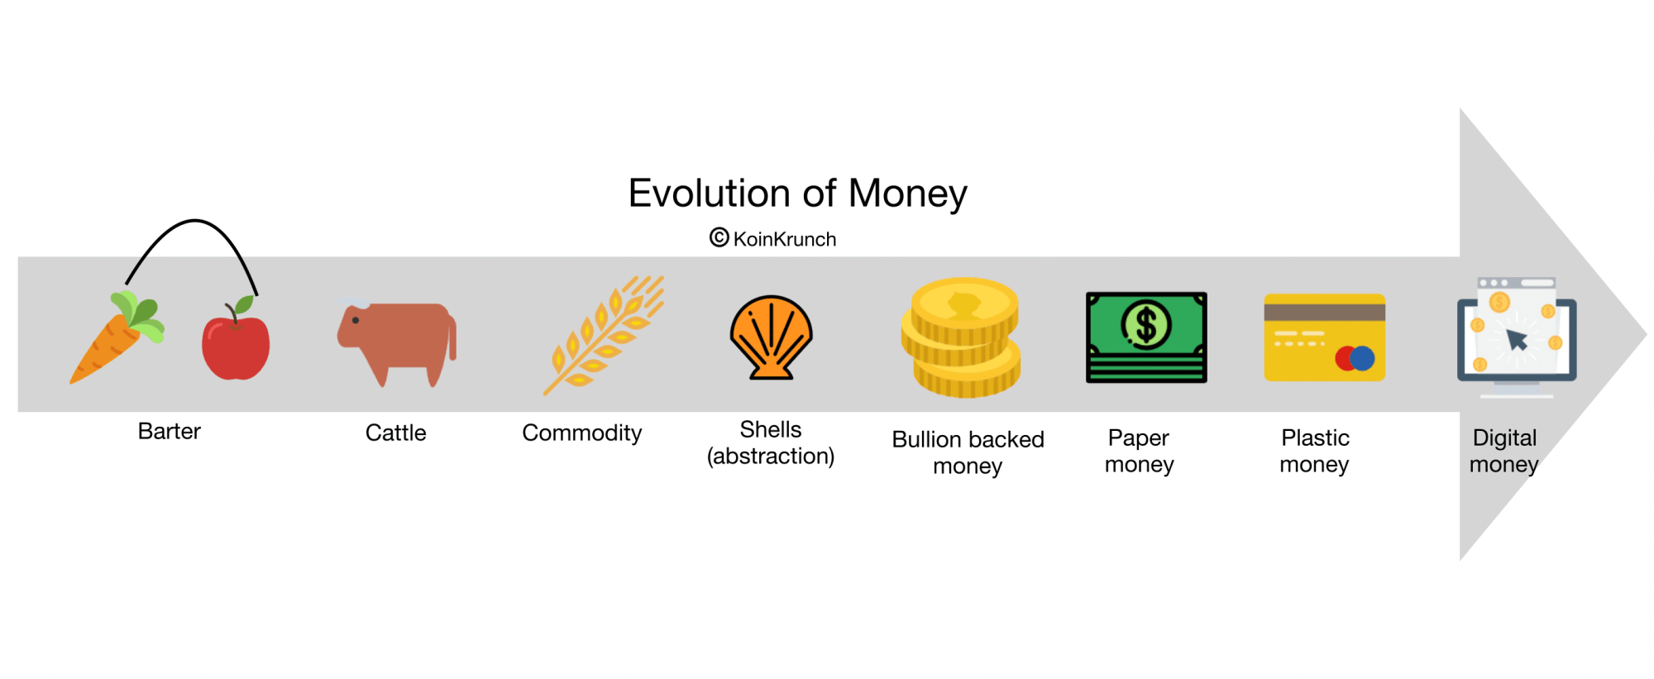
History of Money
IN THE BEGINNING: BARTER - exchange of resources or services for mutual advantage
9000 - 6000 B.C.: CATTLE: Including other livestock.
  First and oldest form of money.
1200 B.C.: COWRIE SHELLS: Shells of a mollusk.
  Most widely and longest used currency in history.
1000 B.C.: FIRST METAL MONEY AND COINS: Bronze and Copper imitations manufactured by China at end of Stone Age.
  containing holes so they could be put together like a chain.
500 B.C.: MODERN COINAGE: First coins were developed from lumps of silver.
  Stamped with gods and emperors to mark authenticity.
A.D. 800 - 900: THE NOSE: "To pay through the nose" comes from Danes in Ireland.
  Slit the noses of those who were remiss in paying the Danish poll tax.
Notes:
Money has been a part of human history for almost 3,000 years. From the origins of bartering to modern money, this is how the system has evolved
BARTER
dates back tens of thousands of year
Today individuals, organizations, and governments still use, and often prefer, barter as a form of exchange of goods and services.
Cattle
With agriculture also came the use of grain and other vegetable or plant products.
COWRIE SHELLS
First use of cowries in China
widely available
many societies have used cowries as money
As recent as the middle of this century, used in some parts of Africa
FIRST METAL MONEY AND COINS
could be considered some of the earliest forms of metal coins.
Metal tool money, such as knife and spade monies, was also first used in China
Chinese coins were made out of base metals
developed into primitive versions of round coins.
Modern Coinage
familiar round form of today,
first appeared in Lydia, which is part of present-day Turkey
made from precious metals such as silver, bronze, and gold, which had more inherent value.
techniques quickly copied and further refined by the Greek, Persian, Macedonian, and later the Roman empires.
LEATHER MONEY
used in China in the form of one-foot-square pieces of white deerskin with colorful borders.
The Nose
Paper Curency
China experienced over 500 years of early paper money, spanning from the ninth through the fifteenth century.
This was still many years before paper currency would reappear in Europe, and three centuries before it was considered common
1455, paper money in China disappeared for several hundred years.
Potlach
In some instances potlach was a form of initiation into secret tribal societies.
Because the exchange of gifts was so important in establishing a leader's social rank, potlach often spiralled out of control as the gifts became progressively more lavish and tribes put on larger and grander feasts and celebrations in an attempt to out-do each other.
WAMPUM
The earliest known use of wampum
Most likely, this monetary medium existed well before this date.
Indian word "wampum" means white, which was the color of the beads
GOLD STANDARD
Banknotes had been used in England and Europe for several hundred years before this time, but their worth had never been tied directly to gold.
Devaluing was the first step in ending the relationship altogether.

Slide 42
History of Money (con't)
806: PAPER CURRENCY: First known paper banknotes appeared in China.
  Grew in production until value rapidly depreciated and inflation soared.
1816: THE GOLD STANDARD: Officially made the standard of value in England in 1816.
  Guidelines made to allow for a non-inflationary production of standard banknotes which represented a certain amount of gold.
  U.S. Gold Standard Act officially enacted in 1900, helped lead to the establishment of a central bank.
1930: END OF THE GOLD STANDARD: Massive Depression of 1930s, beginning of the end for gold standard.
  In US, gold standard was revised and price of gold was devalued.
  gold standards soon ended, and complexities of international monetary regulation began.
THE PRESENT: currency continues to change and develop, like the new $100 U.S. Ben Franklin bill.
THE FUTURE: DIGITAL MONEY
  economic transactions regularly take place electronically, without the exchange of any physical currency.
  Digital cash in the form of bits and bytes will most likely continue to be the currency of the future.
Notes:
BARTER
dates back tens of thousands of year
Today individuals, organizations, and governments still use, and often prefer, barter as a form of exchange of goods and services.
Cattle
With agriculture also came the use of grain and other vegetable or plant products.
COWRIE SHELLS
First use of cowries in China
widely available
many societies have used cowries as money
As recent as the middle of this century, used in some parts of Africa
FIRST METAL MONEY AND COINS
could be considered some of the earliest forms of metal coins.
Metal tool money, such as knife and spade monies, was also first used in China
Chinese coins were made out of base metals
developed into primitive versions of round coins.
Modern Coinage
familiar round form of today,
first appeared in Lydia, which is part of present-day Turkey
made from precious metals such as silver, bronze, and gold, which had more inherent value.
techniques quickly copied and further refined by the Greek, Persian, Macedonian, and later the Roman empires.
LEATHER MONEY
used in China in the form of one-foot-square pieces of white deerskin with colorful borders.
Pay through The Nose
who slit the noses of those who were remiss in paying the Danish poll tax.
Paper Currency
China experienced over 500 years of early paper money, spanning from the ninth through the fifteenth century.
This was still many years before paper currency would reappear in Europe, and three centuries before it was considered common
1455, paper money in China disappeared for several hundred years.
1500: POTLACH: "Potlach" comes from Chinook Indian ceremony where not only were gifts exchanged, but dances, feasts, and other public rituals were performed.
In some instances potlach was a form of initiation into secret tribal societies.
Because the exchange of gifts was so important in establishing a leader's social rank, potlach often spiralled out of control as the gifts became progressively more lavish and tribes put on larger and grander feasts and celebrations in an attempt to out-do each other.
1535: WAMPUM: Strings of beads made from clam shells, was by North American Indians in 1535.
The earliest known use of wampum
Most likely, this monetary medium existed well before this date.
Indian word "wampum" means white, which was the color of the beads
GOLD STANDARD
Banknotes had been used in England and Europe for several hundred years before this time, but their worth had never been tied directly to gold.
Devaluing was the first step in ending the relationship altogether.

Slide 43
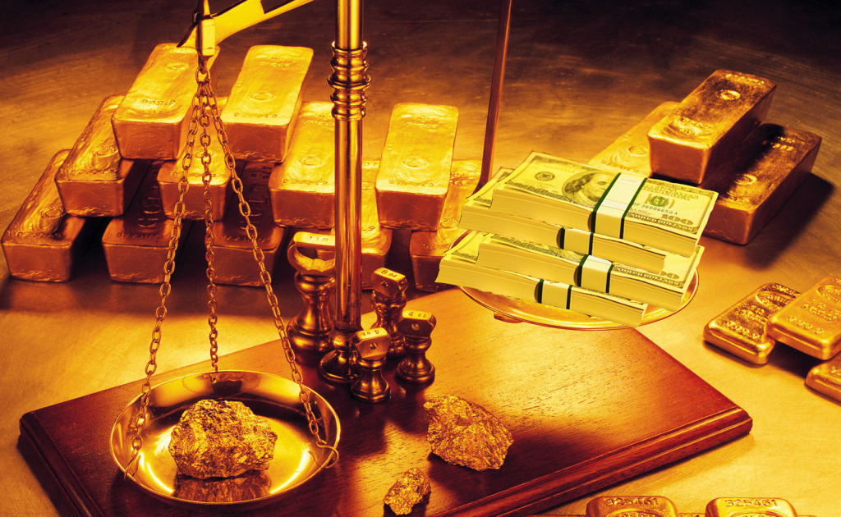
Unit of Account
A standard monetary numerical unit of measurement of the market value of goods, services, and other transactions.
It must be divisible into smaller units without a loss of value.
It must be fungible, one unit or piece must be perceived as equivalent to any other.
It must have a specific weight, measure, or size in order to be verifiably countable.
Notes:
For example, precious metals can be coined from bars or melted down into bars again.
This is why diamonds, works of art, or real estate are not suitable as money.
For instance, coins are often milled with a reeded edge, so that any removal of material from the coin (lowering its commodity value) will be easy to detect.

Slide 44
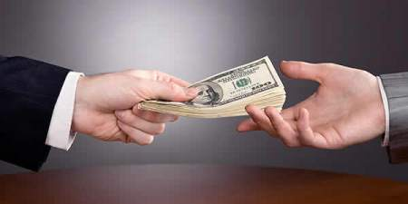
Medium of Exchange
An intermediary used in trade to avoid the inconveniences of a pure barter system.
The medium (money) avoids the inefficiencies of a barter system, such as the dependence on the occurrence of a coincidence of wants.
To be widely acceptable, a medium of exchange should have stable purchasing power.
Common characteristics:
  Valuation of common assets
  Constant utility (Fungible)
  Low cost of preservation
  Transportability (Portable)
  Divisibility
  High market value in relation to volume and weight
  Recognizability
  Resistance to counterfeiting
Notes:
Gold was popular as a medium of exchange and store of value because it was inert.
Gold was convenient to move because even small amounts of it had considerable value.
Gold also had a constant value due to its special physical and chemical properties, which made it cherished by men.

Slide 45
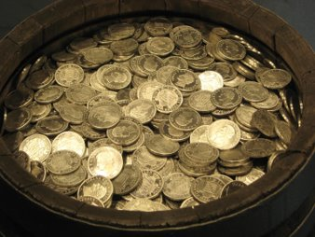
Store of Value
Anything with value that may be stored or held (HODLed) and retrieved at a later date with the expectation that it will still have value.
Stores of value include real estate, securities and precious metals.
INFLATION
  Expansion in the supply of circulated money.
  Purchasing power of money declines, undermining its function as a store of value.
DEFLATION
  Contraction in the supply of circulated money
  Purchasing power of currency and wages are higher than they otherwise would have been.

Slide 46
What are Economics? (in simplistic terms)
Microeconomics
Implications of individual human action, specifically about how those decisions affect the utilization and distribution of scarce resources.
How and why different goods have different values
How individuals make more efficient or more productive decisions
How individuals best coordinate and cooperate with one another.
Macroeconomics
Impact of inflation / deflation
Fluctuating price levels
Value rate of growth
National income
Gross domestic product

Slide 47

Cryptocurrencies
Definition 1
  Digital currency using
  Encryption techniques
  Used to regulate the generation of units of currency and
  Verify the transfer of funds,
  Operating independently of a central bank
Definition 2
  Requires using a computer program in order to view, send, or receive money
  Computer program uses cryptography to create and verify transactions
  The state of currency ownership is determined by some consensus of computers who are sharing transaction information and following the same code

Slide 48
Cryptocurrencies
Technology building blocks (not new)
  Digital Ledger
  Cryptography
  Network Communications

Slide 49


Popular Cryptocurrencies
Notes:
Coin Market Cap
Top Cryptos in 4 words

Slide 50
Where Do They Come From? ERC20 Tokens
Ethereum Request for Comments (ERC)
Over 21,000 ERC20 token contracts (Jan 2018)
Examples:
  EOS, Sirin Labs, Bancor, Quash, and BANKEX raising over $70 million each.
  Mercury Protocol's Global Messaging Token is an example of an application based on ERC20 tokens.
ERC20 tokens use 'gas' to process transactions.
Gas is purchased using ethereum.
Transactions with more gas will be prioritized by the blockchain network and processed more quickly.
.
Creating a new cryptocurency / token (economy)
totalSupply [Get the total token supply]
balanceOf(address _owner) constant returns (uint256 balance) [Get the account balance of another account with address _owner]
transfer(address _to, uint256 _value) returns (bool success) [Send _value amount of tokens to address _to]
transferFrom(address _from, address _to, uint256 _value) returns (bool success)[Send _value amount of tokens from address _from to address _to]
approve(address _spender, uint256 _value) returns (bool success) [Allow _spender to withdraw from your account, multiple times, up to the _value amount. If this function is called again it overwrites the current allowance with _value]
allowance(address *_owner*, address *_spender*) constant returns (uint256 remaining) [Returns the amount which _spender is still allowed to withdraw from _owner]

Slide 51

Supporting Tools
Tools being developed to support new cryptocurrencies and blockchains
SIMBA Chain (Free for GBA members)
Easy-to-use platform
For users, developers, government, and enterprises
Quickly deploy blockchain dapps for iOS, Android, and the web

Slide 52

Who are Members of the Crypto Ecosystem?
Token Creators
Exchanges
Wallets
Sellers / Buyers
Legislators
Regulators

Slide 53


Exchanges and Wallets
Exchanges serve as trading platforms, same as the DOW or NASDAQ. Some include "on/off ramps" where money can be transferred to/from bank accounts or credit cards.
Example Exchanges
  Bittrex
  GDAX (CoinBase)
  Kraken
  Bitfinex
Wallets use a public/private key where cryptocurrency is stored. Types of wallets include:
  Hosted
  Software
  Hardware

Slide 54
Cryptocurrency Wallets and Exchanges
Role and functions of wallets & exchanges
How they read from and write to a blockchain
Types of wallets and exchanges

Slide 55
Wallets
Hardware
Features
Benefits and
Limitations
Software
Features
Benefits and
Limitations
Hosted
Features
Benefits and
Limitations

Slide 56
Exchanges
Distributed
Features
Benefits and
Limitations
Private
Features
Benefits and
Limitations

Slide 57

Blockchain / Cryptocurrency Stack
Blockchain Product, Platforms and Protocols
1) Products serve end users
2) Platforms serve product developers
3)Protocols serve platform & product developers
Notes:
Blockchain technologies break down into three categories: products, platforms, and protocols.
Products serve end users
Platforms serve product developers
Protocols serve platform & product developers
Products sit at the top of the stack and are what end users interact with. These are often standalone assets: cryptocurrencies and tokens. Sometimes these assets serve a function within larger products called smart contracts or decentralized applications (dapps). Tokens are generally built by developers on top of a platform.
Platforms are a kind of middleware. Platforms facilitate the creation of products (in this case, tokens) and are usually associated with things like IDEs, high level languages, compilers, and other tools. These platforms, along with the products built on top of them, abide by conventions and procedures defined in their respective protocols.
Protocols are the set of rules that govern the network. Blockchain protocols usually include rules about consensus, transaction validation, and network participation. Protocols are often dependent on economic incentives — which generally means the protocol hinges upon an asset.
Circularly, this protocol-level asset can also serve as the protocol’s native product (no platform required!)
Bitcoin is a good example of this. Bitcoin (capital B) refers to the protocol. The protocol hinges upon a native asset: bitcoin (lowercase b). This native asset is also what gets used as the end product: it is the user’s means of payment, store of value, and (let’s be honest) vehicle for speculation. Note that Bitcoin does not really offer a platform. It’s not very friendly for developers trying to build new products on top of it.
Ethereum, on the other hand, exists at all three layers. It is a protocol, providing base-level rules. It is a platform, enabling developers to build new products on the system. And, because its protocol also has a native asset, it also gets a built-in product (in the form of ether).

Slide 58
Currency Vs Tokens
Currency
  Bitcoin / Bitcoin Blockchain
  Ethereum / Ethereum Blockchain
Tokens
  Chuck E. Cheese (no blockchain)
  Mint Health Security Token (MHST)
    Rewards patients for healthy behavior
    Decentralized healthcare platform
Some blockchains do not have any associated tokens

Slide 59

Token Standards
ERC 20 - 99% (if not all) issued ICO tokens and supports standard smart contracts
ERC 223 - Proposal to solve issues with the current ERC-20 standard (protects against remote threat of lost tokens and uses less gas)
ERC-721 – For non-fungible tokens
ERC 621 – Modifies the supply of tokens
ERC 827 – Supports third party spend of tokens
ERC 1155 – Interfaces with multiple token types
Many other ERC standards

Slide 60
Token Protocols & Governance
Why is blockchain different?
  Protocols like TCP/IP and HTTP define the rules for devices to interact with the internet
  Internet protocol enabled the peer-to-peer movement of information
  The blockchain is a
    set of rules that computers use to transfer the ownership
    of digital assets (value) between peers
    without requiring a third-party intermediary to validate or facilitate the transaction.
  First protocol in the history of mankind that allows for decentralized control
Example: Bitcoin (Hundreds of billions in transactions)
  No employees
  No buildings / equipment
  No one is in charge, owns anything, has responsibility or liability
  Not one nanosecond of downtime / never hacked / never compromised

Slide 61
Other Cryptocurrency Considerations
Token economics
Adoption
Price
Air Drops
Regulatory & legislative issues

Slide 62

Cryptocurrency Uses

Slide 63
As a Payment System
Any Cryptocurrency can be used for payment, but the best one in any given situation will have the following characteristics:
  Protocol Security
  Implementation security
  Sufficient liquidity and/or exchange speed among your target market
  Demand is stable enough over the life of a transaction (from initial buy in to final sell out)
  Performs some domain-specific useful informational function

Slide 64

Cryptocurrency Characteristics
Bitcoin % decrease of Inflation as supply grows

Slide 65

Capital Formation
  Initial Coin Offering (IC0)
  Token Sales
  Crowd Sourcing

Slide 66
The Complete ICO Cycle
Analyze your particular blockchain business model.
Determine if you actually need a utility token or not for your implementation.
  If not, then consider a permission based blockchain platform like Hyperledger.
  If so, then look at what token platform meets your needs. Most ICOs in 2017 were based on the Ethereum blockchain as ERC-20 tokens. There are other emerging Ethereum based token standards like ERC-721. You can also consider other token standards like NEO.
For all tokens, whether it’s a utility or security token, please carefully review with your ICO legal counsel how the SEC would potentially view your token from a security issuance standard.

Slide 67

Legal Counsel For An ICO
Secure competent legal counsel and have them look at the Howey test and determine if you may want to consider doing a Reg D or Reg A+ type of filing. (GBA Member Lawfirms like Cogent specialize in ICOs.)
Work with the lawfirm to develop your white paper and SAFT or token issuance agreement.

Slide 68
Legal Counsel For An ICO (Cont)
Once the lawfirm representing your company’s ICO determines the necessary SEC filings, then you can move on to setting up a multi-sig (multiple signature) wallet for accepting the initial investor pre-sale deposits.
Depending on the type of filing you may be only able to accept a certain amount of deposits from non-qualified investors, and you need to be concerned about any restrictions on security solicitations that your ICO lawfirm has informed you about.
  Some countries may be excluded
  KYC requirements may apply
  May require registerd investors

Slide 69
The ICO Presale
As the ICO presale unfolds, your company may offer discounts to spur interest based on the final token sale price, (e.g. 75% off, 50%, 25%) depending on how early the money goes in, and the amount being invested.
For ICO presales, there can be restrictions on which countries would allow their citizens to invest in the ICO, i.e. only non-U.S. citizens for several.
Many times you have to affirm your citizenship when participating in an ICO. Deposits to the multi-sig wallet are usually made by an investor using Bitcoin or Ethereum, and some ICOs will accept Fiat currency via a wire transfer as well.
Once all of the initial investment capital has been collected and the token sale is completed, the firm will want to then look at listing their token with one of the many exchanges.

Slide 70
Listing Tokens With Exchanges
A well known exchange like ShapeShift is an exchange that deals with a number of Alt tokens.
The term Alt tokens is used to define those tokens that are non-standard (i.e. Bitcoin and Ethereum) like Doge coin, Zcash or Dash.
The token that a company issues via an ICO will begin life as an alt token, so it’s important to have it listed with exchanges that deal in alt tokens to have tradability going forward.

Slide 71
Listing Tokens With Exchanges (Cont)
All of these exchanges have to be concerned with know your customer (KYC) issues to avoid money laundering with these tokens.
Over time the value of a token can vary significantly depending on the perceived value of the token on the secondary market.

Slide 72

Can I Invest in Cryptocurrencies?
There is no regulation that prevents one from buying certain cryptos (e.g. bitcoin).
However, there are limitations to the ability to purchase certain ICO coins imposed by regulations based on the geographic location of the ICO firm.
Measures are put in place to "regulate" buyers, such IP address of the buyer and KYC (you must provide identification, usually a passport or equivalent). While one could use a VPN to hide their IP address location, subverting the KYC rules would be a clear violation of those regulations.

Slide 73

Can I Invest in Cryptocurrencies? (Cont)
Scams and scammers will always exist when there are people that want to give over their money in return for some perceived value.
  There is no magic formula to determine if an ICO or crypto is "legitimate".
  Many regulators believe it is their duty to "protect" investors from themselves.
Due Diligence
  Read White Papers
  Technical Feasibility
  Management Team

Slide 74
Which Cryptocurrencies are Good Investments?
Investing in cryptocurrencies is highly volatile and carries the same risks of any speculative investment strategy.
Many ICOs, upward to 97%, fail in the first 6 months (some by design)
Many are "pump & dump" where the creators are simply running a scam.
Should I invest in an ICO?
Do you trade IPOs and penny stocks?
No
Not Recommended
Yes
Do your Due Diligence!
Don't risk anything you cannot afford to loose

Slide 75

Module 4: Utility Tokens

Slide 76

Utility Tokens
Tokens satisfy one or more of the following functions:
  A currency, used as a payment system between participants
  A digital asset
  A means for accounting (number of API-calls, volume of torrent uploads)
  A share (stake) in a company
  A reward for contributors (i.e. Steemit)
  Payment for using a system/product/service

Slide 77
Token Types
Utility Tokens
Security Tokens
They serve as a (future) access to a product or service and can be best compared to a gift card or software license.
They represent a "closed loop" purchasing power.
Chuck E. Cheese tokens can get you a stuffed animal, but you can't pay your speeding ticket with that token.
These tokens constitute an investment contract.
The main use-case, and the reason for the contributors to buy the tokens, is the anticipation of future profits in form of dividends, revenue share or (most commonly) price appreciation.

Slide 78
Security or Utility Token (Howey Test)
Established by the SEC in 1946
Flexible test to determine when something qualifies as a security
Two questions, both need to answered with “yes” for the token to qualify as a security
  Is the token being sold as an investment?
  Is there a person upon whom investors rely?
In practical use, the answers tend to be more nuanced

Slide 79


Howey Test (Continued)
Reliance on Single Entity (or network)
Investment
Desirable because buyers anticipate future profits or price appreciation or if the token is being bought because it provides some sort of use-value to the buyer.
Money goes in...What comes out?
  More money or
  Product/service
Example: Amazon for cloud storage (single Entity) compared to Decentralized cloud storage (Storj)

Slide 80

Howey Test (Continued)
The rules are not clear. But, the further up and to the right, the more it is likely to be a security.
Security
May change over time

Slide 81
Currency or Token (alt-coin)?
Coins
  Decentralized
  Own blockchain algorithms
Token
Centralized
Operated on top of a blockchain algorithm
With unique changes

Slide 82

Utility Tokens - Examples
OmiseGO - Enables financial inclusion and interoperability through the public, decentralized network.
Tron - A decentralized content entertainment protocol based on blockchain technology.
Tether – Stable Cryptocurrency Transactions
EOS - Distributed Application (DApp) Platform
VeChain – Supply Chain Management

Slide 83
Governing Regulations
Section 2(a)(1) of the Securities Act of 1933 (1933 Act)
Section 3(a)(1) of the Securities Exchange Act of 1934 (1934 Act).
Utility tokens can be considered a security
A security token has a significant utility in the operation of the application, it may be less likely to be considered a security (since this characteristic may help the token to fail the Howey test, as discussed above).
Otherwise, every investment contract could just escape securities law jurisdiction simply by building in a trivial utility to the token. Imagine a tokenized share of stock, except the token also enables you to redeem it for a cat GIF.
Until the SEC delivers thorough guidance through, no one can say for certain that utility tokens are not securities.

Slide 84
More Regulated Uncertainty
Can you invest in a utility? If so, what is it?
Structured like a utility, used as a security?
The SEC goes by the philosophy of “substance over form”, so the commission looks at tokens according to the way they are actually used rather than the way they were intended to be used.
This might lead to many projects being classified as securities even though they initially setup their tokens as a utility, just because the economic reality is that the contributors invest primarily because of anticipation of profits.

Slide 85

Module 5: Regulatory Framework
Concerns
  Anti-Money Laundering
  Know Your Customer (KYC) and Know your Business (KYB)
  Consumer Protection
  Tax Collection and Payments
Opportunities
  Economic Development
  Reduced Friction
  Efficiencies
    Cost
    Time
    Integrity

Slide 86
Legal Framework
European Union
United Nations
International Standards Organization

Slide 87

Federal Law - Taxes for Individuals
IRS published the following guidelines:
Virtual Currency Is Treated as Property for U.S. Federal Tax Purposes; General Rules for Property Transactions Apply
This means if you accept bitcoin as payment for goods, you must report the market value of the bitcoins as income
Notes:
Photo source:
https://www.flickr.com/photos/donkeyhotey/6262484026

Slide 88
Federal Law - Taxes for Individuals (Cont)
If/when you later sell the bitcoins, you must report the sale to the IRS and calculate a capital gain or capital loss, and report/pay taxes on that as well
If you don't have comprehensive records of all of your bitcoin transactions, you may be able to get away with not paying the full capital gain rate on bitcoin sales in accordance with the Cohan Rule
The Cohan Rule states that the IRS may accept reasonable estimates for expenses incurred provided there is some factual basis for it
Notes:
Photo source:
https://www.flickr.com/photos/donkeyhotey/6262484026

Slide 89

Federal Law - Money Service Businesses
Cryptocurrency exchanges must register as Money Service Businesses (MSB)
Exchanges and Centralized Cryptocurrency operators must:
  Develop and document an Anti-money laundering program for their business
  Register their business with FinCEN, and regularly renew registration
  Report suspicious activity to FinCEN
  Collect, record, and verify customer identity information
  Keep transaction records for five years
Notes:
Photo source:
https://pixabay.com/en/money-finance-business-wealth-1012597/

Slide 90

Federal Law - Money Service Businesses – Bitcoin Miners?
FinCEN released guidance in 2013 stating that Bitcoin miners (and miners of other decentralized cryptocurrency) are MSBs and must comply with the bank secrecy Act if they sell their bitcoins, but not if they use their bitcoins directly on goods and services
This has never been enforced against any cryptocurrency miner and is not expected to hold up against bitcoin miners in a court of law
Notes:
Photo source:
http://maxpixel.freegreatpicture.com/Insolvency-Bankrupt-Debt-Bankruptcy-Insolvent-2922154

Slide 91

Federal Law - ICOs
Coins sold in ICOs could be utility tokens or security tokens
A utility token represents the product or services a company plans to develop
A security token represents real money, debt, or company ownership
Anyone who issues and markets securities to US investors must register with the Securities and Exchange commission
Notes:
Image Source:
http://maxpixel.freegreatpicture.com/Paper-Certificate-Roll-Scroll-Parchment-Sheet-154169

Slide 92
Federal Law - ICOs – Requirements for ICO issuers
If an ICO issuer wants to sell equity tokens to the public, it must do a registered public offering, just like it was doing an IPO
  Fill out SEC Form S-1
  Create a prospectus
  Very expensive
  No ICO issuer has done this
If an ICO issuer wants to sell privately or only to accredited investors, it can do a simplified offering
  Still some paperwork
  No public solicitation allowed
Notes:
Source:
https://www.quora.com/How-do-you-register-an-ICO-with-the-SEC
https://www.sec.gov/news/public-statement/statement-clayton-2017-12-11

Slide 93
Federal Law - ICOs – Utility Tokens?
If a ICO issuer is selling a utility token, it is not clear if it is subject to the same requirements as a security
Many ICOs claim they're not subject to registration or other SEC requirements because their tokens are not securities
The SEC has said that "most" ICOs, which are operating as if they are not subject to securities registration requirements, are in fact subject
SEC Chairman Clayton gave an example of a book club token as one that would not be a security and would not require registration
Notes:
Source:
https://www.ccn.com/utility-token-ico-probably-securities-offering-sec-chairman/

Slide 94


State and Provincial Law
States Have Their Own Laws
Challenges
Colorado
Delaware
Florida
Georgia
Illinois
New York
Vermont
Washington
Wyoming
Different countries have conflicting laws
Departments and agencies have conflicting rules
Different states and local jurisdictions have conflicting rules

Slide 95
Lesson 3
How Blockchain Technology Works

Slide 96

Centralized vs Decentralized Ledgers

Slide 97
Pros & Cons of Ledgers
(Centralized v. Dist’d)
Pros (for centralized ledgers)
Centralized organizations can sometimes be extremely efficient
Owners can move very quickly
Procedures can be very structured and not available to interpretation
Cons (against centralized ledgers)
Can usually get too bureaucratic and slow
Too many layers
Can often bog down with too many steps
Can stifle innovation
Become non competitive
and eventually die

Slide 98
Encryption
Scrambles data with an algorithm at the word level or at the letter level
Generates ciphertext that can only be read if decrypted properly
Can be enhanced by variables like randomness and other credentials (i.e., fingerprint)
Theoretically possible to break into an encrypted system with a supercomputer
Uses authorized keys

Slide 99


Non-Repudiation
Systems or policies that prevent the unauthorized use of credentials or misuse of credentials.
Non-repudiation removes deniability.
For example, if someone allowed others to use their access codes or cards, it would then become difficult to know who actually used them to access secured information or locations. That would be a violation of non-repudiation.

Slide 100


Common Authentication Methods
A Trusted Third Party is often used to authenticate someone/something
Trusted third parties typically include:
Banks & other financial institutions
Notary Publics
Government Offices (for property records)
These are usually not free and can slow down a transaction

Slide 101
Consensus Algorithms: Proof-Of-Work
A proof-of-work (POW) system (or protocol, or function) is an economic measure to deter denial of service attacks and other service abuses (such as spam on a network) by requiring some work from the service requester, usually meaning processing time by a computer.
A key feature of these schemes is their asymmetry: the work must be moderately hard (but feasible) on the requester side but easy to check for the service provider.
This idea is also known as a CPU cost function, client puzzle, computational puzzle or CPU pricing function.
Distinct from a CAPTCHA, which is intended for a human to solve quickly, rather than a computer.

Slide 102

Other Consensus Algorithms
Proof of Bandwidth
Proof of bandwidth approaches have been discussed in the context of cryptocurrency
Proof of Space (PoS)
PoS proposals apply the same principle by proving a dedicated amount of memory or disk space instead of CPU time
Proof of Ownership (PoW)
Proof of Stake

Slide 103
What's in the Hash?

Slide 104

Hash / Hash function
Hashes are the foundation of the Blockchain
Formal definition of hash function: any function that can be used to map data of arbitrary size to data of fixed size
The value returned are known as hashes

Slide 105

Hash / Hash function
Put simply, It is a function that takes in data of any size and returns an output with a specific size. That output is known as a hash.
Example: 3-digit value hash function
“Adfoadihfopahfeoapfjda” ---> “391”
“Adfjka” ---> “126”
“A” ---> “792”

Slide 106


Hash Function
Hash functions are not unique, there are many different versions of them! The one that bitcoin uses is called the SHA-256 function and it specifically returns hashes that are 256 bits long in hexadecimal format.
07123e1f482356c415f684407a3b8723e10b2cbbc0b8fcd6282c49d37c9c1abc
https://www.freeformatter.com/sha256-generator.html#ad-outputa

Slide 107


How Secure Is Hash a Encryption?
Click This Link
https://www.youtube.com/watch?v=S9JGmA5_unY&t=0s

Slide 108

Hexadecimal
In mathematics and computing, hexadecimal (also base 16, or hex) is a positional numeral system with a radix, or base, of 16. It uses sixteen distinct symbols, most often the symbols 0–9 to represent values zero to nine, and A, B, C, D, E, F (or alternatively a, b, c, d, e, f) to represent values ten to fifteen.

Slide 109

Hashes are Unique
This makes a hash an effective identifier of a specific input
  One hash represents one specific input
  A hash never represents two or more inputs
SHA-256 hash function generates hashes of 256 bits
  Each bit represents either a 0 or a 1
  2²⁵⁶ different hashes is enough to identify every single thing in the universe

Slide 110

Hashes Only Go One Way
Hashes are asymmetrical, there is no “inverse hash function.” In other words, you can apply the hash formula on some input to return some output. But there is no formula to reverse the output and get back the input.
The only way to do it, would be to brute force the input, applying millions/billions of different inputs and see which one returns the correct output.

Slide 111

Hashes are pattern-less
Hashes are Random, if you change the input by a tiny bit, the output is completely different.
This means that you can not tell whether two inputs are correlated based on their similarity in hash.
You’ll see why this is favorable in a second.

Slide 112
Quick recap of the properties
Uniqueness: 1 hash represents 1 input (identifier)
Asymmetrical: only from input to output
Randomness: change sensitive, no pattern
How is this all tied to the Blockchain?

Slide 113
Hash and the Blockchain of a digital asset (coin)
Say we have a transaction described as this:
“Jaxon gave Alleigh 57.2 bitcoins on September 29, 2017 at 4:35 pm.”
If we apply a hash function on it, we can get a specifically formatted hash, such as something like this:
“123910912” → a hash of that specific transaction
(This is a randomly made up example, the actual bitcoin hash is a much longer)

Slide 114
Hash and the Blockchain
Hash “123910912”
uniquely identifies this specific transaction statement
it cannot be traced back to the transaction statement
it cannot be inferred by knowing what similar hashes stand for
For example, “123910913” could stand for “Harper received 25 Litecoins through mining on January 6, 2002 at 1:12 am.”
There is absolutely no correlation between “123910912” and “123910913”

Slide 115
Now things start getting cool:
Hash function doesn’t have to be 1-input-to-1-output.
It can be 2-input-to-1-output or 3-input-to-1-output. It can take in multiple inputs and still generate 1 output.
You can take 2 inputs and combine them into 1 hash, or 3 inputs and combine them into 1 hash.
The hash no longer represents any individual output, but instead it represents the combination of the two or three.
Hashes and hashes can combine to form new hashes.

Slide 116

Hashes and hashes can combine to form new hashes

Slide 117
What exactly does “blending” the hashes do?
Take hash123: 83513 for example:
First, it is a unique identifier of the three-input-combination (The ball, the ball with a mark, and the square); it is the proof of existence of these three pieces of data.
Second, if all you see is the hash123: 83513, there’s no way for you to figure out what the inputs are.
And third, hash123: 83513 is not inferable. 83514, 83515, or 83516 does not tell you anything about 83513.

Slide 118
What exactly does “blending” the hashes do?
As shown in the picture, you can keep on combining and combining hashes until you get to one final hash.
This is a block of transactions
This final hash is cryptographically secure and it’s a proof that all the data went into it exists. The visual outline of this process is known as the Merkle Tree, the ultimate, single hash is known as the Merkle Root.
A Merkle Tree could have as little as 2 branches or it could have up to as many branches as needed.
B2cbbc37c9c1abc07123e1f482356c415f684407a3b8723e100b8fcd6282c49d
82307123e1f456c415f684407a3b8723e10b2cbbc0b8fcd6282c49d37c9c1abc
282c49b2cbbc0b807125f684407a3b8723e10fcd6d37c9c1abc3e1f482356c41
5f68448fcd6282c4982c49d37c9c1abcd37c9c1abc07123e1f482356c4107a38
B2cbbc37c9c1abc07123e1f482356c415f684407a3b8723e100b8fcd6282c49d
07123e1f482356c415f684407a3b8723e10b2cbbc0b8fcd6282c49d37c9c1abc
b2cbbc0b807125f684407a3b8723e10fcd6282c49d37c9c1abc3e1f482356c41
8fcd6282c4982c49d37c9c1abcd37c9c1abc07123e1f482356c415f684407a38
B2cbbc37c9c1abc07123e1f482356c415f684407a3b8723e100b8fcd6282c49d
82307123e1f456c415f684407a3b8723e10b2cbbc0b8fcd6282c49d37c9c1abc
282c49b2cbbc0b807125f684407a3b8723e10fcd6d37c9c1abc3e1f482356c41
5f68448fcd6282c4982c49d37c9c1abcd37c9c1abc07123e1f482356c4107a38
B2cbbc37c9c1abc07123e1f482356c415f684407a3b8723e100b8fcd6282c49d
07123e1f482356c415f684407a3b8723e10b2cbbc0b8fcd6282c49d37c9c1abc
b2cbbc0b807125f684407a3b8723e10fcd6282c49d37c9c1abc3e1f482356c41
8fcd6282c4982c49d37c9c1abcd37c9c1abc07123e1f482356c415f684407a38
B2cbbc37c9c1abc07123e1f482356c415f684407a3b8723e100b8fcd6282c49d
82307123e1f456c415f684407a3b8723e10b2cbbc0b8fcd6282c49d37c9c1abc
282c49b2cbbc0b807125f684407a3b8723e10fcd6d37c9c1abc3e1f482356c41
5f68448fcd6282c4982c49d37c9c1abcd37c9c1abc07123e1f482356c4107a38
B2cbbc37c9c1abc07123e1f482356c415f684407a3b8723e100b8fcd6282c49d
07123e1f482356c415f684407a3b8723e10b2cbbc0b8fcd6282c49d37c9c1abc
b2cbbc0b807125f684407a3b8723e10fcd6282c49d37c9c1abc3e1f482356c41
8fcd6282c4982c49d37c9c1abcd37c9c1abc07123e1f482356c415f684407a38
b2cbbc37c9c1abc07123e1f482356c415f684407a3b8723e100b8fcd6282c49d

Slide 119
Security
This is essentially how transactions are recorded in a block:
If you take in 100 transaction statements and hash them into 100 unique, uninterpretable, un-patterned code and combine them down to 50, then 25, then 13, 7, and finally down to 1,
That 1 hash is a proof that ALL 100 transactions took place, and is infinitely close to being 100% secured.

Slide 120

For you visual learners

Slide 121
Purpose of previous hash
The mere existence of the most current block is the proof that all the transactions before are valid, since you cannot get here without them being so.
Two other reasons:
Saves time, for a new comer (a new computer that joins the network), all they need to download is the latest block
Saves disk space, you don’t need blocks prior to the latest block, as the latest block is a mix of all the previous blocks

Slide 122

Picture of how it all fits together
The Blockchain Manages Changes to the Transaction Database

Slide 123

The Transaction Database
Each node maintains a live copy
Records inputs, outputs & unspent balances
Inputs & Outputs – not addresses

Slide 124

Prerequisite: All computers have the same copy
For the Blockchain to work, every computer currently on the network needs to have an exact same copy of the newest Blockchain.
When one computer announces an updated version of the Blockchain, his work is publicized and all the other computers online verify his work.

Slide 125


Consensus
The newest Block chain needs to be consistent.
The newest Blockchain must be accepted by the majority of the computers online
A variety of consensus algorithms exist, which ensure the formation of Byzantine fault-tolerant consensus in a permissioned as long as a specific proportion of ‘consensus nodes’ are honest.

Slide 126
Consensus
A predefined quorum of ‘consensus nodes’ needs to reach agreement through voting before a transaction or block gets committed.
This threshold ranges from slightly more than 50% to unanimous consensus (100%)
The use of a particular consensus algorithm depends on a variety of factors (e.g., network structure and topology, desired confirmation time, security assumptions) and the requirements of the use case.

Slide 127
Consensus
When computers come online, they’ll compare the copy they hold with the newest copy out there
If the newest copy is longer and consistent, they’ll automatically update their copy up to that version
Computers only have the ability to verify if the updated transactions are consistent

Slide 128
Algorithm - Hack Proof
One important build-in mechanism of the Blockchain algorithm is that the more people participating in the activity of extending the Blockchain, the harder the mathematical problem becomes.
The average time to add a new block onto the existing Blockchain doesn’t change (for Bitcoin, it’s 10 minutes), but the probability that any particular participant solving out the puzzle diminishes.
The more people involved, the more unlikely that a hacker will be able fraud the system. As of right now, it is practically impossible to hack the system.

Slide 129

But Wait,
There’s More

Slide 130

Tangle
No blocks
No miners
No fees
Faster
Transactions in depth
Scalable
Quantum proof

Slide 131
Blockchain Attributes
There are many different types of blockchains (those presented are only examples)
Other types of blockchain technologies are presented during the Blockchain Technology Course.
  In other distributed ledger technologies, transactions may not be organized in blocks
  In other distributed ledger technologies, blocks might not be regular
Blockchain Properties
  Decentralized systems
  Distributed ledger
  Safer & secure ecosystem
  Mining is used to validate blocks of transactions
  Transactions are immutable

Slide 132
Why It Matters
The rate of blockchain interest and application is growing rapidly
Blockchain solutions have such a wide scope of application
Blockchain technology could bring huge efficiencies to existing business processes by eliminating intermediaries and streamlining business processes.

Slide 133
Blockchain Benefits & Risks
Blockchain solution can provide:
Shared common view of the transaction history and status of transactions
Security of transaction integrity
Transparency, openness, and trust
However, blockchain solution can result in:
Solutions may not be scalable
Theft or loss of digital assets
Legal and regulatory violations, fines, or other enforcement activity

Slide 134
Lesson 4
Blockchain
Use Cases

Slide 135
Blockchain Use Cases
Acquisition Management
Architecture, Engineering, and Construction
Artificial Intelligence
Asset Management
Banking
Big Data
Budgeting, Accountability & Transparency
Cannabis
Contract Management
Crypto Asset Management
Cybersecurity
Digital Identification
Economic Analysis
Economic Development
Education & Training
Energy
Financial Regulatory & Compliance
Government Administration

Slide 136
Blockchain Use Cases (Cont)
Healthcare
Higher & Continuing Education
Identity Management
Information Technology
Insurance
Intellectual Property (IP)
Land Titling
Law Enforcement
Legislative & Policy
Mining & Cryptocurrency
Public Accountability
Records Management
Simulation
Smart City
Supply Chain
Taxes
Telcom, Internet & Comms
Voting
Let's look at some examples

Slide 137

Identity Management Use Cases

Slide 138


Identity Management - 1
Applicable to all use cases
Applies to individuals and organizations
Addresses identity vs persona

Slide 139











Identity Management – 2 (What Makes an Identity Profile)

Slide 140
Identity Management - 3
Identity protocols confirmation the:
Uniqueness of the identity in the intended context
Claimed identity is legitimate.
Operation of the identity in the community over time.
Linkage between the identity and the person claiming the identity.
Identity is not known to be used fraudulently.
Blockchain Solutions
Identity meta-data can be hashed and stored on a blockchain
Information could be available when and when people need it
Identity data can be safely and securely recorded and accesses by authorized parties

Slide 141

Identity Management
User generated date is collected by companies like:
Google, Facebook, Retail Stores
Sold to “data mines” who then resell that information to advertisers.
Hosting digital identities on a blockchain gives the individual users power over who has access to their personal data.
Blockchain based Identity management would allow for greater transparency in the collection and use of personal data.

Slide 142
Lesson 5
Real-world Use Case
& Adoption of Blockchain Technology

Slide 143
Blockchain Use Cases in Every Industry, Everywhere
Contract Management
Financial Oversight
Cryptocurrency Economic Analysis
Cybersecurity
Education
Land Titling
Government Administration
Identity Management
Legal & Legislative
Healthcare
Intellectual Property
Smart City
Supply Chain
Voting
Let's look at some examples

Slide 144

Healthcare Blockchain Use Cases

Slide 145

Dhonor Blockchain
Our mission is to assist millions of patients with deficient organs around the world by safely giving them access to organs from drivers deceased in traffic accidents and assisting the families of the deceased through this everyone wins ecosystem.
Our vision is to become an organ bank that is transparent and 100% verified, spreading life and happiness to humanity
Play Video
www.dhonor.org

Slide 146

Dhonor cont..
2.5 million lives are lost every year to traffic accidents
8 million organ deficient patients are waiting to be matched with an organ
Dhonor wants to match these two realities by using Blockchain technology
Dhonor secures organs for patients in addition to blood management
Dhonor prevents ay trading in organs with secure DNA signature verification stored on the blockchain anonymously
Dhonor supplies drivers and patients around the world a platform to subscribe to annonymously
Dhonor
In Humanity We Trust

Slide 147

Genomic Research & Use on a Blockchain
Propelling genetic research to develop new health solutions
An ecosystem and Portal for GDAPPS (genetic apps)
Propelling precision personalizes medicine
Customer targeted platform- easy to use
Get specific big Data for small money
Anonymous genetic services
Genetic storage and transfer
Own your DNA
www.youtube.com/watch?v=gOJGOV3rCvY

Slide 148



Doc.AI
Doc.AI
AI-powered, blockchain-enabled platform for quantified biology.
What problem does this service solve?
Doc.AI is using blockchain and AI to ena.ble consumers to control their biological and medical profile
Doc.AI
AI-powered, blockchain-enabled platform for quantified biology.
What problem does this service solve?
Doc.AI is using blockchain and AI to enable consumers to control their biological and medical profile
Doc.AI is a platform that secures biological and medical data through blockchain technology. It generates insights from this data with the help of artificial intelligence.
Doc.AI hopes to empower individuals to take advantage of their medical, anatomic, and genetic data. They are launching NEURON, a decentralized artificial intelligence platform that will allow anyone to perform a data trial.
Doc.AI hopes to empower individuals to take advantage of their medical, anatomic, and genetic data. They are launching NEURON, a decentralized artificial intelligence platform that will allow anyone to perform a data trial.

Slide 149

Hashed Health
Blockchain consulting services for the healthcare industry
What problem does this service solve?
Hashed Health is working to use blockchain-based systems to improve inefficiencies in healthcare transactions.
Hashed Health is focused on advancing the development of blockchain and distributed ledger technologies in the healthcare industry.
Hashed Health provides a variety of different blockchain-related services, such as consulting, community development, product management, and tech support.
Hashed Health works with healthcare providers to create and manage blockchain solutions for a variety of problems that the industry faces.

Slide 150

Health Nexus
Blockchain-based medical data management platform
What problem does this service solve?
A blockchain solution for managing healthcare data.
Health Nexus and ConnectingCare are products being developed by SimplyVital Health. They're hoping to bring together providers from different medical organizations onto the same platform, where they can view the same data for shared patients.
Financial and clinical algorithms powered by artificial intelligence will provide actionable information to all parties.
The platform powered by blockchain, enables users to follow-up on patients as well as to reduce the cost of care. Health Nexus will be compatible with HIPAA (Health Insurance Portability and Accountability Act).

Slide 151

DentaCoin
A Token for the dental Community.
What problem does this service solve?
Dentacoin aims to use blockchain to make dental care more affordable.
Dentacoin wants to make dental car more affordable and provide greater access to preventive dental care.
The platform is powered by the DCN token that will enable users to pay for dental insurance, treatments, and oral care products.
Dentacoin also plans on developing a decentralized database of all patient health records. Patient data will be accessible exclusively by patients or by dentists, upon a given permission.
Token Stats: Dentacoin (DCN)
Rank 95 Market Cap $66.08 MIL

Slide 152

Iryo
Blockchain enabled healthcare ecosystem
What problem does this service solve?
Iryo is developing a unified blockchain platform for tracking healthcare records.
Iryo's goal is to create a dedicated and unified platform for tracking healthcare records.
Iryo’s solution is meant to store data securely and allow patients to share their medical history anywhere in the world.
Iryo Token is designed as a gateway cryptocurrency that will enable patients and healthcare professionals to participate in Iryo’s global healthcare network. The token will encourage collaboration and promote medical research.

Slide 153

Nebula Genomics
Solving big data problems related to identifying and sequencing genes
What problem does this service solve?
Nebula Genomics wants to use blockchain technology to address the challenges of genomic big data.
Nebula Genomics is working to use blockchain to improve the process of identifying and sequencing genes.
Genome sequencing is becoming easier and more affordable and is very likely that this technology will become accessible on a large scale in the near future.
Nebula Genomics aims to use blockchain to create a genomic data market which would potentially be worth billions of dollars.

Slide 154

Patientory
A blockchain-based platform for securing data for patients and healthcare professionals
What problem does this service solve?
Patientory is developing a blockchain based dAPP that will enable patients to track their medical information.
Patientory is developing a blockchain-based platform for storing healthcare data.
It allows users to create a patient profile to keep track of their medical history and be in control of their information.
The software provides patients with an easy way of tracking doctor visits, medical bills, personal medical information, insurance, immunizations and pharmacy medications.
Patientory will run on their token.
Token Stats Patientory (PTOY) Rank 670 Market Cap 2.66 MIL

Slide 155

Other Use Cases Include:
Verifying the Authenticity of Returned Drugs
Prevention of Counterfeit Drugs and Medical Devices
Compliance in Pharma supply chain
Transparency and traceability of consent in Clinical Trials
Improving the quality and reliability of Clinical Trials data
And many, many more…..

Slide 156
Lesson 6
Introduction to Smart Contracts

Slide 157
Ethereum
Ether is similar to Blockchain except for the following differences:
Instead of only handling accounts and transaction it can also store computer programs (called “smart contracts”) like:
If xx account has ฿yy balance
And if today is December 31st, 2016
Then transfer ฿5 to zz account
If not, don't do anything

Slide 158
Smart Contracts (Ethereum)
Smart contracts are computer protocols that facilitate, verify, or enforce the negotiation or performance of a contract, or that obviate the need for a contractual clause. Smart contracts usually also have a user interface and often emulate the logic of contractual clauses.
Smart contracts work in 3 steps
Coding
Distributed Ledgers
Execution
Notes:
Why is this interesting?
By leveraging the POW aspects of a Blockchain network, it can become the basis of proving work is both completed and delivered per the contract. This is very powerful when automated into a workflow that is distributed by every single member of the community that is affected.
(No wonder the founder of Netscape, Marc Andressen has said the "software is eating the world". This is why.)
Think about new services that would not require you to trust a third party, and pay the related fees and suffer the related delays, but you are still able to enforce the terms of the contract.
It will allow the creation of encryptable and financially binding workflows to be established for almost anything imaginable.

Slide 159
Smart Contracts (Ethereum)
Coding (What goes into a Smart Contract)
Because smart contracts work like computer programs, it is very important that they do exactly what the parties want them to do.
This is achieved by inputting the proper logic when writing your smart contract (more can be found here about an Introduction to Programming Smart Contracts on Ethereum).
The code behaves in predefined ways and doesn’t have the linguistic nuances of human languages, thus, it has now automated the “if this happens then do that” part of traditional contracts.

Slide 160
Smart Contracts (Ethereum)
Distributed Ledgers (How the smart contract is sent out)
The code is then encrypted and sent out to other computers via a distributed network of ledgers (i.e. Distributed Ledgers).
If this is done via public permissionless Blockchain such as Bitcoin, the contract is sent out similar to the way that a network update of a bitcoin transaction would occur.
This can also be done in a permissioned or hybrid distributed ledger platform such as the R3 Distributed Ledger.

Slide 161
Smart Contracts (Ethereum)
Execution (How it is processed)
One the computers in this network of distributed ledgers receive the code, they each come to an individual agreement on the results of the code execution.
The network would then update the distributed ledgers to record the execution of the contract, and then monitor for compliance with the terms of the smart contract.
In this type of system, single party manipulation is averted because control over the execution of the smart contract is no longer possible because execution is no longer in the hands of a single party.

Slide 162



Smart Contracts (Ethereum)
Examples of Smart Contracts:
Federal, state or local government contracting
Benefits management (Medicare, Medicaid, Social Security)
Progress payments (to primes and subcontractors)
Intellectual Property (IP) Management
(Notional use for Ethereum)
Notes:
Federal, state or local government contracting... only pays for mile stones, deliverables and output... as the work is completed
For small contributions of work that can be piece-parted out to individual contributors and paid for as they are accomplished and "checked in" to the correct repository.
Benefits management – this is a multi-million dollar business for governments around the world where fraud is VERY expensive
Progress payments are very common in any field where a deliverable (I.e., hardware, software, objects, research, large assets, etc.) is expensive and takes a long time.
IP Management: Well known example is the music industry, where an artist is paid for their intellectual property (I.e., a copyrighted lyric or melody) and whenever a listener downloads their work, it triggers a royalty payment to the IP owner.
This has the potential to do for contracting... what hyper-links did for computing and word processing... except "on steroids"
Enforce aspects of any given deliverable and work process without fear of tampering.
Will rely upon natural motivations of incentives and rewards;
Consider how many forms are completed in an average agency (local, county, state, federal, international).
When you automate citizen data, combine it with secure computing, and automatically triggered workflows, you can achieve true optimized efficiencies! This is a process consultants dream!
Has potential to save hundreds of billions in the United States Federal government alone.
Discussion
Conclusion on the governmental use of smart contracts:
It has wide and deep potential to "lean-out" just about any governmental process where there is a transaction (exchanged of data, inputs, outputs, funds, forms, compliance details, condition, status, health, etc.).

Slide 163
Ethereum
Ethereum is a decentralized platform that runs smart contracts: applications that run exactly as programmed without any possibility of downtime, censorship, fraud or third party interference.
These apps run on a custom built Blockchain, an enormously powerful shared global infrastructure that can move value around and represent the ownership of property.
Enables developers to create markets, store registries of debts or promises, move funds in accordance with instructions given long in the past (like a will or a futures contract) and many other things that have not been invented yet, all without a middle-man or counterparty risk.

Slide 164
Use Cases (Ether) Vocab
DAO (Decentralized Autonomous Organizations) - A decentralized autonomous organization (DAO), sometimes labeled a decentralized autonomous corporation (DAC), is an organization that is run through rules encoded as computer programs called smart contracts. A DAO's financial transaction record and program rules are maintained on a Blockchain.
Supply Chain Management – The Blockchain can provide a means to allow every participant on a supply chain network to input and track sourcing of raw materials, record parts manufacturing telemetry, track provenance of goods through shipping, and maintain immutable records of all aspects of the production and storage of a finished good through to sale and afterwards.

Slide 165
Use Cases (Ether)
Since the Blockchain acts as a distributed, single source of shared truth, it can be a solution
Smart contracts can be leveraged to update the state of transaction, but also be shared amongst parties
Smart contracts can also trigger events that can be used to indicate the success or failure of a transaction
Walmart is currently testing using the Blockchain for Supply Chain Management
Deloitte is promoting the use of Blockchain to manage the food supply chain
Any potential to tokenize and manage the movement of value

Slide 166

Complementary Technologies
Internet
of Value
Artificial Intelligence
Internet
of Things
Internet of Information

Slide 167
Lesson 7
Data Storage & Blockchain

Slide 168
Data Storage
While public blockchains such as Bitcoin and Ethereum store all essential transaction data on the blockchain itself (i.e., on-chain), permissioned blockchains and distributed ledgers offer a broader set of possibilities.
There is a general trend towards limiting the data that needs to be stored on the network itself for various reasons, including privacy concerns, data storage constraints, processing costs, and network latency issues.

Slide 169
Data Storage
Distributed ledgers that store all data on-chain can enforce operations on the data without external dependencies as they are aware of the semantics and meanings of the underlying data.
Off-chain Distributed ledgers only store “fingerprints” (pointers) are not aware of the underlying data and can’t enforce operations on that data.
  Ledger functions more as a distributed timestamping server that provides a shared, real-time auditable log of records
  Auditors must have access to the underlying data stored off-chain to recreate the fingerprints and verify the integrity of the data

Slide 170
Data Storage

Slide 171


This is a Fast-Moving Train

Slide 172

Don’t Take the Journey Alone
Where do I get more information?

Slide 173

Resources

Slide 174

GBA Chapter Locations

Slide 175
GBA Working Groups
Acquisition Management
Asset Management
Big Data
Budgeting, Acct & Transparency
Cannabis
Contract Management
Cybersecurity
Economic Analysis
Education & Training
Energy
Financial Regulatory & Compliance
Government Ontology
Health Care
Identity Management
Insurance
Intellectual Property (IP)
Land Titling
Law Enforcement
Legislative & Policy
Mining & Cryptocurrency
Records Management
Smart City
Supply Chain
Taxes
Telcom, Internet & Comms
Voting

Slide 176

GBA Professional Networking Platform

Slide 177

Looking Ahead
Questions?
Thoughts?
Recommendations?

