Slide 1

Blockchain Foundations
Presented by:
Name of Presenter, Name of Organization

Slide 2
About the Trainer
Info
Info
Info

Slide 3
Introductions

Slide 4


GBA Blockchain Certification Courses:
Certified Government Blockchain Consultant
  Blockchain Foundations Course
  Blockchain Technical Consulting Course
  Blockchain Executive Consulting Course
This Course

Slide 5
Objectives for the 3 Blockchain Certification Courses
Familiarization with the basics of cryptocurrencies and blockchain technology.
Familiarization with blockchain protocols and technical security requirements.
Discuss the legal and regulatory framework related to blockchain technology.
Discuss the architectural and technical issues that must be considered before launching a blockchain development program.
Review use-cases and lessons learned from previous blockchain projects.
Create a blockchain model project in the form of a blockchain enterprise solution.
These need an intro and some revision, and might we want to group these by course?

Slide 6
Blockchain Foundation Objectives
Introduce the history of bitcoin and blockchain technology.
Discuss why cryptocurrencies and blockchain technologies are important.
Explain the basic principles of cryptocurrencies.
Explain the basic principles of blockchain technology.
Introduce smart contracts.
Introduce legal and regulatory considerations.
Discuss blockchain use cases, benefits, and risks.

Slide 7


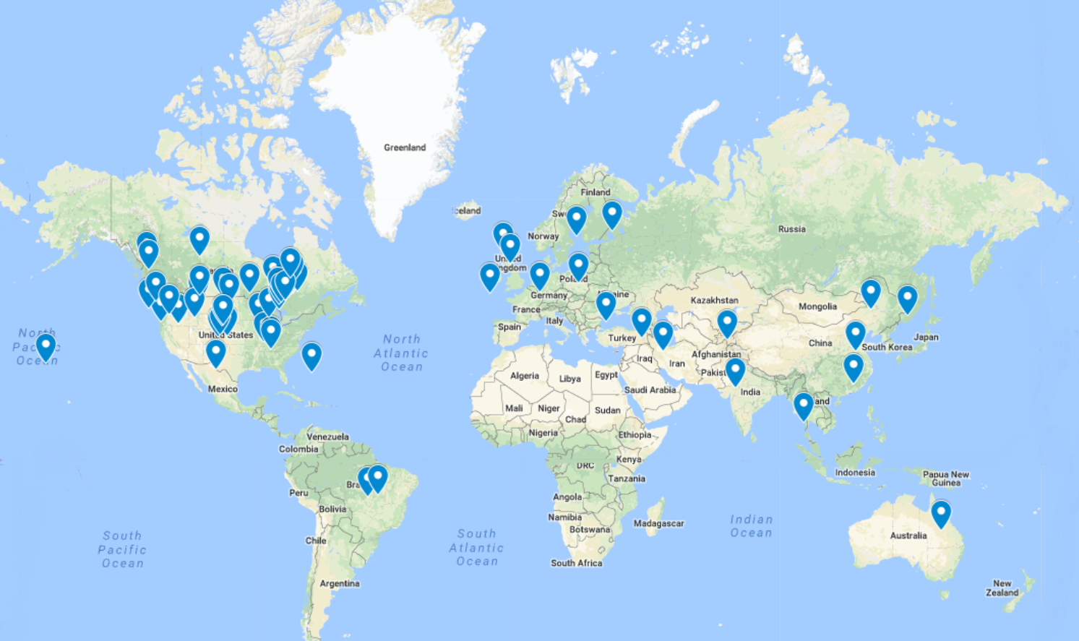

About the Government Blockchain Association
Working Groups
Contract Management
Financial Oversight
Cryptocurrency Economic Analysis
Cybersecurity
Education
Land Titling
Government Ontology
Legal & Legislative
Working Groups
Healthcare
Software Product & License Management
Smart City
Supply Chain
Voting

Slide 8
Brief History of Money
Notes:
In order to understand the importance of Bitcoin as a currency, one must understand the role of money on our society.

Slide 9
      Class Question
How do you define money?

Slide 10
      What is Money?
Fiat Currency
Medium of Exchange
Measure of Value
Standard of Deferred Payment
Store of Value?
Bitcoin changed how we look at “money”
Notes:
Interest in blockchain technology developed after the launch of Bitcoin by Satoshi Nakamoto in 2009. Bitcoin utilizes a blockchain as a transaction ledger to securely record transfers of bitcoins from one party to another.
However, Nakamoto’s original paper does not mention the term ‘blockchain’, which first appears as ’block chain’ in a comment in the original Bitcoin client C++ source code.
The paper focused on Bitcoin as an alternative currency and store of value, with much less attention given to the many different ‘non-currency’ uses of blockchain technology (e.g., serving as a voting system).

Slide 11

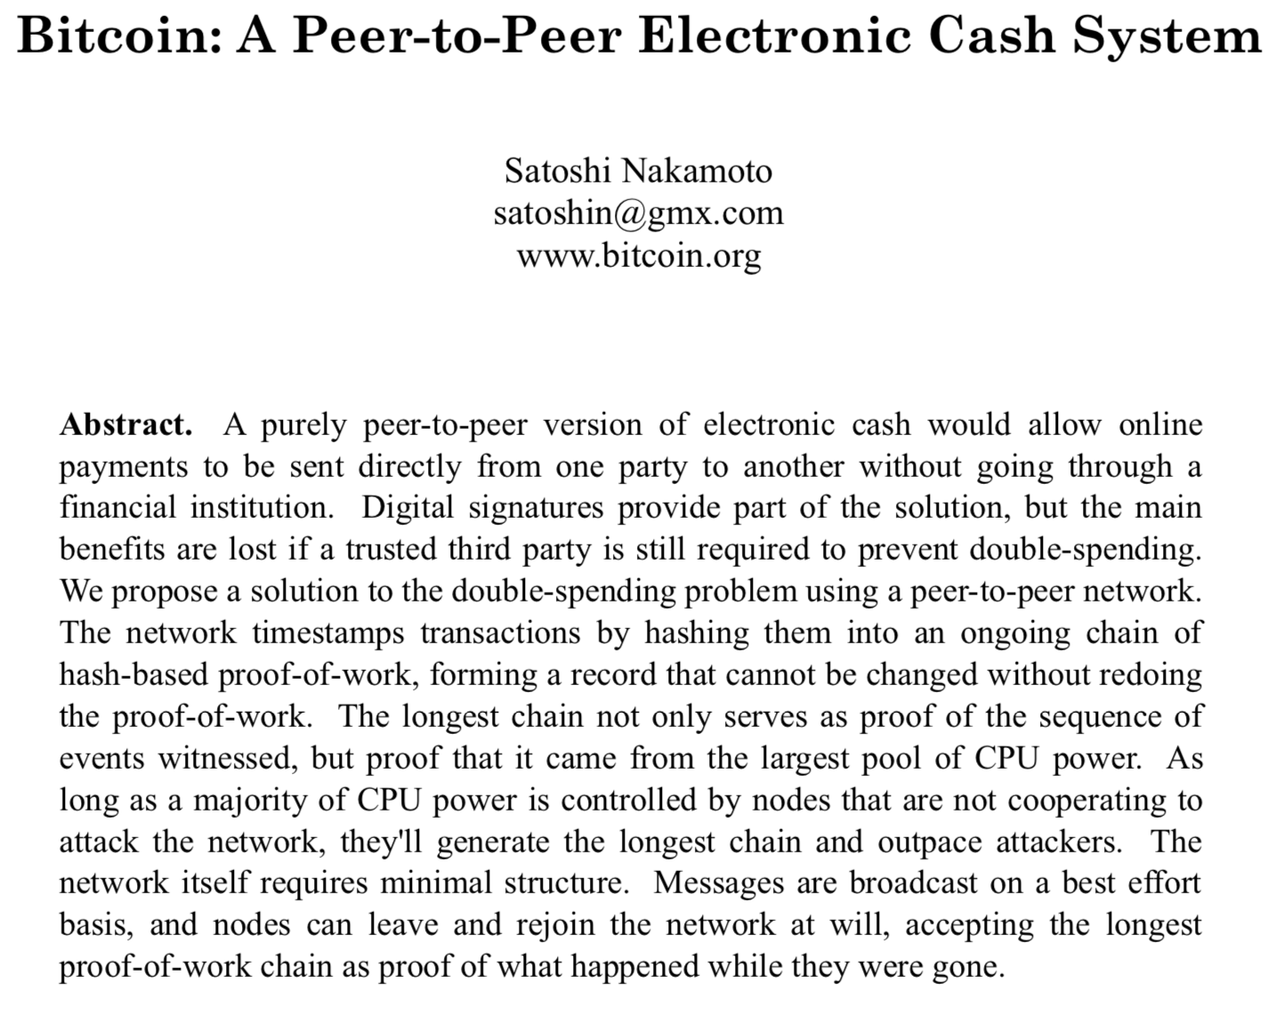

The Bitcoin White Paper
Notes:
Interest in blockchain technology developed after the launch of Bitcoin by Satoshi Nakamoto in 2009. Bitcoin utilizes a blockchain as a transaction ledger to securely record transfers of bitcoins from one party to another.
However, Nakamoto’s original paper does not mention the term ‘blockchain’, which first appears as ’block chain’ in a comment in the original Bitcoin client C++ source code.
The paper focused on Bitcoin as an alternative currency and store of value, with much less attention given to the many different ‘non-currency’ uses of blockchain technology (e.g., serving as a voting system).

Slide 12
Who is Satoshi Nakamoto?
Satoshi Nakamoto is the name used by the unknown person, or persons, who developed bitcoin, authored the bitcoin white paper, and created and deployed bitcoin's original reference implementation. As part of the implementation, they also devised the first blockchain database.
Question: Is Satoshi Nakamoto’s identity important?
Notes:
Interest in blockchain technology developed after the launch of Bitcoin by Satoshi Nakamoto in 2009. Bitcoin utilizes a blockchain as a transaction ledger to securely record transfers of bitcoins from one party to another.
However, Nakamoto’s original paper does not mention the term ‘blockchain’, which first appears as ’block chain’ in a comment in the original Bitcoin client C++ source code.
The paper focused on Bitcoin as an alternative currency and store of value, with much less attention given to the many different ‘non-currency’ uses of blockchain technology (e.g., serving as a voting system).

Slide 13
Important Definitions
These terms are used in the Bitcoin White Paper:
Peer to Peer (P2P) - A connection between two or more computers that allows them to directly share information, files, or other data where there are no privileged peers with special rights or advantages.
Digital Signatures - Permission and proof done through a computer that an authorized person has agreed to something and generates a verification code that proves a transaction took place.
Double Spending - A form of deceit using digital money where the same money is promised to two parties but only delivered to one. If completed successfully, one of the two recipients will not be paid.

Slide 14
Important Definitions contd
These terms are used in the Bitcoin White Paper:
Proof of Work - A process for achieving consensus and building on a digital record on the blockchain. With Proof of Work, users compete with their computers to solve a problem. In Proof of Work, computers compete to solve a tough math problem.
Nodes - Any computing device (computer, phone, etc.) that is participating in a network by way of receiving and sending data. Cryptocurrencies are supported by a network of computers each keeping a digital record of the data known as a blockchain.

Slide 15
      Class Question
Bitcoin was the first cryptocurrency. How many cryptocurrencies do you think are in existence today?

Slide 16
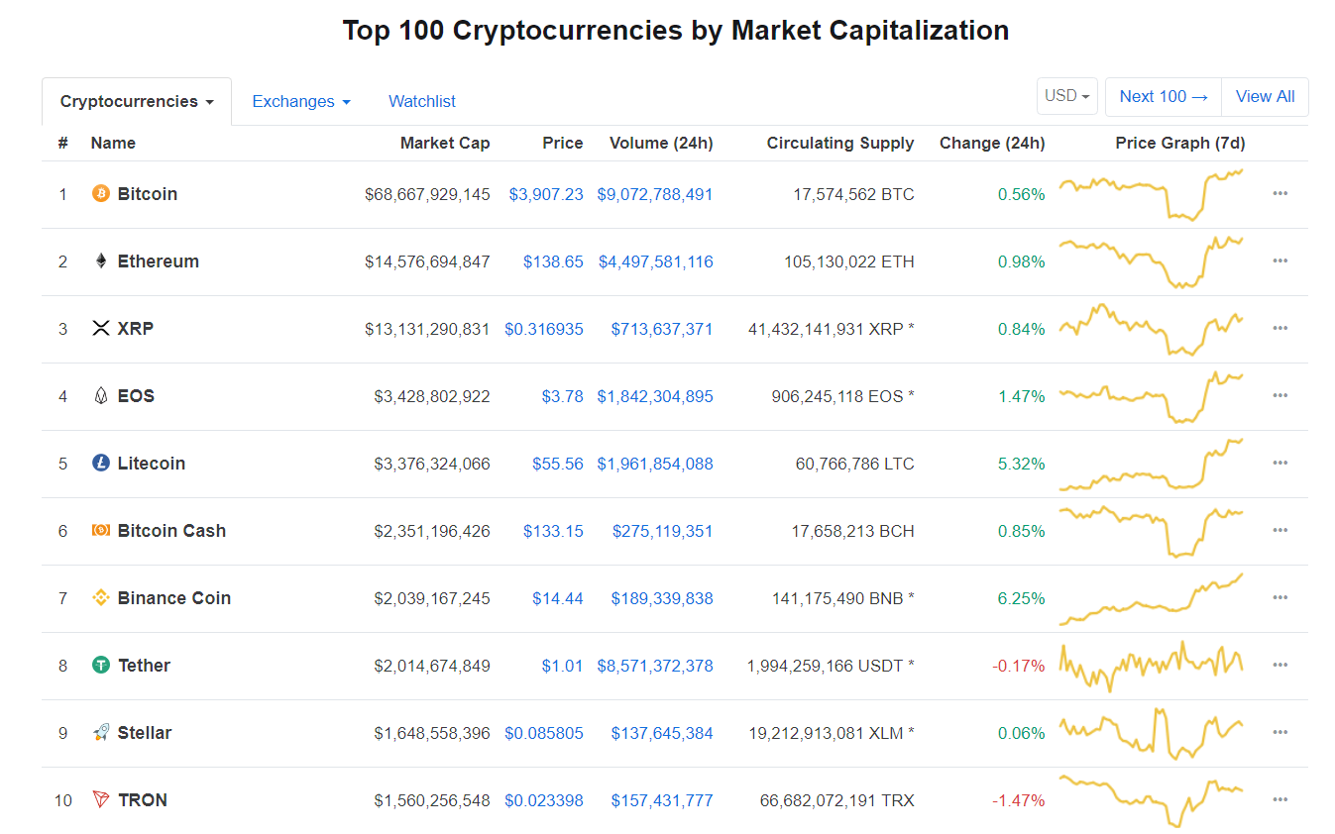
CoinMarketCap.com
An excellent resource for:
Current Prices
Historical Prices
Market Cap
Access to websites

Slide 17
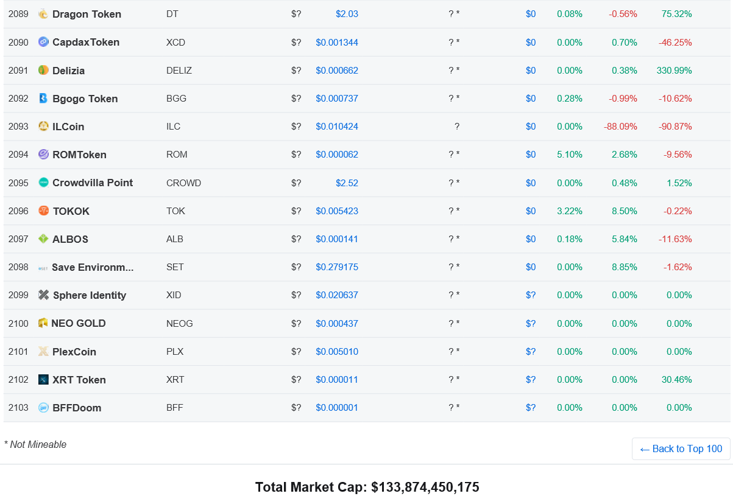
CoinMarketCap.com
There are over 2000 cryptocurrencies!

Slide 18
What is the Blockchain?
Why is the Blockchain Important?

Slide 19

How the Blockchain Started
The Bitcoin White Paper does not use the word “blockchain”, the term used is “forming a record”.
Bitcoin utilizes the blockchain as a transaction ledger to securely record transfers of bitcoins from one party to another.
As discussed later, Ethereum expanded the capability of the blockchain.
Notes:
Interest in blockchain technology developed after the launch of Bitcoin by Satoshi Nakamoto in 2009. Bitcoin utilizes a blockchain as a transaction ledger to securely record transfers of bitcoins from one party to another.
However, Nakamoto’s original paper does not mention the term ‘blockchain’, which first appears as ’block chain’ in a comment in the original Bitcoin client C++ source code.
The paper focused on Bitcoin as an alternative currency and store of value, with much less attention given to the many different ‘non-currency’ uses of blockchain technology (e.g., serving as a voting system).

Slide 20
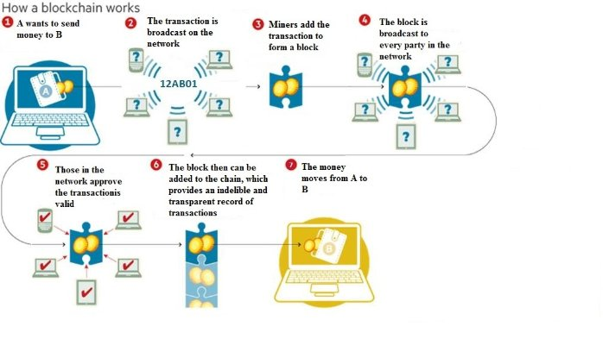
How Blockchains Work

Slide 21
The Blockchain Explained in a Different Context
What is a Block?: All the transactions/records within a period of time
The blocks are added to the Blockchain in a linear, chronological order
Each node (or “block”) gets a full copy of the Blockchain upon joining the network
The Blockchain has complete information about the addresses and their balances right from the genesis block to the most recently completed block
Notes:
The block is step 5 in the diagram

Slide 22
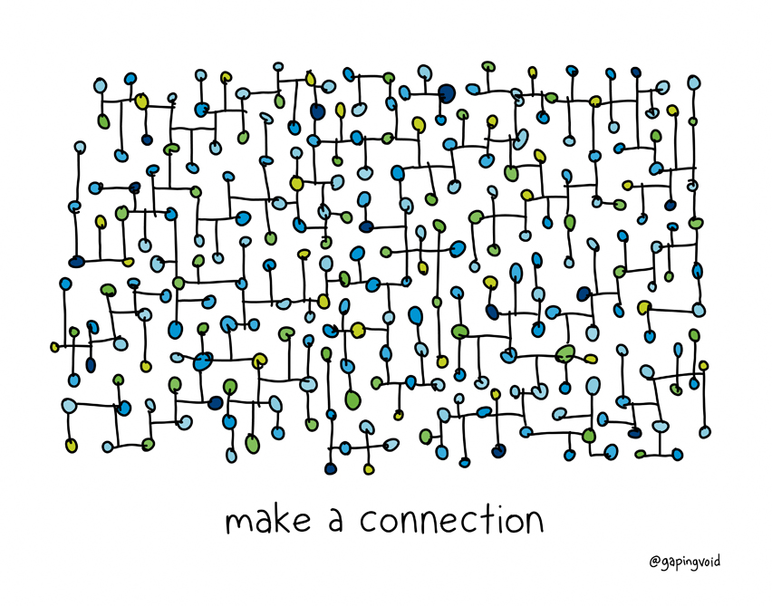
The Five Properties of the Blockchain
1. Decentralized Systems
2. Distributed Ledger Technology
3. Cryptographically safe and secure
4. Mining is used to validate blocks of transactions
5. Transactions are immutable
Notes:
Interest in blockchain technology developed after the launch of Bitcoin by Satoshi Nakamoto in 2009. Bitcoin utilizes a blockchain as a transaction ledger to securely record transfers of bitcoins from one party to another.
However, Nakamoto’s original paper does not mention the term ‘blockchain’, which first appears as ’block chain’ in a comment in the original Bitcoin client C++ source code.
The paper focused on Bitcoin as an alternative currency and store of value, with much less attention given to the many different ‘non-currency’ uses of blockchain technology (e.g., serving as a voting system).

Slide 23
Blockchain as a Ledger
Ledger functions include: Financial transactions (ledger), list of registries (car, land), record ownership (house), etc.
Shared: everybody has an exact copy
Constantly updated
The ledger cannot be altered

Slide 24
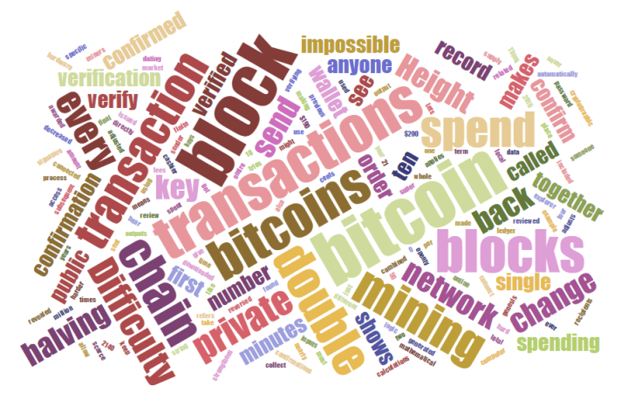
How Blockchains Work
A deeper dive into how the Blockchain actually works
A bit technical
The “Nuts and Bolts”
Play Video
https://www.youtube.com/watch?v=r43LhSUUGTQ
24

Slide 25
The Ethereum Abstract
So far "Bitcoin" as a currency unit has taken up the bulk of the public attention, both in terms of the political aspects of a currency without a central bank and its extreme upward and downward volatility in price. However, there is also another, equally important, part to Satoshi's grand experiment: the concept of a proof of work-based blockchain to allow for public agreement on the order of transactions. Bitcoin as an application can be described as a first-to-file system: if one entity has 50 BTC, and simultaneously sends the same 50 BTC to A and to B, only the transaction that gets confirmed first will process. There is no intrinsic way of determining from two transactions, which came earlier, and for decades this stymied the development of decentralized digital currency. Satoshi's blockchain was the first credible decentralized solution. And now, attention is rapidly starting to shift toward this second part of Bitcoin's technology, and how the blockchain concept can be used for more than just money.
Notes:
Ethereum expanded the use of the blockchain beyond financial transactions

Slide 26
Expanded Blockchain Vocabulary
Distributed database: type of database where data is stored across multiple computing devices
Distributed ledger type of distributed database that assumes the possible presence of malicious users (nodes)
Blockchain: type of distributed ledger that is composed of a chain of cryptographically linked ‘blocks’ containing batched transactions; generally broadcasts all data to all participants in the network
Notes:
These terms were not in the Bitcoin White Paper but they were an important part of the Ethereum White paper.

Slide 27

Types of Blockchains
Notes:
.

Slide 28
Three Types of Blockchains
PUBLIC
HYBRID
PRIVATE
Notes:
These were mentioned in the Ethereum White Paper
Public
Hybrid
Private

Slide 29
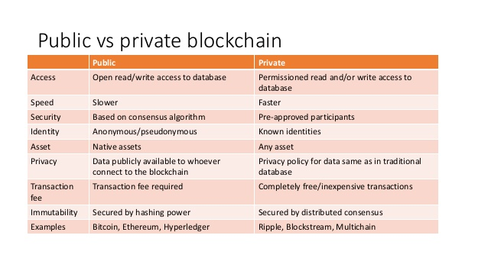
A Tale of Two Blockchains

Slide 30
Types of Blockchains
Main types of blockchains segmented by permission model: Read (can access the ledger and see transactions), Write (who can generate transactions and send them to the network), and ‘Commit’ (who can update the state of the ledger).
The terms ‘private’, ‘permissioned’, and ‘closed’ are often used interchangeably

Slide 31
Venn Diagram for Distributed Data
“Blockchains and distributed ledgers are types of distributed databases”
Distributed databases
1
.
ADVERSARIAL MODEL
Presence of malicious nodes assumed
Distributed ‘ledgers’ (DLT)
2
.
DATA STRUCTURE AND DIFFUSION
Chain of cryptographically linked blocks,
and/or global data broadcast
Blockchains
3
.
PERMISSION MODEL
-
:
public vs. private
Read
-
:
Write/Commit
permissionless vs. permissioned
Permissioned
blockchains

Slide 32
Hybrid Blockchains
PUBLIC
HYBRID
PRIVATE
Notes:
Public
Hybrid

Slide 33
Hybrid Blockchains
Hybrid Blockchains contain both public and private parts to operate
Hybrid provides an enterprise-ready blockchain solution that is better suited to highly regulated enterprises and governments as it enables them to have the flexibility and control over what data is kept private versus shared on a public ledger.
The benefits of the private blockchain include faster transaction speeds, privacy of the data/content and centralised control over access to the blockchain.
Notes:
List examples:
Transition – This completes the blockchain basics. Now let’s look at some of the facts and myths about the blockchain

