Slide 1

7 Blockchain Myths

Slide 2



6 Blockchain Myths
1: Blockchain is Inherently Immutable
Nick Ayton: The 7 Mythos about Blockchain Nov 10, 2016
Notes:
The Blockchain (ledger) itself is not immutable. It is a myth. Immutability in fact comes from the expenditure of effort (in this case power and computing resources) relating to the Proof of Work algorithm where the difficulty increases and number of Bitcoin rewards for Miners reduces every 4 years. Currently 12.5. The ultimate visible Proof of Work example is the Pyramids in Egypt, taking decades to complete, where those that took on the project had to feed and water hundreds of thousands of people that in turn moved mountains. Therefore Proof of Work completeness encompassing extreme difficulty and expenditure of resources.
Miners expend huge effort, resources having already invested capital in Mining equipment to mine the mainstream crypto-currencies. And very different to Proof of Stake investment/vested approach. Miners make the investment in computing and electrical power to solve the increasingly challenging (difficult) PoW algorithm (SHA256) to try to get a match, called Hashing. Used to verify transactions and be able to write these to a new Block (taking 10 minutes) for which they get a reward. It is a race and mining power has a direct impact on the result.
Transactions on a blockchain network can be reversed by network participants under specific circumstances
The illusion that blockchain transactions are immutable stems from its append-only data structure that suggests that data can only be added to, but not removed from the database.
However, blocks comprising transactions can, in theory, be reversed
if enough nodes decide to collude.

Slide 3
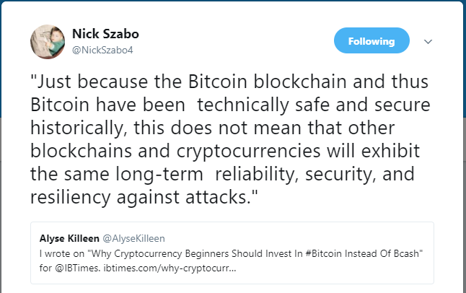
6 Blockchain Myths
Notes:
The Blockchain (ledger) itself is not immutable. It is a myth. Immutability in fact comes from the expenditure of effort (in this case power and computing resources) relating to the Proof of Work algorithm where the difficulty increases and number of Bitcoin rewards for Miners reduces every 4 years. Currently 12.5. The ultimate visible Proof of Work example is the Pyramids in Egypt, taking decades to complete, where those that took on the project had to feed and water hundreds of thousands of people that in turn moved mountains. Therefore Proof of Work completeness encompassing extreme difficulty and expenditure of resources.
Miners expend huge effort, resources having already invested capital in Mining equipment to mine the mainstream crypto-currencies. And very different to Proof of Stake investment/vested approach. Miners make the investment in computing and electrical power to solve the increasingly challenging (difficult) PoW algorithm (SHA256) to try to get a match, called Hashing. Used to verify transactions and be able to write these to a new Block (taking 10 minutes) for which they get a reward. It is a race and mining power has a direct impact on the result.

Slide 4


6 Blockchain Myths
In August 2010, a bug where the sum of two outputs overflowed to a negative number allowed attackers to create two outputs of 92,233,720,368.54 coins from an input of 0.50 coins
Notes:
The Blockchain (ledger) itself is not immutable. It is a myth. Immutability in fact comes from the expenditure of effort (in this case power and computing resources) relating to the Proof of Work algorithm where the difficulty increases and number of Bitcoin rewards for Miners reduces every 4 years. Currently 12.5. The ultimate visible Proof of Work example is the Pyramids in Egypt, taking decades to complete, where those that took on the project had to feed and water hundreds of thousands of people that in turn moved mountains. Therefore Proof of Work completeness encompassing extreme difficulty and expenditure of resources.
Miners expend huge effort, resources having already invested capital in Mining equipment to mine the mainstream crypto-currencies. And very different to Proof of Stake investment/vested approach. Miners make the investment in computing and electrical power to solve the increasingly challenging (difficult) PoW algorithm (SHA256) to try to get a match, called Hashing. Used to verify transactions and be able to write these to a new Block (taking 10 minutes) for which they get a reward. It is a race and mining power has a direct impact on the result.

Slide 5
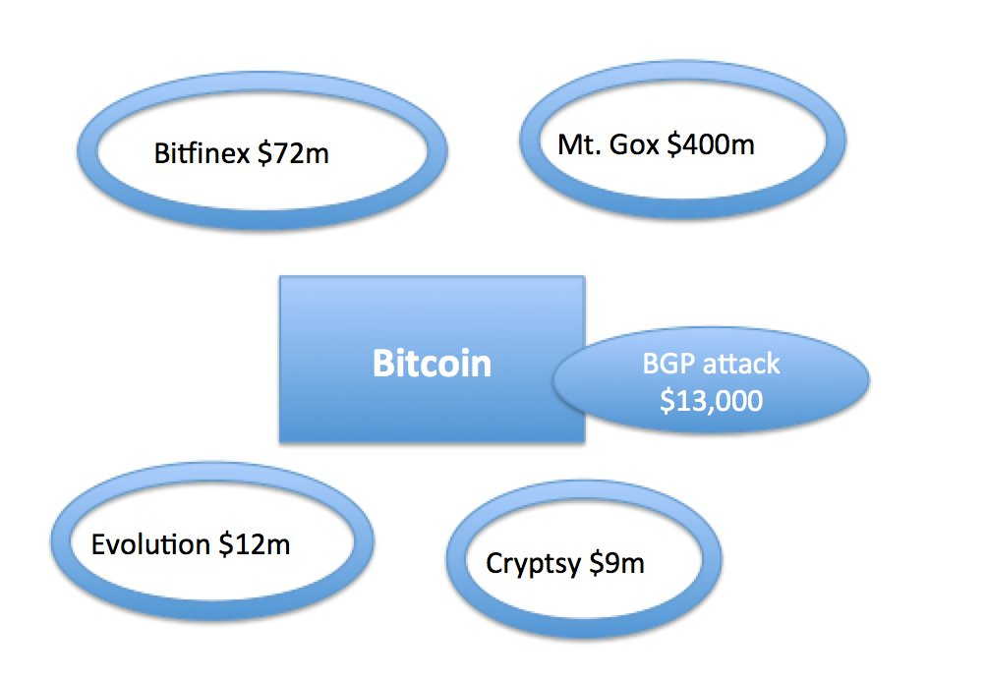
6 Blockchain Myths
Nick Szabo Twitter Jun 17 2017
Notes:
Bitcoin is the most secure financial network on the planet. But its centralized peripheral companies are among the most insecure.

Slide 6
6 Blockchain Myths
3: Blockchain network can be shut down
Nick Ayton: The 7 Mythos about Blockchain Nov 10, 2016
Notes:
Bankers and purists generally don’t like Bitcoin for the primary reason of Openness, Transparency and because it is generally Free (micro fees), arguing anonymity allows miss-use. Bitcoin is not owned by anyone. The Bitcoin Foundation provides oversight but not control.
The code is Open Source and anyone can download it and set himself or herself up as a Miner to mine Bitcoin. Others may download Bitcoin as clients onto their smart phones as Bitcoin Wallets to transact Peer 2 Peer with whomever they want, passing Bitcoin tokens across the network and not via any central control or body, like a clearing bank or central authority. Frictionless and where the transaction is guaranteed and immediate.
Bitcoin is for the people, run by the people and like the Internet cannot be shut down although there are of course efforts to police it, with others that want to control it. It is beyond the central authorities (Regulators, Clearing Banks and some Governments) that see the Libertarian threat of Bitcoin and fear it. It is censorship resistant, without geographical boundaries. Many governments are starting to see the potential and want to be part of its evolution, as sovereign governments race to be first to issue debt on the Blockchain, and deploy their own crypto-currency. To be one of the first matters.
The other myth is once the 21million of Bitcoins are mined the currency will collapse and stop and people will lose their value. The last coins will be mind in 2140 and given there are 9 decimal places to play with the Bitcoin crypto-currency will do just fine.

Slide 7
6 Blockchain Myths
4: Bitcoin and Ethereum are the same
Nick Ayton: The 7 Mythos about Blockchain Nov 10, 2016
Notes:
Bitcoin was designed as a Peer 2 Peer financial system using the core code based on the Satoshi papers of 2008. It was designed as a borderless financial (payment) system beyond the control and manipulation of central banks, governments and retail banks that take disproportionate fees for doing very little. Bitcoin was the first and is the largest Public Blockchain and the network is neutral treating all transactions the same.
Ethereum forked the original open source code and went live in 2015 with its own genesis block, when Vitalik Buterin engineered it to deliver a complete development environment around a global Computational (State) Machine, that may one day become the new Internet. Ether arrived Jan 2016 and things really took off.
Ethereum offered for the first time a Turing complete language (a development environment) to build out architecture for Smart Contracts that can run as a Blockchain Operating Model. Ethereum delivers the future of commerce and where the crypto-currency as a financial rail is a consequence and not the focus. Many call Ethereum Distributed Autonomous Technology (DAT).
They share common features; they started from the same source code, they are both a network (P2P), a currency and a technology.

Slide 8
6 Blockchain Myths
5: The Blockchain has been hacked
Nick Ayton: The 7 Mythos about Blockchain Nov 10, 2016
Notes:
The Value Overflow Incident and the DAO Hack
Discuss the 51% attack – Ethereum Classic 51% attack – Technologyreview.com

Slide 9
6 Blockchain Myths
6: Blockchains cannot be linked together
Nick Ayton: The 7 Mythos about Blockchain Nov 10, 2016
Notes:
Apart from a host of activity to patent aspects of Blockchain design largely by banks, much of the Blockchain community remains Open Source and committed to improving the underlying performance of the Blockchain code so that it may scale.
Many Blockchain start ups are doing amazing things to improve the performance and usability of the original code. Consensys, Eris Industries (now Monax) and Tendermint are achieving great things.
The big activity is to link Chains developed and built in different languages and structures (consensus, voting, approaches to Identity etc) and enable the passing of Tokens (currencies/value) between each Blockchain remains complex. Two leading examples of this effort are Interledger and Cosmos Hub (Tendermint) two such projects that are linking chains together to create Blockchain eco systems and communities, very useful when deployed as an Industry Solution.

Slide 10
6 Blockchain Myths
7: Blockchains are ‘trustless’
Notes:
Blockchains always require some degree of trust
Although blockchains may help reduce the need for trust, they do not completely remove the need for trust.
At the bare minimum, trust must be placed in the underlying cryptography.
In the case of a permissioned network, trust must be placed in the operator(s) and/or the validators.

Slide 11
6 Blockchain Myths
8: Blockchains are 100% secure
Notes:
Blockchains are not automatically more secure than other systems
Blockchains employ cryptography for authentication, permission enforcement, integrity verification, and other areas.
The mere application of cryptography, however, does not automatically make the system more secure per se.
The system may be more resilient as data storage and permissions are distributed, but compromising the private keys of some network participants could give attackers full access to the shared database, including the ability to reverse transaction history

Slide 12
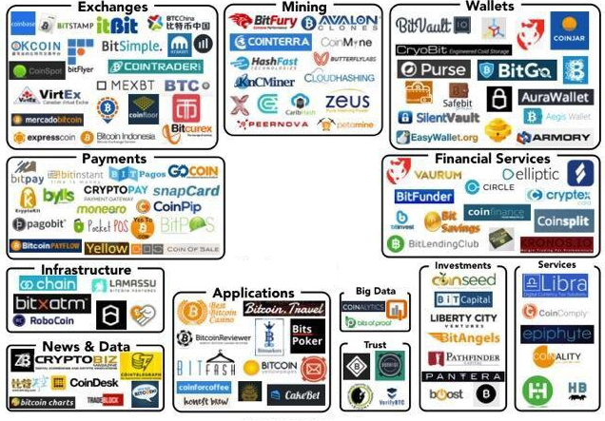
Today – The Blockchain Ecosystem
Applications
Associations
Exchanges
Financial Services
Infrastructure
Investments
Mining
News & Data
Payments
Services
Wallets

Slide 13
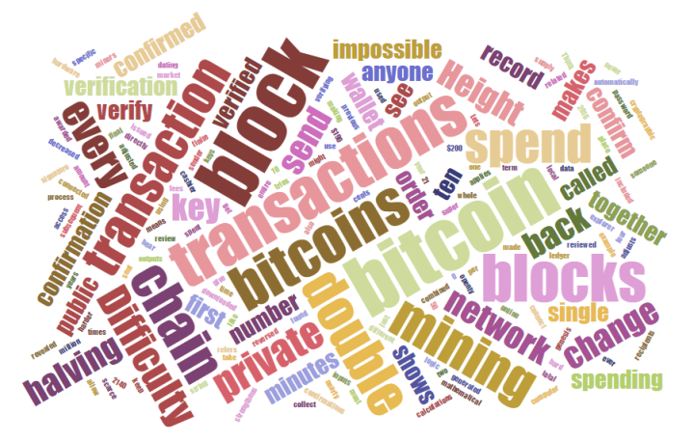
Cryptocurrency Wallets and Exchanges
13

Slide 14
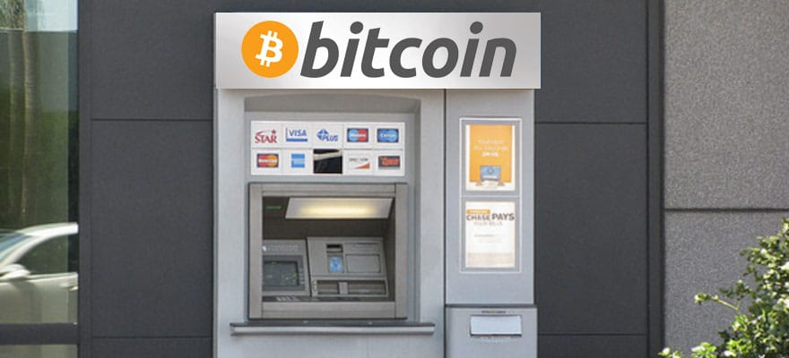
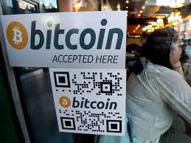
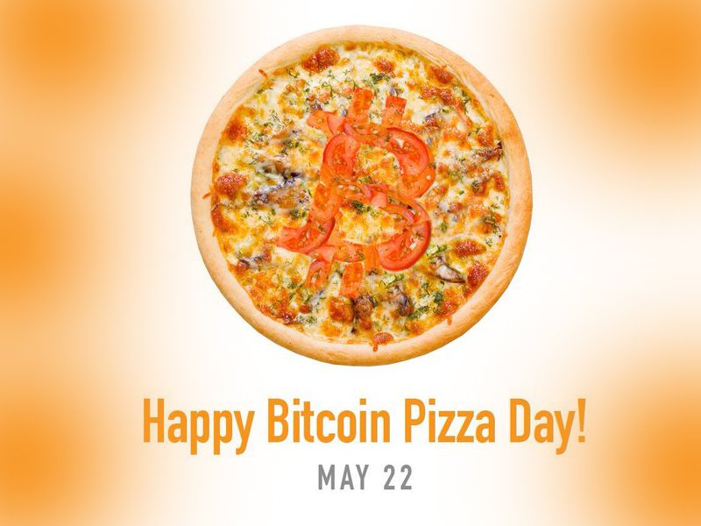
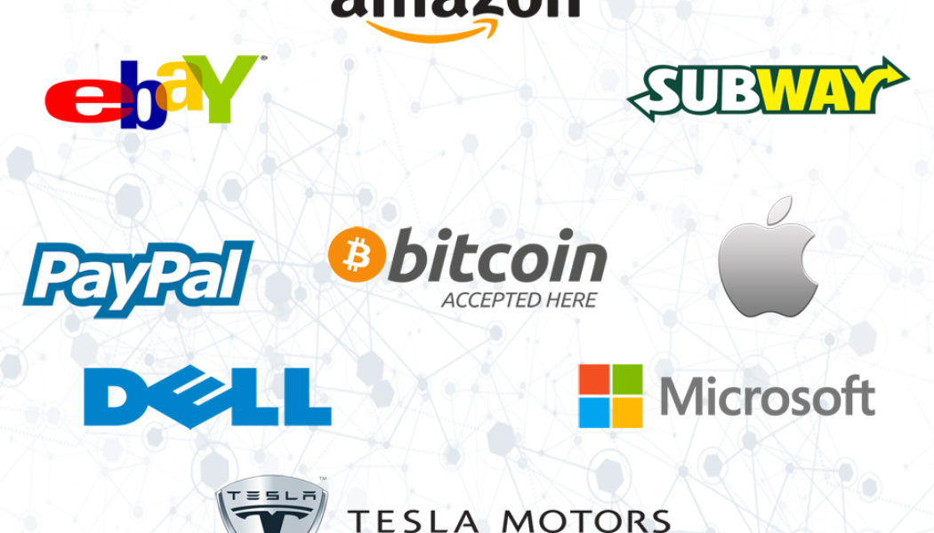
Cryptocurrency Adoption

Slide 15
Cryptocurrency Wallets and Exchanges
Wallets – A combination of addresses, private keys and public keys in software that interacts with the blockchain allowing users to send and receive coins. Technically, wallets do not store coins, the just lock them away.
Exchanges – Systems that allow people to trade cryptocurrencies for cryptocurrencies or cryptocurrencies for fiat currencies.

Slide 16
Role and Functions of Wallets
Different Kind of Wallets:
Paper – Printed sheet with a QR code
Hardware – Typically a USB
Desktop – Program saved on a PC or MAC
Mobile - Program saved on the a phone
Online – Wallets on the internet
Why are they listed in this order?

Slide 17
What are Cryptocurrencies and Crypto-Tokens?
A common question from new cryptocurrency investors is the difference between a “cryptocurrency” and a “crypto-token”?
Cryptocurrency as “digital medium of exchange using strong cryptography to secure financial transactions, control the creation of additional units, and verify the transfer of assets”.
Crypto-token as “a digital unit designed with utility in mind, providing access and use of a larger
crypto-economic system.
Notes:
StateoftheDapps provides examples of cryptocurrencies and crypto-tokens

Slide 18
Protocols, Platforms and Products
Blockchain protocols
are like internet protocols. While the internet protocol enabled the peer-to-peer movement of information; the blockchain protocol enables the peer-to-peer movement of value.
Internet protocols such as TCP/IP and HTTP are a set of rules that all computers on the network use so that people can share information without a third party. The blockchain is a set of rules that computers use to transfer the ownership of digital assets between peers without requiring a third-party intermediary to validate or facilitate each transaction.

Slide 19
The ERC20 Token
ERC-20 is a technical standard used for smart contracts used on the Ethereum blockchain for implementing tokens. ERC means “Ethereum Request for Comment” and 20 is the number assigned to this request. The majority of tokens on the Ethereum blockchain are ERC-20 compliant.
The ERC token is covered in greater detail in the GBA Technical Consulting Course.

Slide 20
“Smart Contracts” on Blockchain

Slide 21
What are Smart Contracts? (Ethereum)
Smart contracts are computer protocols that facilitate, verify, or enforce the negotiation or performance of a contract, or that eliminate the need for a contractual clause. Smart contracts usually also have a user interface and are similar to the logic of contractual clauses.
Smart contracts work in three steps
Coding
Distributed Ledgers
Execution
Notes:
Why is this interesting?
By leveraging the POW aspects of a Blockchain network, it can become the basis of proving work is both completed and delivered per the contract. This is very powerful when automated into a workflow that is distributed by every single member of the community that is affected.
(No wonder the founder of Netscape, Marc Andressen has said the "software is eating the world". This is why.)
Think about new services that would not require you to trust a third party, and pay the related fees and suffer the related delays, but you are still able to enforce the terms of the contract.
It will allow the creation of encryptable and financially binding workflows to be established for almost anything imaginable.

Slide 22
Ethereum
Ether is similar to Blockchain except for the following differences:
Instead of only handling accounts and transaction it can also store computer programs (called “smart contracts”) like:
If xx account has ฿yy balance
And if today is December 31st, 2016
Then transfer ฿5 to zz account
If not, don't do anything

Slide 23
Smart Contracts (Ethereum)
Coding (What goes into a Smart Contract)
Because smart contracts work like computer programs, it is very important that they do exactly what the parties want them to do. This is achieved by inputting the proper logic when writing the smart contract (more can be found here about an Introduction to Programming Smart Contracts on Ethereum).
The code behaves in predefined ways and doesn’t have the linguistic nuances of human languages, thus, it has now automated the “if this happens then do that” part of traditional contracts.

Slide 24
Smart Contracts – Distributed Ledgers
Distributed Ledgers (How the smart contract is sent out)
The code is then encrypted and sent out to other computers via a distributed network of ledgers (i.e. Distributed Ledgers).
If this is done via public permissionless Blockchain such as Bitcoin, the contract is sent out similar to the way that a network update of a bitcoin transaction would occur.
This can also be done in a permissioned or hybrid distributed ledger platform such as the R3 Distributed Ledger.

Slide 25
Smart Contracts - Execution
Execution (How it is processed)
One the computers in this network of distributed ledgers receive the code, they each come to an individual agreement on the results of the code execution.
The network then updates the distributed ledgers to record the execution of the contract, and then monitor for compliance with the terms of the smart contract.
In this type of system, single party manipulation is averted because control over the execution of the smart contract is no longer possible as execution is no longer in the hands of a single party.

Slide 26
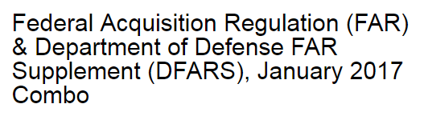


Examples of Smart Contracts (Ethereum)
Federal, state or local government contracting
Benefits management (Medicare, Medicaid, Social Security)
Progress payments (to primes and subcontractors)
Intellectual Property (IP) Management
Notes:
Federal, state or local government contracting... only pays for mile stones, deliverables and output... as the work is completed
For small contributions of work that can be piece-parted out to individual contributors and paid for as they are accomplished and "checked in" to the correct repository.
Benefits management – this is a multi-million dollar business for governments around the world where fraud is VERY expensive
Progress payments are very common in any field where a deliverable (I.e., hardware, software, objects, research, large assets, etc.) is expensive and takes a long time.
IP Management: Well known example is the music industry, where an artist is paid for their intellectual property (I.e., a copyrighted lyric or melody) and whenever a listener downloads their work, it triggers a royalty payment to the IP owner.
This has the potential to do for contracting... what hyper-links did for computing and word processing... except "on steroids"
Enforce aspects of any given deliverable and work process without fear of tampering.
Will rely upon natural motivations of incentives and rewards;
Consider how many forms are completed in an average agency (local, county, state, federal, international).
When you automate citizen data, combine it with secure computing, and automatically triggered workflows, you can achieve true optimized efficiencies! This is a process consultants dream!
Has potential to save hundreds of billions in the United States Federal government alone.
Discussion
Conclusion on the governmental use of smart contracts:
It has wide and deep potential to "lean-out" just about any governmental process where there is a transaction (exchanged of data, inputs, outputs, funds, forms, compliance details, condition, status, health, etc.).

Slide 27
Ethereum
Ethereum is a decentralized platform that runs smart contracts: applications that run exactly as programmed without any possibility of downtime, censorship, fraud or third party interference.
These apps run on a custom built Blockchain, an enormously powerful shared global infrastructure that can move value around and represent the ownership of property.
Enables developers to create markets, store registries of debts or promises, move funds in accordance with instructions given long in the past (like a will or a futures contract) and many other things that have not been invented yet, all without a middle-man or counterparty risk.

Slide 28
Blockchain Use Cases
Supply Chain Management – The Blockchain can provide a means to allow every participant on a supply chain network to input and track sourcing of raw materials, record parts manufacturing telemetry, track provenance of goods through shipping, and maintain immutable records of all aspects of the production and storage of a finished good through to sale and afterwards.
Voting
Medical
Cloud Storage
Human Resources

Slide 29
Blockchain Use Cases cont’d
Since the Blockchain acts as a distributed, single source of shared truth, it can be a solution
Smart contracts can be leveraged to update the state of transaction, but also be shared amongst parties
Smart contracts can also trigger events that can be used to indicate the success or failure of a transaction
Walmart is currently testing using the Blockchain for Supply Chain Management
Deloitte is promoting the use of Blockchain to manage the food supply chain
Any potential to tokenize and manage the movement of value

Slide 30
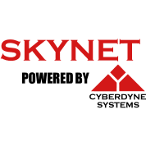
Complementary Technologies
Internet
of Value
Artificial Intelligence
Internet
of Things
Internet of Information

Slide 31
6 Blockchain Myths
2: Smart Contracts are “smart” and they are legal documents
Nick Ayton: The 7 Mythos about Blockchain Nov 10, 2016
Notes:
Smart Contracts are dumb. They are not contracts at all. They are scripts as software code that are deployed onto the Blockchain at a particular address (data store) that follow simply instructions normally triggered events, e.g. IF, THEN statements. They are normally written as a transaction instruction and rely on the Computational Capabilities of the Ethereum Blockchain.
Smart Contracts eliminate the need for individuals to handle time consuming and costly business processes. They are autonomous and once loaded cannot be stopped or altered. Like a virus they can operate alone (autonomously) or in conjunction with other Smart Contracts, Data Stores as Oracles and interoperate with other legacy systems.
Smart Contracts are not contracts in any legal sense, nor will legal contracts be part of Smart Contracts. But they are capable of executing terms (as instructions) that may reside in an agreement between parties, to make a payment or move entitlement/ownership and transfer funds. They form part of the business logic layerthat links nicely with the process logic to form what become unintelligent groups of transactions.
Smart Contracts are emerging and the development and deployment is very complex. They are vulnerable to attacks/hacks and where most of the recent problems such as the DAO have been. Smart Contracts carry transaction instructions and become layers and groups of Smart Contracts that work together to form a new generation of Decentralised applications or Dapps.
Smart Contracts along with Keys (Public and Private digital fingerprints) play an increasing important role in the design of Blockchain Operating Models where core business processes are automated using embedded Smart Contracts and eventually embedded as firmware into physical things in an IoT world. With everything written to a ledger of Everything. Smart Contracts is the business logic layer that directs the transaction traffic between the participants.
A Smart Contract does not form any legal status, and the legal position is largely irrelevant. Should a Smart Contract do something the parties had not intended. Make a wrong payment? Who is responsible? Was it hacked or just poor coding?

Slide 32
What are DAOs?
DAO (Decentralized Autonomous Organizations) - A decentralized autonomous organization (DAO), sometimes labeled a decentralized autonomous corporation (DAC), is an organization that is run through rules encoded as computer programs called smart contracts. A DAO's financial transaction record and program rules are maintained on a Blockchain.

Slide 33
Benefits of Using the Blockchain

Slide 34
Risks of Using the Blockchain

Slide 35
The DAO Hack
One event that showed the risk of the blockchain is the DAO Hack.

Slide 36
Legal and Regulatory Considerations
A deeper dive into how the Blockchain actually works
A bit technical
The “Nuts and Bolts”
36

Slide 37
Areas of Enforcement
State Legislation
Proposed Legislation
SEC Enforcement Actions
IRS Enforcement

Slide 38
Enforcement – State Legislation

Slide 39
Enforcement – Proposed Legislation

Slide 40
SEC Enforcement
The most common laws the SEC uses for enforcement over the securities industry include.
Securities Act of 1933
Securities Exchange Act of 1934
The SEC is enforcing ICOS and the Howey Test is one of the tools that SEC uses to determine if a transaction is an investment.

Slide 41
IRS Enforcement
The IRS views cryptocurrencies, which the IRS calls “virtual currencies” as “property” and ruled on the taxation of cryptocurrencies in stating: “The sale or other exchange of virtual currencies, or the use of virtual currencies to pay for goods or services, or holding virtual currencies as an investment, generally has tax consequences that could result in tax liability.”
IRS Notice 2014-21 is one of the most important IRS documents related to cryptocurrencies

Slide 42
Specific Regulatory Considerations
Anti-money laundering (AML)
Consumer and Investor Protection
Banking and Financial
Taxation/Tax Collection
Privacy Issues
Digital Identity
National Security – In the future state

