Slide 1
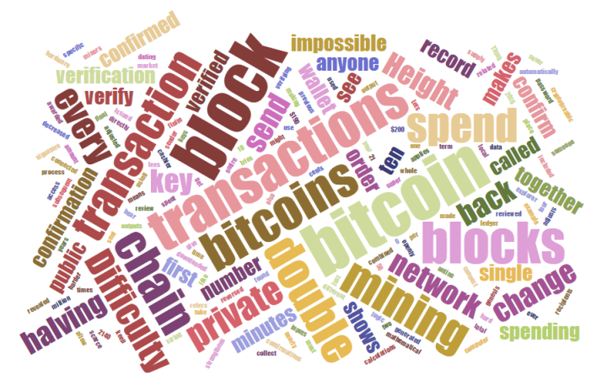
Legal and Regulatory Considerations
A deeper dive into how the Blockchain actually works
A bit technical
The “Nuts and Bolts”
1

Slide 2
Areas of Enforcement
State Legislation
Proposed Legislation
SEC Enforcement Actions
IRS Enforcement

Slide 3
Enforcement – State Legislation

Slide 4
Enforcement – Proposed Legislation

Slide 5
SEC Enforcement
The most common laws the SEC uses for enforcement over the securities industry include.
Securities Act of 1933
Securities Exchange Act of 1934
The SEC is enforcing ICOS and the Howey Test is one of the tools that SEC uses to determine if a transaction is an investment.

Slide 6
IRS Enforcement
The IRS views cryptocurrencies, which the IRS calls “virtual currencies” as “property” and ruled on the taxation of cryptocurrencies in stating: “The sale or other exchange of virtual currencies, or the use of virtual currencies to pay for goods or services, or holding virtual currencies as an investment, generally has tax consequences that could result in tax liability.”
IRS Notice 2014-21 is one of the most important IRS documents related to cryptocurrencies

Slide 7
Specific Regulatory Considerations
Anti-money laundering (AML)
Consumer and Investor Protection
Banking and Financial
Taxation/Tax Collection
Privacy Issues
Digital Identity
National Security – In the future state

Slide 8
Blockchain Use Cases and Benefits
A deeper dive into how the Blockchain actually works
A bit technical
The “Nuts and Bolts”
8

Slide 9
General Use Cases Benefits and Risks
There are three primarily uses for blockchains.
Cryptocurrencies,
Utility Tokens and
Process Automation.

Slide 10
General Use Cases Benefits and Risks
Cryptocurrencies - A special kind of virtual currency that reside on existing blockchains and represent an asset or utility.
Utility Tokens - A special kind of virtual currency that reside on existing blockchains and represent an asset or utility.
Process Automation - The use case of blockchain technology and smart contracts to eliminate the need for middlemen to enforce contracts, verify transactions, or perform background checks. This serves as basis for fully automating the business processes and manage new technology embedded in the process.

Slide 11
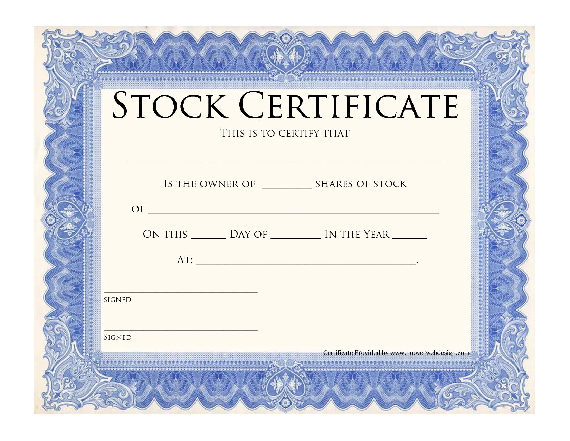
Digital Assets
A digital asset is anything that exists in a binary format and comes with the right to use. Data that do not possess that right are not considered assets. Digital assets include but are not exclusive to:
Intellectual property
  Video
  Audio recording
Financial Instruments
  Stocks
  Bonds
  Currencies
Records
  Certificates
  Ownership
  Education
  Permits
Notes:
In summary….
A digital asset can be anything that is stored electronically on a device such as a computer, phone or in the cloud. The value is not related to the storage device, it is related to the information, not any physical product.

Slide 12
To Blockchain or Not To Blockchain?

Slide 13
Data Storage
While public blockchains such as Bitcoin and Ethereum store all essential transaction data on the blockchain itself (i.e., on-chain), permissioned blockchains and distributed ledgers offer a broader set of possibilities.
There is a general trend towards limiting the data that needs to be stored on the network itself for various reasons, including privacy concerns, data storage constraints, processing costs, and network latency issues.

Slide 14
Data Storage
Distributed ledgers that store all data on-chain can enforce operations on the data without external dependencies as they are aware of the semantics and meanings of the underlying data.
Off-chain Distributed ledgers only store “fingerprints” (pointers) are not aware of the underlying data and can’t enforce operations on that data.
  Ledger functions more as a distributed timestamping server that provides a shared, real-time auditable log of records
  Auditors must have access to the underlying data stored off-chain to recreate the fingerprints and verify the integrity of the data

Slide 15
Data Storage

Slide 16
So What?

Slide 17

What Do I Need?
Ledger or distributed ledger
Distributed ledger or database
Database or distributed database
Database or blockchain
Permissioned or permission-less
Blockchain or Tangle

Slide 18
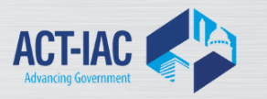
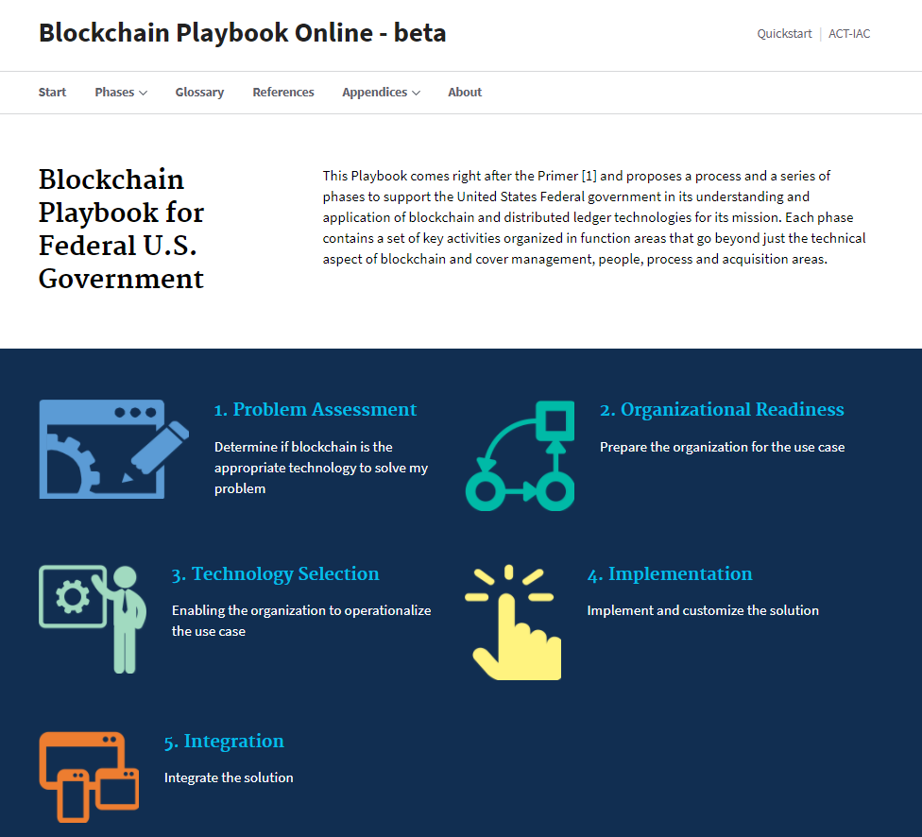

Slide 19


Government Impacts
Technology is moving fast
There is a global race for digital dominance
New capabilities allows governments to:
  Become global leaders in innovation
  Deliver the best value in real estate, acquisition, and technology services by:
  Delivering better value and savings
  Ensure more sustainable government
  Improve citizen's confidence in their governments
  Improve opportunities for small businesses
  Improve organizational performance
  Reduce fraud, waste and abuse
  Serving our Partners

Slide 20
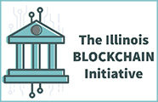
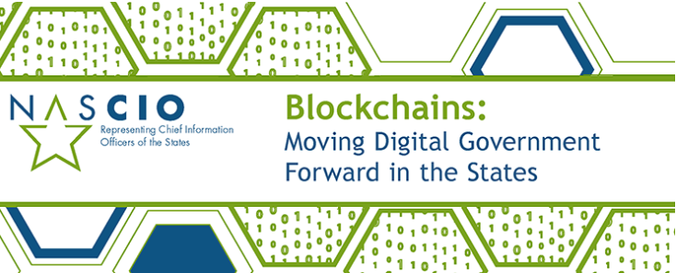

US States
According to National Association of State Chief Information Officers (NASCIO), State CIO’s stated:
  5% have adopted blockchain technology in support of some state government services
  5 % are having formal discussions about blockchain technology
  63% are still investigating blockchains in state government with informal discussions
  5% have had no discussion about blockchain technology.
Source: https://www.nascio.org/Portals/0/Publications/Documents/2017/NASCIO%20Blockchains%20in%20State%20Government.pdf

Slide 21
Review

Slide 22
Review of Objectives
Introduce the history of bitcoin and blockchain technology.
Discuss why cryptocurrencies and blockchain technologies are important.
Explain the basic principles of cryptocurrencies.
Explain the basic principles of blockchain technology.
Introduce smart contracts.
Introduce legal and regulatory considerations.
Discuss blockchain use cases, benefits, and risks.

Slide 23
How Do I Learn More?
www.GBAGlobal.org

Slide 24
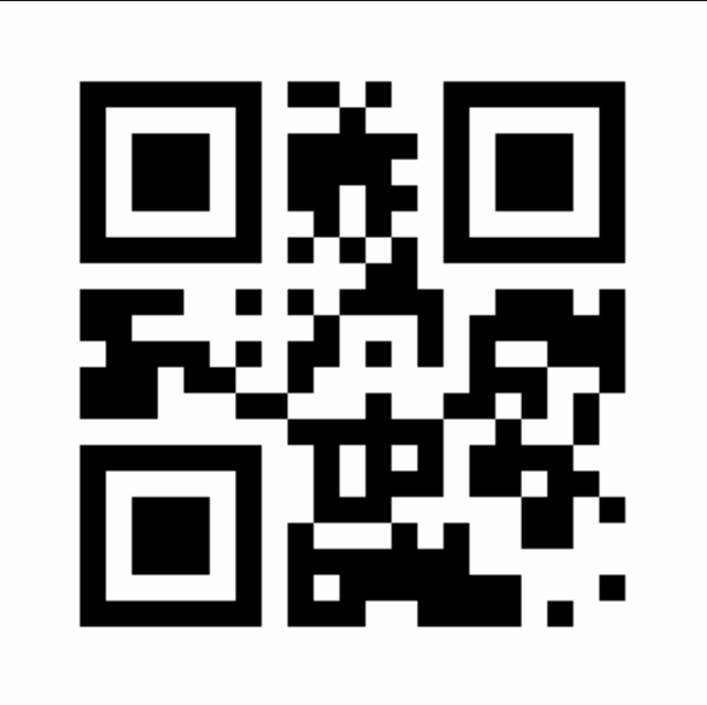
GBA Has Free Resources For Members
Member directory, publications, organizations, applications & products, merchants, jobs/contract positions, projects, proposals and grant opportunities & an opportunity to self promote.

Slide 25
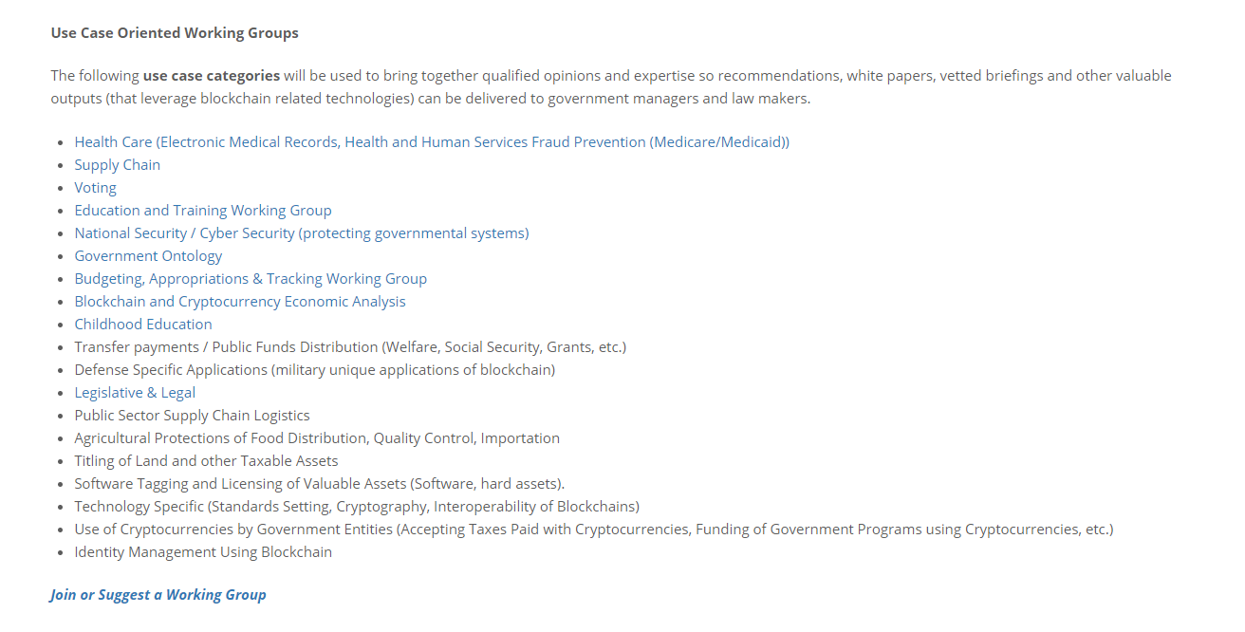
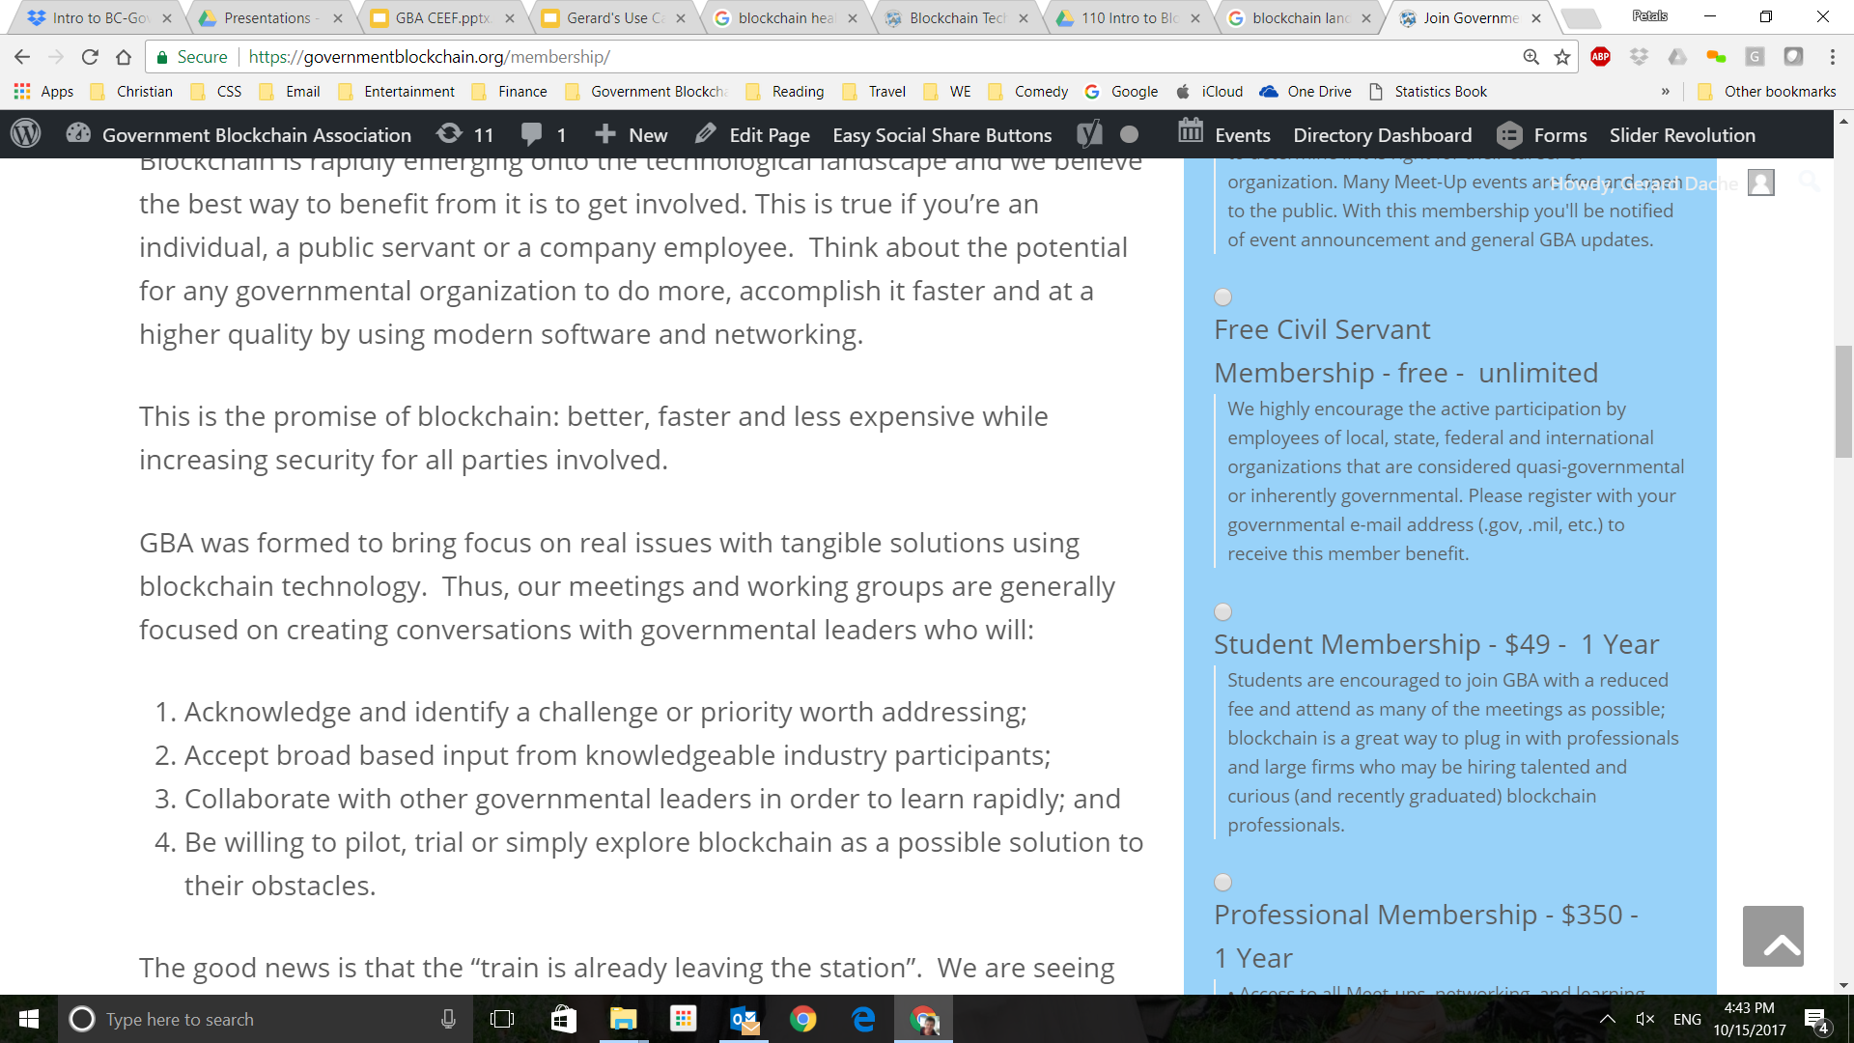
GBA Working Groups

Slide 26
GBA Global Chapters

Slide 27
For More Information
Gerard Dache
President, GBA
gerard.dache@GBAglobal.org
703-474-7939
Sandy Barsky
Deputy, IT Software Category Manager for Emerging Technology
General Services Administration
sandy.barsky@gsa.gov
202-438-4555

