Slide 1
Blockchain Voting Standards: GBA
January 30, 2020
Email: susan@wintergreenresearch.com

Slide 2
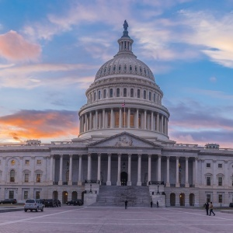
The Future of Money, Governance, and the Law – U.S. Capitol
Government Blockchain
Association
Election Committee Working on Election Security Standards

Slide 3
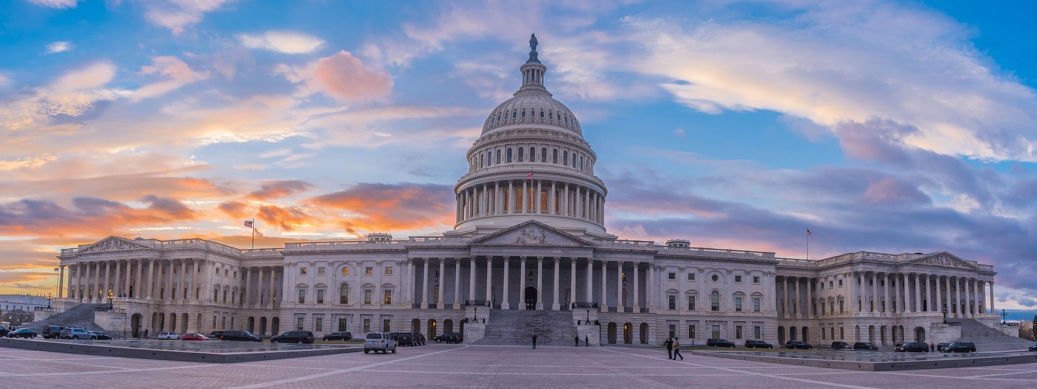
GBA Evolving Election Security Standards for Digital Audit
Elections Accessibility and Security
Susan Eustis inventor of first electronic voting machine
Panel leader

Slide 4

Blockchain Provides Answers to Voting Security
Standards need to address protection of devices 24 x 7
Voting equipment BIOS a severe vulnerability
Need to make fraud detectable
Middle of the night break-ins to stored voting equipment create a major vulnerability

Slide 5
Local Control of Elections is Fundamental
Each state different
Elections depend on local control
People work with neighborhood groups
Nomination process local
Poll sites local
Poll Wardens local
Two party watchers secure site
Make fraud detectable
Candidate campaigns local
Elections dependent on local control
Process
Testing Equipment
Local Vote Counting
Local Voting Sites
Nomina-tion

Slide 6

Electronic Voting Machine Security Status
There have been US elections where more votes disappear than the margin of winning in the election
Lack of consistent state government regulation
Some states do a much better monitoring job than others
Some states do a much better machine approval job
Lack of consistent standards
Almost no oversight of standards that do exist
Federal oversight impinges on state control
of election process

Slide 7

All Voting Systems Have Security Vulnerabilities: Before Polls Open:
Access to vote counting mechanism to adjust software
Access to vote counting system to adjust firmware
Tamper with software vote selection connections
Insert extra votes
Insert negative votes
Change vote counters
Encryption helps security

Slide 8
ES&S: 70 million Americans Vote Using ES&S Equipment.
Half the country votes on ES&S machines
ES&S-owned technology was in use when 150,000 voters inexplicably did not cast a vote for lieutenant governor
Lack of audit trail an issue
Indiana, ES&S’ systems were plagued by mishaps
In Johnson County brand-new machines faltered
Was difficult to know whether people had voted more than once
Recounts Core to Accurate election Process

Slide 9
Voting Machine Companies
ES&S: More than half the US votes on this system
Hart InterCivic
Dominion
Leading Voting Machine Companies
None Implements Digital Audit
Paper Audit not Accurate Trail

Slide 10
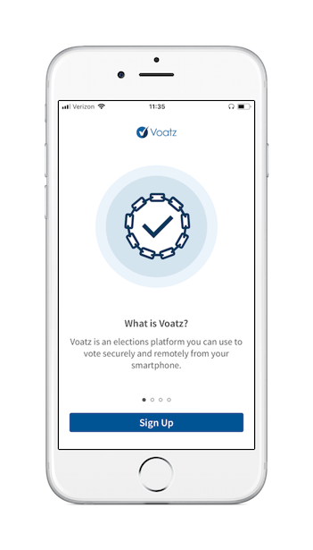
Voatz
Seeks to make voting safer and more accessible
Voting by Cellphone
Voting using blockchain

Slide 11

Voatz
Voatz: offers blockchain voting on cellphone for military
Voatz, developed by a Massachusetts software firm specializing in blockchain encryption
Blockchain Security for Protecting Vote Totals

Slide 12

Voting Standards
Need to protect integrity of each selection
Need to follow what has been learned from protecting financial transactions
Need to look at the once only once delivery of transaction information by IBM MQ
Standards prevent corruption
Message security specification
Once and only once counting
Secure audit trail
Secure server storage

Slide 13
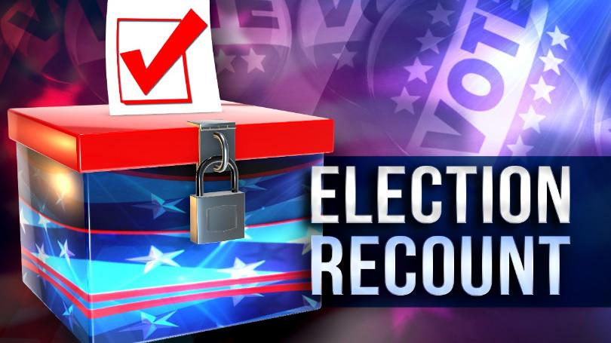
Blockchain
Blockchain a distributed database
Provides a secure, transparent vote count
Audit trail way to make, record and verify digitally
Way to authenticate each vote and broker the exchange
Blockchain eliminates the need for centralized control – instead all transactions are decentralized, and verified by the blockchain database itself in the distributed ledger.
Blockchain is a secure distributed ledger

Slide 14
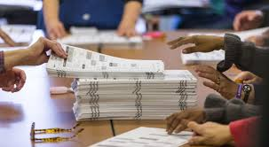
Election Machine Standards Basics: Close Elections Illustrate Need for Accurate Count
Prevent manipulation of the voting equipment
Prevent manipulation of the vote selections
Prevent manipulation of ballot presentation
Provide audit trail of every selection
Manage close elections
Protect the integrity of every voter’s selection
Integrity of the election process depends on party observers from each candidate

Slide 15
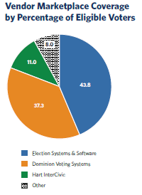
Election Machine Coverage
Voting machine companies limited in revenue
A few companies control the vote counting
Blockchain brings high level of technology, more sophisticated technology than is available to existing market leaders
Source: Penn Warton

Slide 16
Summary:
1. Standards needed to improve election process accuracy of count
2. Digital audit trail from blockchain adds to protections provided by paper ballot audit trail
3. Standards example can be gleaned from MQ and Websphere, the leading financial messaging systems

Slide 17
WinterGreen Research
Industry reports focus on opportunities to expand existing markets
Focus on innovation
Focus on artificial intelligence
Major trillion dollar markets evolving from the new industrial revolution
Studies provide primary analytical insight about the market participants

Slide 18
WinterGreen Research, Inc.
WinterGreen Research is an independent research organization entirely funded by selling market research studies
Research strategy relates to identifying market trends
Discovering, tracking, and thinking about markets is a priority
Business is conducted with integrity above all else
New studies describe electric vehicles, 5G, youth sports, utility scale energy storage, lithium ion batteries, and Global Renewable Energy: 100%, the latter being from which the following power point presentation is derived.
Please visit www.wintergreenresearch.com and buy studies for $4,500. Media inquiries invited.

Slide 19







WGR Worldwide Market Presence
Worldwide Market Research Presence
Telecommunications
Finance, Banking and Insurance
Healthcare
Internet
Software - Blockchain
Hardware
Energy
Voting

Slide 20
WinterGreen Research
About the Principal Author
Susan Eustis, President of WinterGreen Research, is a senior analyst. She has done research in communications, healthcare equipment, and computer markets and applications. She invented the first electronic voting machine.
As the lead author of many market research studies, she is recognized for including coverage on a range of topics including: Finland data Centers, Blockchain, AI, Hyperscale Data Centers. Robots, Agricultural Robots, Surgical Robots, Drones. Amateur League Sports Software, Youth League Sports Software, and Sports Coaching Platforms.
Ms. Eustis was named Top Woman CEO in 2012 by Who’s Who Worldwide. She was named Top Woman Market Research Analyst in 2012, 2013, 2014, 2015, 2016, 2017, 2018, and 2019. She has been twice featured on the cover of the Women of Distinction magazine. Regarding Youth Sports Topics Ms. Eustis was cited in a recent Time Magazine article and major media articles on Youth Sports market growth. She was featured in many recent Wall Street Journal, New York Times, Barron’s, Forbes, Bloomberg, HBO, and London Times articles on the topic of youth sports. Last week Ms. Eustis was quoted by the Barron’s publication Market Watch on youth sports and by the Harrisburg Gazette. Ms. Eustis is a graduate of Barnard College.

Slide 21
WinterGreen Research, Inc.
35 Distributors Worldwide including Research and Markets and Global Information GII
January, 2020
Email: susan@wintergreenresearch.com
781 863 5078 617 852 7876

