Slide 1
Blockchain & Energy Building Resilient Global Infrastructure
Gerard Dache
Executive Director
Government Blockchain Association
Gerard.dache@GBAglobal.org
www.GBAglobal.org

Slide 2
Introduction - GBA
Non-Profit Membership Organization
Membership includes:
Civil servants in over 500 government offices globally
Private sector companies of all sizes
Professional members
Student members
Over 50 working groups
Consisting of world-renowned experts
Creating opportunities for all members to
Connect, Communicate and Collaborate

Slide 3
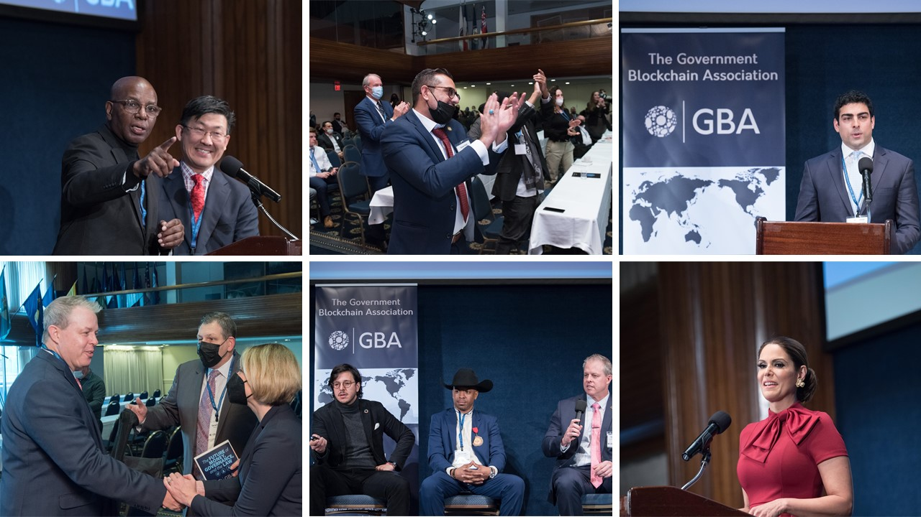
Introduction – GBA (Continued)
Over 50 Energy Relegated Posts including:
Five Ways that Blockchain is Reshaping the Energy Industry
Blockchain in Carbon Credit Space: Is Blockchain the savior?
Over 280 Videos in our free online video library including:
Doug Miller - Energy Blockchain Use Cases - Blockchain & Infrastructure
Derek Khanna – Head of Policy, Bitcoin Advocacy Project
Decentralized solar and internet project
Events
Weekly & Monthly Online Events
Blockchain & Crypto for State & Local
The State of Cryptocurrency
Government Blockchain Public Forum
Notes:
https://gbaglobal.org/blog/2017/12/07/five-ways-blockchain-reshaping-energy-industry

Slide 4
Energy Industry Challenges & Solutions

Slide 5
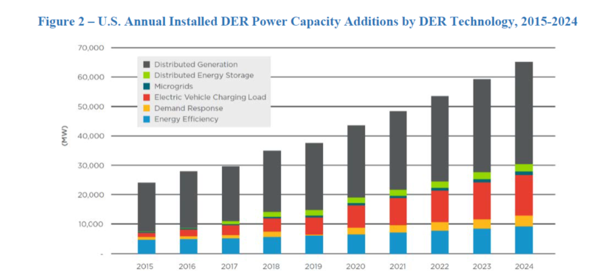
Distributed Energy Resources (DERs)
Demand Side Management (DSM)
Distributed Generation (DG)
Distributed storage (DS)
DER Aggregation
Notes:
Demand side management (DSM) - consists of electric loads whose usage can be altered either permanently or temporarily. This includes energy efficiency and demand response (DR).
Distributed Generation (DG) - consists of generating resources that produce electricity including combined heat and power (CHP), rooftop photovoltaic (PV) solar, reciprocating generating sets (generating heat and electricity), gas microturbines, and fuel cells.
Distributed Storage (DS)- consists of resources that have the capability to both absorb electricity and supply energy back at a later time. DS technologies include thermal energy storage, battery storage, and flywheels.
DERs can be aggregated to provide blocks of useful resources. Forms of aggregation include blocks of DSM resources, virtual power plants (VPPs), and microgrids.
End-use consumers often invest in DERs for the purposes of reliability and reduction of energy bills. And in certain cases, DERs can participate in wholesale markets. These include DR, cogeneration, wind and solar connected directly to the distribution system, and DS.
In the future, evolution of additional market opportunities for DERs is expected. This could include participation of aggregated DERs in wholesale markets, as well as development of distribution level markets.
In such markets, DERs have the potential to provide capacity, energy, and ancillary services. DERs may also provide resources for non-wires alternatives (NWAs) utilized by distribution utilities as an alternative to capital investment in the grid.

Slide 6
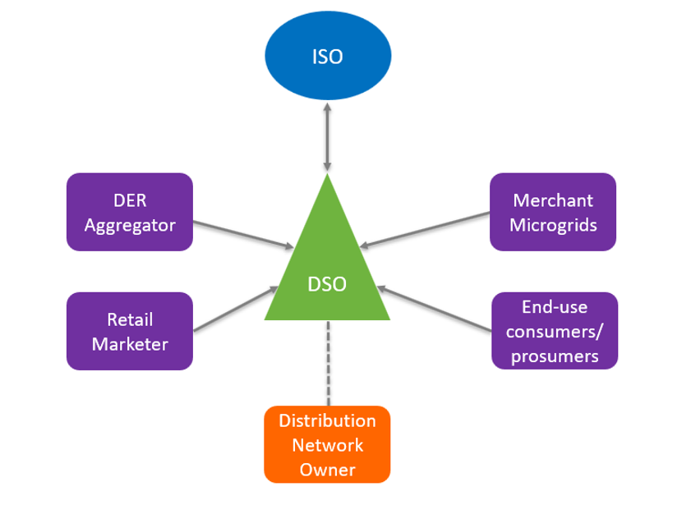
System Operator Models
Notes:
With the growth of distributed energy resources (DERs) and the potential benefits of using DERs as grid resources, there is a greater need for an entity to manage the scheduling and dispatch of these resources in a manner like how Independent System Operators (ISOs) and other balancing authorities schedule and dispatch transmission-level resources.
One potential model to provide this function is the distribution system operator (DSO). The DSO would provide the same function for distributed energy resource dispatch, distribution system operations, and facilitation of distributed markets that ISOs provide for the bulk electric system. Like ISOs, the DSO would be an unbiased entity without ties to any market participant. The DSO would interact with the distribution utility, which would likely become a distribution network operator (DNO), simply responsible for maintaining and operating the distribution facilities much like a transmission operator (TO) in the ISO model. To facilitate active retail markets, the DSO would bid aggregated distributed resources into competitive ISO wholesale markets in competition with centralized generators.

Slide 7
Changing Times -Decentralization
Distributed energy resource aggregators are exploring how local energy devices can participate in power systems and earn compensation
Utilities are facing a meaningful shift as consumers become partners (Prosumers)
The Distribution System Operator (DSO) model will drive how utilities can manage more distributed and participatory systems
Utilities are looking for ways that local energy resources can offer services to wholesale markets as well as to support the distribution system.
Utilities focusing on a DSO future must invest in technologies and programs that can evolve alongside the role of the consumer

Slide 8
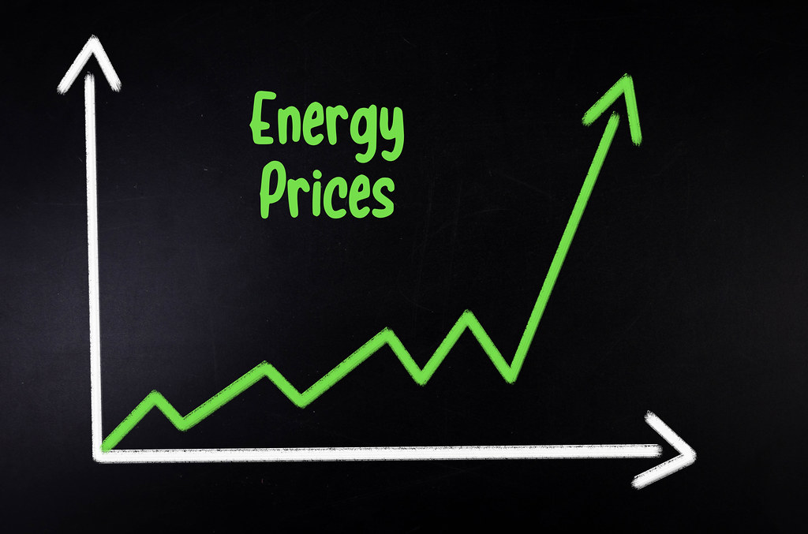
Affordability (10% Increase in 2023)
Driven by
Higher natural gas prices
Supply & demand
Provisioning costs
Market disruptions (Ukraine)
Trade off –
Capital investment
Lower consumer prices
Notes:
Notes: https://www.utilitydive.com/spons/top-5-challenges-facing-distribution-utilities-in-2023/638222/

Slide 9
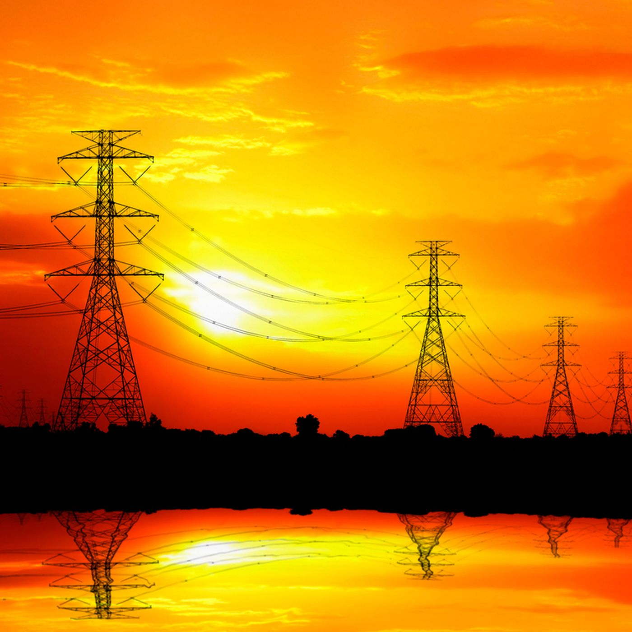
Blockchain Uses to Reduces Costs
Provisioning Costs
Proof of Concept - tracking equipment and building materials through their chain of custody.
Energy Web Asset Management
Customizable solution that packages
Self-sovereign identity and access management tools all types of resources
Trading System Maintenance
ENI, BP, Wein Energie pilot
Yielded a 30-40% cost reduction in gas trades
Labor, data management, data visibility, settlement delays, and intra-system communications

Slide 10
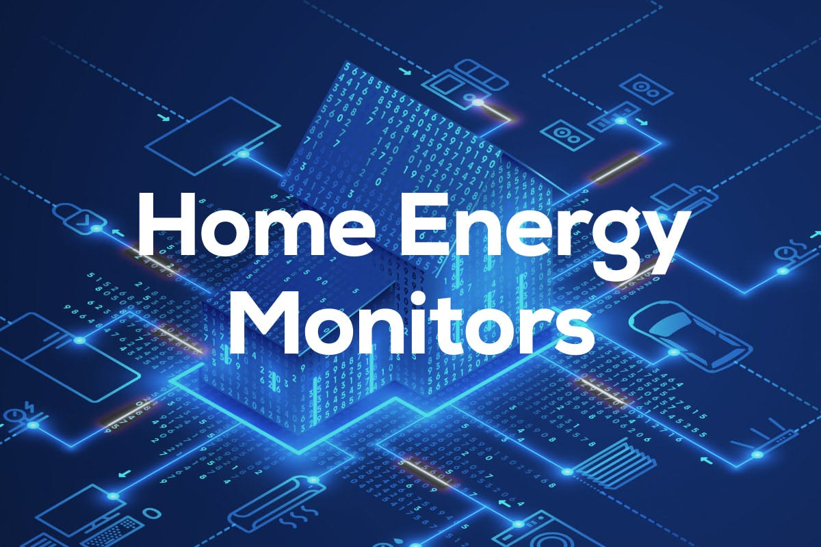
Blockchain Uses to Reduces Costs (Cont)
Managing Demand
New market mechanisms are needed for energy consumption
Time-differentiated rates nudge consumption away from peak hours,
Currently lacks granularity
Multi-hour block pricing not adequate for sending market signals
Need real-time accounting
Blockchain technology can be used to distributed ledgers to track individual energy behavior and reward it
Carbon Credits
PG&E and BMW are working to create carbon credits for EV drivers
Based on the emissions profile of when they charge their cars
Charging when the grid is flush with solar generation produces greater carbon reduction

Slide 11
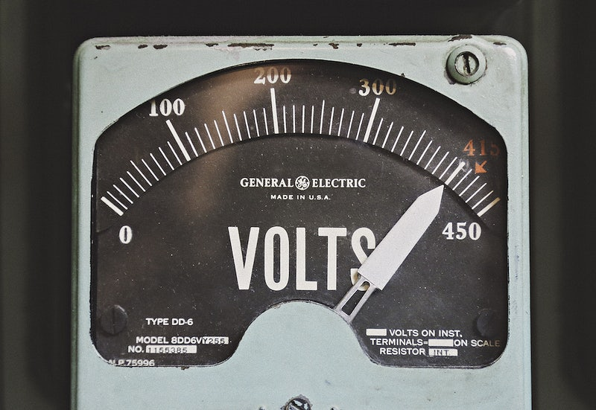
Data Management
A tidal wave of data is collected from:
Smart meters /IOT devices
Distributed energy resources, and
New monitoring devices
Critical utility datasets are not interoperable with others
Limited capability to transform massive amounts of data into actionable insights

Slide 12
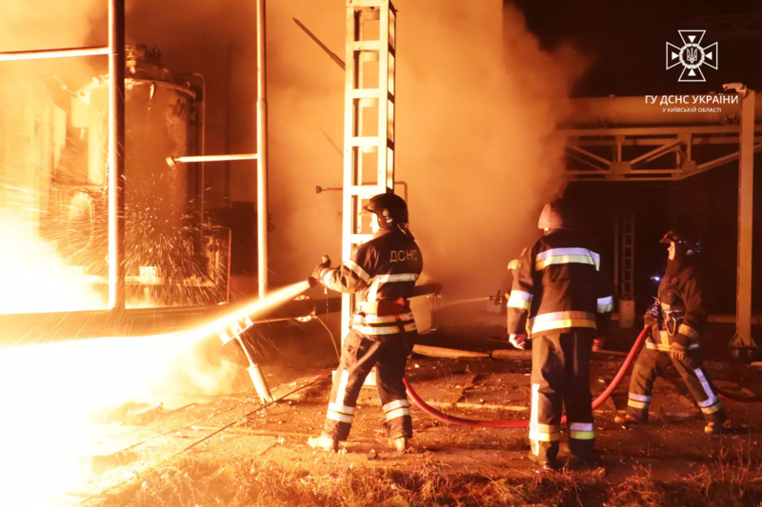
Grid Resilience
Storing and transporting energy (oil/gas/electricity)
Heavily regulated
Requires disaster/risk mitigation and infrastructure maintenance
Blockchain technology supports multi-stakeholder information sharing, especially for asset tracking.

Slide 13
Grid Resilience (Continued)
Former US National Security Council member, Brian Cavanaugh
Hostile actors are increasing their understanding US critical infrastructure, its interconnected nature and the vulnerabilities of our system.
US advisories are mapping pipelines and the energy grids to plan and execute attacks on critical utilities like energy
Oak Ridge National Laboratory - U.S. Department of Energy
Using blockchain technology for first-of-its-kind demonstration
New power system communications framework
Rapidly respond to anomalies
Notes:
https://www.youtube.com/watch?v=DAYEef7RNJo&t=416s
https://www.utilitydive.com/news/doe-tests-blockchain-technology-to-ensure-grid-security-resilience/637364/

Slide 14
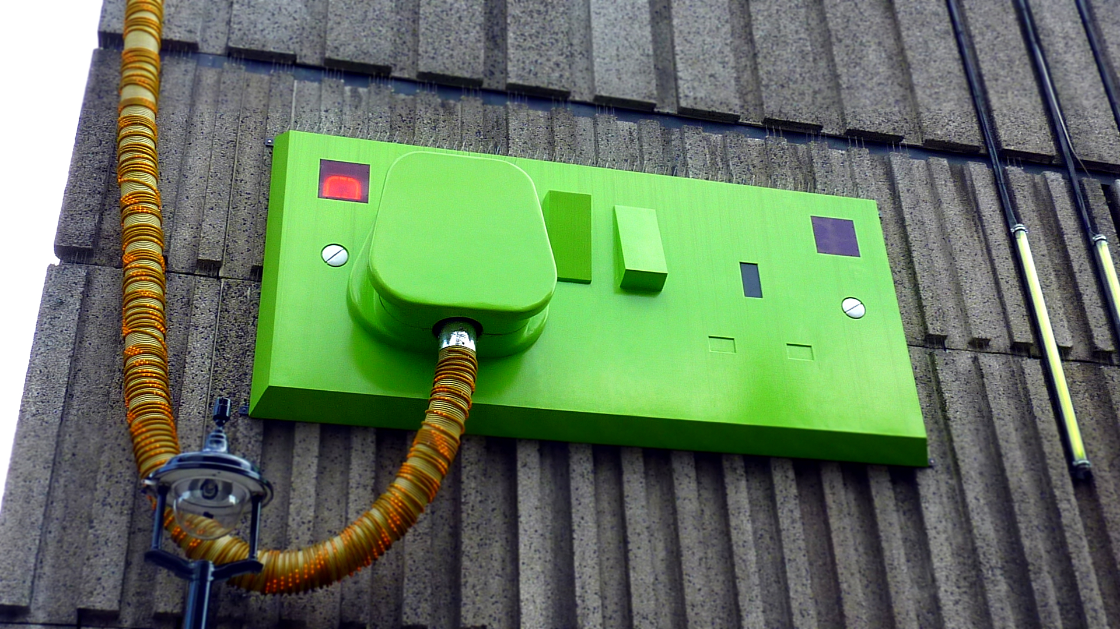
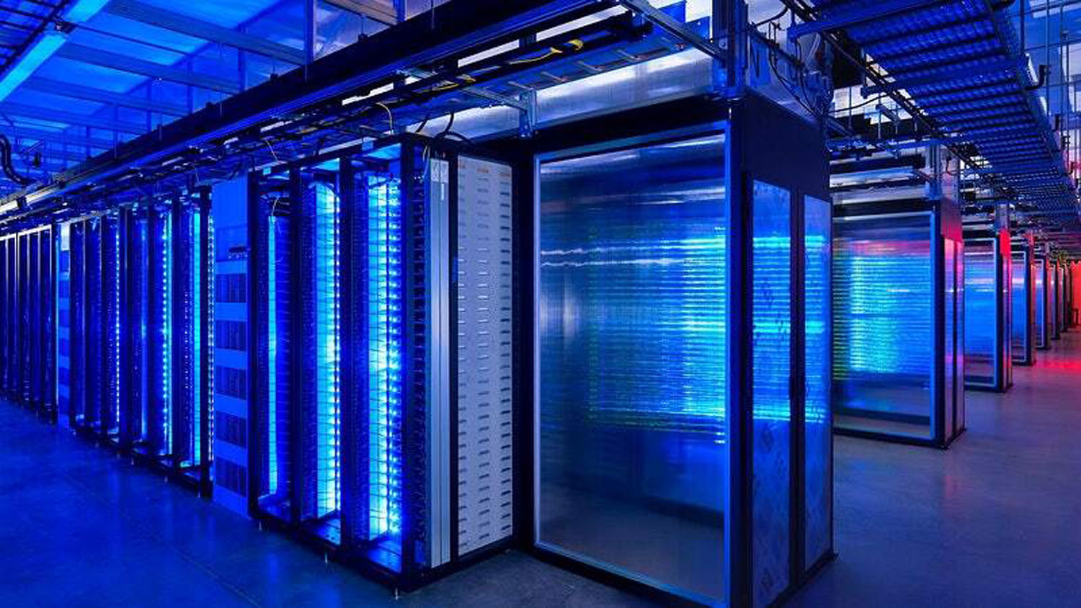
Data Management
New Environmental, Social and Governance (ESG) reporting requirements
European Union
United States
… Global
Mandatory nonfinancial reporting requirements
Applicable if your enterprise is part of the value chain of an entity that is required to report
Organizations will be sending and receiving ESG questionnaires to gather the data necessary for their ESG reports.

Slide 15
Data Management (Cont)
Retailers and DSOs:
Develop new business models that encourage customers to become prosumers
Regulatory requirements to consume energy from local green sources.
Integrate with energy data management & billing systems using blockchain as a transactional system

Slide 16
Data Management (Cont)
Grids are become more diverse and dynamic
Increasing risks associated with
Maintaining point-to-point integrations between thousands of participants
Scaling existing systems to interface with an ever-increasing array of stakeholders
Assets to aggregators
Regulators
Retailers
EW Data Exchange
Streamlines communications and data processing between organizations without a central broker
Any protocol, any use case, all with a single integration

Slide 17
Availability & Capacity Management
Demand Increases
Technology
Data Centers
Communications
Games
Electric Vehicles
70 new models, tax incentives, fleet purchases explodes adoption
EV chargers can increase a home’s peak load by 40% - 100%
Stresses transformers, unpredictable demand, reliability impacted
Grids not prepared
Unmanaged EV charging loads during peak periods could significantly increase power supply and infrastructure costs

Slide 18
Availability & Capacity Management (Cont)
Limited Visibility
Utilities lack visibility into voltage conditions and loads at transformers and other midline equipment
As EV adoption and other demand changes load profiles, understanding the impact on midline equipment is crucial to ensure reliability
Without visibility, utilities may be forced to overspend on overly-conservative upgrades for thousands of pieces of equipment

Slide 19
Decentralized Electricity Distribution
Challenge: Connecting end-users with the grid directly
Blockchain technologies
IoT devices
Solution: enable consumers to trade and purchase energy directly from the grid rather than from retailers
Powerledger develops software solutions for the tracking, tracing and trading of renewable energy

Slide 20
Summary –Energy Supply Chain
The supply chain starts with the extraction or capture of natural resources and includes the process to transform them into the multiple final products or sell products to end users (i.e., gas stations).
Energy products are directed towards different customers, have different environmental regulations, and require various methods of transportation
Blockchain-enabled supply chains optimize wide-scale and multi-product coordination
The ability of a blockchain technology platform to record and track supply chains could stop an immense amount of waste.
Platforms that utilizes smart legal contracts can replace time, energy, and money currently required by all involved energy companies would save time and money by minimizing loss and theft..

Slide 21
Where do we go from here?

Slide 22
Decentralization – New Paradigm
New paradigms require new responses:
New vocabularies
New technologies
New relationships
New standards

Slide 23
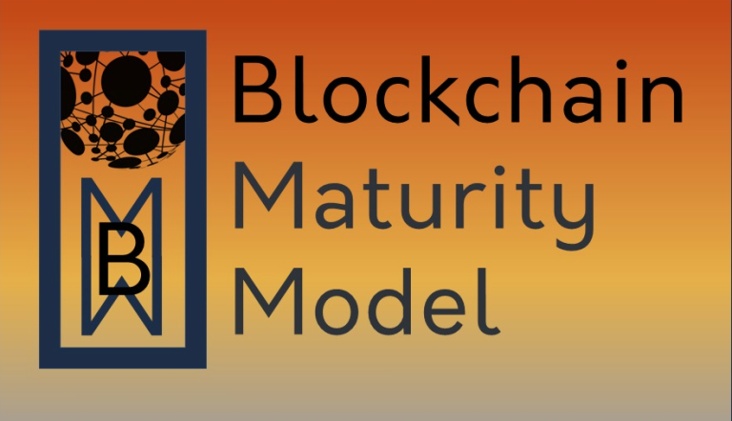
Blockchain Maturity Model (BMM) Course

Slide 24
Blockchain Maturity Model Elements
Distribution
Privacy
Governance
Reliability
Identity Management
Resilience
Infrastructure Sustainability
Security
Interoperability
Performance
Synchronization
Notes:
Here are the eleven elements of the blockchain maturity model. We will be discussing the elements in further detail during this course.
Distribution
Governance
Identity Management
Infrastructure Sustainability
Interoperability
Performance
Privacy
Reliability
Resilience
Security
Synchronization or Consensus

Slide 25
BMM Supplements
Banking & Finance
Healthcare
Voting
Gaming
Next Project:
Energy BMM Supplement
Project Team Forming now

Slide 26
Join Us & Work With Us
Energy Working Group Participation
Work with industry leaders from organizations including:
Clean Energy Buyers Association
Powerledger
US Department of Energy
Taqanal Energy
CarbonMeta Technologies, Inc.
GRN Energy
Energy Web
Patriciate in projects & gain valuable experience

Slide 27
For More Information
https://bit.ly/bc-energy-1
Gerard Dache
Executive Director
Government Blockchain Association
gerard.dache@GBAglobal.org
www.GBAglobal.org

