Slide 1
Government Blockchain Association (GBA) Healthcare Specialist Program Healthcare Megatrends & Intro to Blockchain
Draft 0.1

Slide 2
Agenda
Introductions
Emergence of blockchain
GBA healthcare specialist roadmap
Healthcare megatrends
Intro to blockchain in healthcare

Slide 3
Blockchain Emerging as a Leader
PwC Global 2018 survey of
600 executives from 15 territories
84% say their organizations are involved with blockchain
Gartner forecasts that by 2030:
More than US $3 trillion of business value
10% to 20% of global economic infrastructure will be running on a blockchain
Notes:
PwC Global states: In PwC’s 2018 survey of 600 executives from 15 territories, 84% say their organizations have at least some involvement with blockchain technology.
Everyone is talking about blockchain, and no one wants to be left behind.
It’s easy to see why. As a distributed, tamperproof ledger, a well-designed blockchain doesn’t just cut out intermediaries, reduce costs, and increase speed and reach. It also offers greater transparency and traceability for many business processes.
Gartner forecasts that blockchain will generate an annual business value of more than US $3 trillion by 2030. It’s possible to imagine that 10% to 20% of global economic infrastructure will be running on blockchain-based systems by that same year.

Slide 4
Megatrends
Blockchain enables
Privacy and control of data back in the hands of citizens
Trust and integrity to be established without reliance on third-party intermediaries.
What does this mean for Healthcare?
Healthcare sits at the intersection of several Megatrends.
Notes:
Megatrends
Blockchain promises to put privacy and control of data back in the hands of citizens. Trust and integrity will be established without reliance on third-party intermediaries.
What does this mean for Healthcare?
Healthcare sits at the intersection of several Megatrends.
Megatrends are sustained, global, social, economic, political, environmental or technological changes. These trends will make a considerable and durable impact on the healthcare environment by creating new opportunities, challenges and risks.
Blockchain, AI IoT, Genomics Data, Wearable Devices, Culture, and the immense collection of DATA.

Slide 5
Megatrends (Cont)
Megatrends are
Sustained
Global
Social
Economic
Political
environmental or
technological changes
Significant and durable impact on the healthcare by presenting
new opportunities
challenges &
risks
Blockchain, AI IoT, Genomics Data, Wearable Devices, Culture, and the immense collection of DATA.
Notes:
Megatrends
Blockchain promises to put privacy and control of data back in the hands of citizens. Trust and integrity will be established without reliance on third-party intermediaries.
What does this mean for Healthcare?
Healthcare sits at the intersection of several Megatrends.
Megatrends are sustained, global, social, economic, political, environmental or technological changes. These trends will make a considerable and durable impact on the healthcare environment by creating new opportunities, challenges and risks.
Blockchain, AI IoT, Genomics Data, Wearable Devices, Culture, and the immense collection of DATA.

Slide 6
GBA Healthcare Certification Roadmap
Module 1 Megatrends & Intro to blockchain technologies
Module 2 Blockchain in healthcare – The big picture
Module 3 Blockchain in clinical trials management
Module 4 Blockchain in data management/access/ control
Module 5 Blockchain in drugs supply chain & anti-counterfeiting
Module 6 Blockchain in Insurances

Slide 7
GBA Healthcare Certification Roadmap
Module 7 Blockchain in improving administrative processes
Module 8 Blockchain in a value-based healthcare system
Module 9 New business models & the role of tokenization
Module 10 From acute care to prevention
Module 11 Regulatory
Module 12 Tech implementation & challenges
Module 13 Business Challenges
Module 14 Cultural Challenges

Slide 8
Healthcare Megatrends
According to Gallup, US adults state the most important problems are
Poor government leadership and
Healthcare
17% stated that healthcare was #1 problem
Chronic illness
Aging populations
Digitization of Healthcare Information
Technological – Biological Integration – Explosion
Workforce disruptions
Source: https://bit.ly/2Bx4vLs
Notes:
1) Chronically sick patients, such as those with diabetes, must receive greater attention. The disease is a population health crisis that is very costly for providers.
2) Aging baby-boomers and millennials are demanding more from their providers. Demand for talent in fields such as nursing far outpaces the supply, and this problem will only grow more exaggerated unless providers take action.
3) With increased digitization, providers must harness the power of predictive analytics. Providers have never before had access to this level of patient information and using it can not only revolutionize care but also patient education.
4) Technological and biological fusion will have a dramatic impact on patient care. This means that all sorts of tech companies will now be entering the healthcare space, greatly changing the environmental makeup of the industry.
5) Workforce disruptions, aggravated by mergers and acquisitions, are taking a dramatic toll on employee engagement. Cultural changes that come from merging with a new system can greatly disconnect clinicians from their organization, which systems must be mindful of moving forward.
Source: https://bit.ly/2Bx4vLs

Slide 9
Challenges Facing Healthcare Industry- The Big Picture

Slide 10
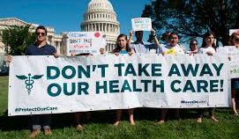
Rising Costs
Population living longer, more active lifestyles
Healthcare costs rising faster than inflation (and expected to continue)
US healthcare spending will grow at an annual rate of 5.8 % from 2015 to 2025
1.3 % higher than the GDP
Very troubling for healthcare leaders
Leaders must find alternative methods to combat the rising costs of care. Options include:
Grants & funding for research and setting up new programs to adapt to rapid change
The Health Services Research Information Central (HSRIC) provides a list of grants, funding and fellowships
Partner with innovative companies in proof of concept projects
Notes:
As more people strive to live longer, healthier and more active lifestyles, healthcare concerns increase and so does the costs. Research reveal healthcare costs and spending often rise at rates exceeding inflation, and is expected to increase in the future. The Society for Human Resource Management present that the Office of “1 the Actuary at the Centers for Medicare and Medicaid Services estimates that aggregate health care spending in the United States will grow at an average annual rate of 5.8 percent from 2015 through 2025, or 1.3 percentage points higher than the expected annual increase in the gross domestic product.” This causes a huge concern for leaders as they seek to provide coverage for their employees.
Leaders must find alternative methods to combat the rising costs of care. They must do the research to find funding, grants and contributors to help them conduct research, set up programs and implement processes at the pace of change. The Health Services Research Information Central (HSRIC) provides a list of “grants, funding and fellowships” leaders might consider helping them train staff members, open up public information sites or labs for processing paperwork and other initiatives.

Slide 11
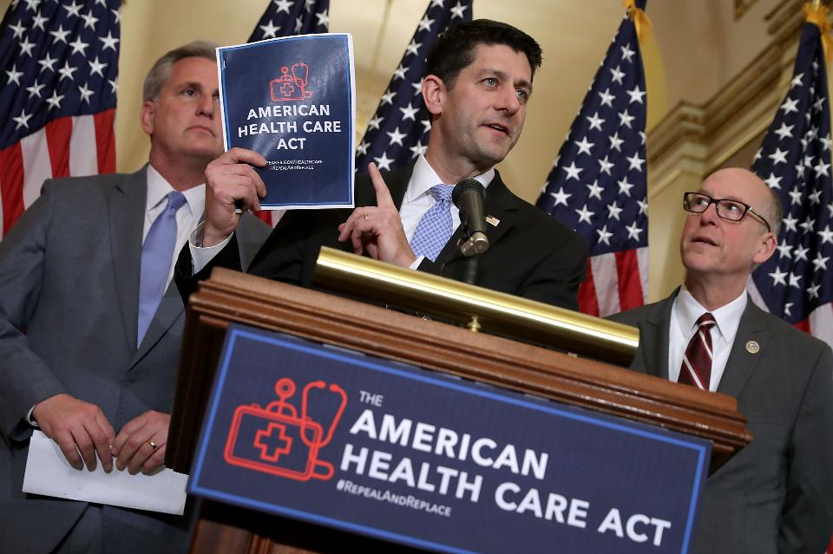
Regulatory Challenges
Philosophical differences between major political parties combined with increasing financial pressures result in shifting legal and regulatory requirements.
The change in administrations or control over branches of government have profound impacts on national healthcare policy.
This causes changes in administrative rules to ripples through the healthcare system.
Notes:
Healthcare has taken center stage in the political arena under the Trump administration. As tension and uncertainties mound regarding Trump’s threats to repeal and replace Obamacare, insurance and medical executives scramble to determine “what business is going to look like in the years ahead” (Gomes, 2016). Larry Levitt, a senior executive with the Kaiser Family Foundation emphasized any transition from one program to the next will require time for insurers to adjust to the “reverse disruption” and “overhaul to how individuals buy policies” (Gomes, 2016). Healthcare leaders must inform themselves, and staff on how to handle the changes in coverage. Currently, there is a “noticeable gap between the belief that change is necessary and actual support for specific reform plans designed to achieve that change” (Wood, 2011). Leaders will be challenged to counter frustration and confusion from Americans, once deemed otherwise uninsurable, who have formed a sense of security their current coverage, argues Wood (2011).
Regulatory challenges drive up the cost of providing services and care. As the Trump administration strive to regulate Medicare and Medicaid eligible healthcare providers are overwhelmed by regulated “changes and new reporting requirements” (Brown, n.d.). Research provide that healthcare leaders are further burdened to comply with a variety of newly revised standards including the Health Insurance Portability and Accountability Act (HIPAA), Centers for Medicare and Medicaid Services (CMS), and Joint Commission on Accreditation of Healthcare Organizations (JCAHO). To combat these challenges, the healthcare provider needs actively engage in awareness and information sharing regularly. Studies suggest leaders must implement document control programs, compliance training, routine audits and address non-conformance incidents immediately utilizing integrated healthcare platforms.

Slide 12
Regulatory Challenges (cont)
The existing regulatory framework is complex and results in strains on the healthcare system. These include requirements resulting from:
Health Insurance Portability and Accountability Act (HIPAA)
Centers for Medicare and Medicaid Services (CMS), and the
Joint Commission on Accreditation of Healthcare Organizations (JCAHO)
This highlights the need for document and records management systems that have integrity, are easy to verify and are unalterable.
Blockchain solutions may be excellent solutions to address many of these challenges
Notes:
Healthcare has taken center stage in the political arena under the Trump administration. As tension and uncertainties mound regarding Trump’s threats to repeal and replace Obamacare, insurance and medical executives scramble to determine “what business is going to look like in the years ahead” (Gomes, 2016). Larry Levitt, a senior executive with the Kaiser Family Foundation emphasized any transition from one program to the next will require time for insurers to adjust to the “reverse disruption” and “overhaul to how individuals buy policies” (Gomes, 2016). Healthcare leaders must inform themselves, and staff on how to handle the changes in coverage. Currently, there is a “noticeable gap between the belief that change is necessary and actual support for specific reform plans designed to achieve that change” (Wood, 2011). Leaders will be challenged to counter frustration and confusion from Americans, once deemed otherwise uninsurable, who have formed a sense of security their current coverage, argues Wood (2011).
Regulatory challenges drive up the cost of providing services and care. As the Trump administration strive to regulate Medicare and Medicaid eligible healthcare providers are overwhelmed by regulated “changes and new reporting requirements” (Brown, n.d.). Research provide that healthcare leaders are further burdened to comply with a variety of newly revised standards including the Health Insurance Portability and Accountability Act (HIPAA), Centers for Medicare and Medicaid Services (CMS), and Joint Commission on Accreditation of Healthcare Organizations (JCAHO). To combat these challenges, the healthcare provider needs actively engage in awareness and information sharing regularly. Studies suggest leaders must implement document control programs, compliance training, routine audits and address non-conformance incidents immediately utilizing integrated healthcare platforms.

Slide 13
Medicinal & Technological Challenges
Healthcare delivery methods are changing
Healthcare providers are facing physician shortages and need “low-cost alternatives to office visits” and in-patient care
Telemedicne
Cyber doctor interactions
Interactive technology like wearables, remote diagnostic equipment and wifi enabled devices supports virtual visits
Virtual visits works well for common conditions such as colds, flu, pink eye and sprains” and “more easily manages patient care for chronic illnesses that require daily interventions
Notes:
The practice of medicine and technology has created opportunity and challenges in the way providers practice medicine today and in the future. Today’s health organizations are facing physician shortages and need “low-cost alternatives to office visits” and in-patient care (Austin, Bentkover, & Chait, 2016). Five to ten years from now, leaders can expect more of a shift from the traditional office visits and prescreening in favor of virtual and cyber doctor patient interactions. Sanicola (2016) argue “telemedicine” – the use of “electronic communication” such as “two-way video, phone, email, wireless tools, and other forms of telecommunications technology.” Telemedicine “works well for treating common conditions such as colds, flu, pink eye and sprains” and “more easily manages patient care for chronic illnesses that require daily interventions” adds Sanicola (2016). The rapid change requires leaders to acquire and develop methods for maintaining and accessing private sessions and data of patients.
Saslow (2016) argue the pressure and “growing influx of patient data, legal requirements for strict privacy and security, rapidly advancing clinical technology increases costs, and other factors. At a minimum, leaders should explore innovative ways to manage and store the information adequately adds Saslow (2016). Heathfield, Pitty and Hanka (1998) posit leaders must “understand and predict the behavior of systems and provide important knowledge to inform further developments.” Once the leader understands the system, they can prepare training strategies for the staff and the patient. The leader’s training efforts must be a continuous initiative to keep up with the continual change of technology and medicine in the future.

Slide 14
Medicinal & Technological Challenges
Need for new procedures, tools and techniques
Explosion of patent data
Storage & security concerns
Privacy concerns
New opportunities for data aggregation for research (still privacy concerns)
The pressure and “growing influx of patient data, legal requirements for strict privacy and security, rapidly advancing clinical technology drives up costs, and other factors.
Blockchain technologies and artificial intelligence can support diagnosis and treatment of patients whild addressing privacy, security
Notes:
The practice of medicine and technology has created opportunity and challenges in the way providers practice medicine today and in the future. Today’s health organizations are facing physician shortages and need “low-cost alternatives to office visits” and in-patient care (Austin, Bentkover, & Chait, 2016). Five to ten years from now, leaders can expect more of a shift from the traditional office visits and prescreening in favor of virtual and cyber doctor patient interactions. Sanicola (2016) argue “telemedicine” – the use of “electronic communication” such as “two-way video, phone, email, wireless tools, and other forms of telecommunications technology.” Telemedicine “works well for treating common conditions such as colds, flu, pink eye and sprains” and “more easily manages patient care for chronic illnesses that require daily interventions” adds Sanicola (2016). The rapid change requires leaders to acquire and develop methods for maintaining and accessing private sessions and data of patients.
Saslow (2016) argue the pressure and “growing influx of patient data, legal requirements for strict privacy and security, rapidly advancing clinical technology increases costs, and other factors. At a minimum, leaders should explore innovative ways to manage and store the information adequately adds Saslow (2016). Heathfield, Pitty and Hanka (1998) posit leaders must “understand and predict the behavior of systems and provide important knowledge to inform further developments.” Once the leader understands the system, they can prepare training strategies for the staff and the patient. The leader’s training efforts must be a continuous initiative to keep up with the continual change of technology and medicine in the future.

Slide 15
Training & Education Challenges
The rate of new information concerning diagnosis, treating and monitoring is overwhelming
Fueled by genomic research
Personalized health
Increasingly comprehensive public health system
Exploding sources of healthcare data
Healthcare data integrity becoming increasingly important
How do we transmit trusted information to healthcare providers while maintaining the integrity of the information
Blockchain and related technologies can provide solutions in the collection, analysis, assembly, distribution and validation of healthcare information.
Notes:
Professional development is the key. Healthcare leaders must take steps to assess, develop and fine tune key personal and professional skills to remain proficient (Northouse, 2013). Most training initiatives, per Dunn (1995) remain centered around “traditional clinical interview with its focus on acute illness,” but healthcare providers will be challenged to change that dynamic. The future will require healthcare leaders to take more of a hands-off approach; involve patients more in personal care; offer alternatives to current practice and make themselves and staff available to forms of communicating with the patient without a trip into the office (Gomes, 2016).

Slide 16
Ethical challenges
Healthcare fraud, waste & abuse
Insurance fraud
Counterfeit drugs & medical device knock offs
False medical credential
Falsified research data and conclusions
Compromised pharmaceutical supply chains
Many, many more….
Blockchain supports the providence, traceability and reliability of healthcare data
Notes:
Ethical challenges in healthcare is a big deal. Recent news stories support this claim with headlines about ethical violations of healthcare providers. In 2016 the British Broadcast Center (BBC) reports Dr. Paolo Macchiarini, was accused of providing misleading medical research which led to the deaths of seven patients (Kremer, 2016). More recently an Olympics Physical Therapy doctor, Larry Nassar was found guilty and sentenced for sexual misconduct. These incidents hurt the character and trust of the medical leaders. In addition, it creates legal costs and rise in malpractice insurance coverage for the agency.
Giving the very serious ramifications, healthcare leaders must ensure their behavior and their employees are above reproach. Bruning and Baghurst (2013) suggest “reform requires ethical decision-making from leaders” because these leaders influence “various relationships” and “creates fundamental successful changes in healthcare.” Sound “ethical principles to transformational leadership improves healthcare relationships and alleviates stress and tension produced by change” (Bruning & Baghurst, 2013). Leaders must understand the success of the organization; heavily rely on their ethical behavior. Building trust earns money and funding and reduces unnecessary liability costs for the agency.

Slide 17
Clinical Trials
US National Library of Medicine and NIH in June of 2017 stated:
Reproducibility, data sharing, personal data privacy concerns and patient enrolment in clinical trials are huge medical challenges for contemporary clinical research. A new technology, Blockchain, may be a key to addressing these challenges and should draw the attention of the whole clinical research community.
Building reliable clinical studies: at each step, keep track and timestamp
Privacy by design and data sharing in community-driven medicine
Clinical trial phase control: Smart Contracts
A proof of concept for collection of consent
Conclusions
Blockchain technology is a major opportunity for clinical research

Slide 18
Data Management/ Access Control/ Consent Management
An important function of health care providers is to maintain trusted information about individual’s health history. Some records exist only in paper form and are not shared from one provider to the next. If changes need to be made in official registries, patients often must appear in person to do so. And, of course, this data must be protected against unauthorized access or manipulation, with no room for error.
Blockchain technology could simplify the management of trusted information, making it easier for healthcare networks to access and use critical public-sector data while maintaining the security of this information.

Slide 19
Blockchain in Drug Supply and Anti-Counterfeiting
With sales ranging from €150 billion to €200 billion (US$163 billion to $217 billion) per year, according to industry estimates, counterfeit pharmaceuticals are the most lucrative sector of the global trade in illegally copied goods. Fraudulent drugs harm or kill millions around the world and inflict serious damage on the brand names and bottom lines of major pharmaceutical manufacturers.
Blockchain Technology can validate that the drugs on the shelf, and from the pharmacy, are legitimately what they claim to be.

Slide 20
Blockchain in Insurance
Fraudulent claims account for a significant portion of all claims received by insurers, and cost billions of dollars annually.
Natural disasters such as hurricanes and wildfires can wreak devastation that lasts long after the event has passed. Medicare Advantage is projected to cover nearly 21 million people in 2018, a 5% increase over 2017, providing a new competitive opportunity for health insurers, and more risk for fraud or error.
Blockchain Technology would expose fraud immediately because these discrepancies would contradict the previous blocks of validation. This will bring down the cost of insurance premiums significantly.

Slide 21
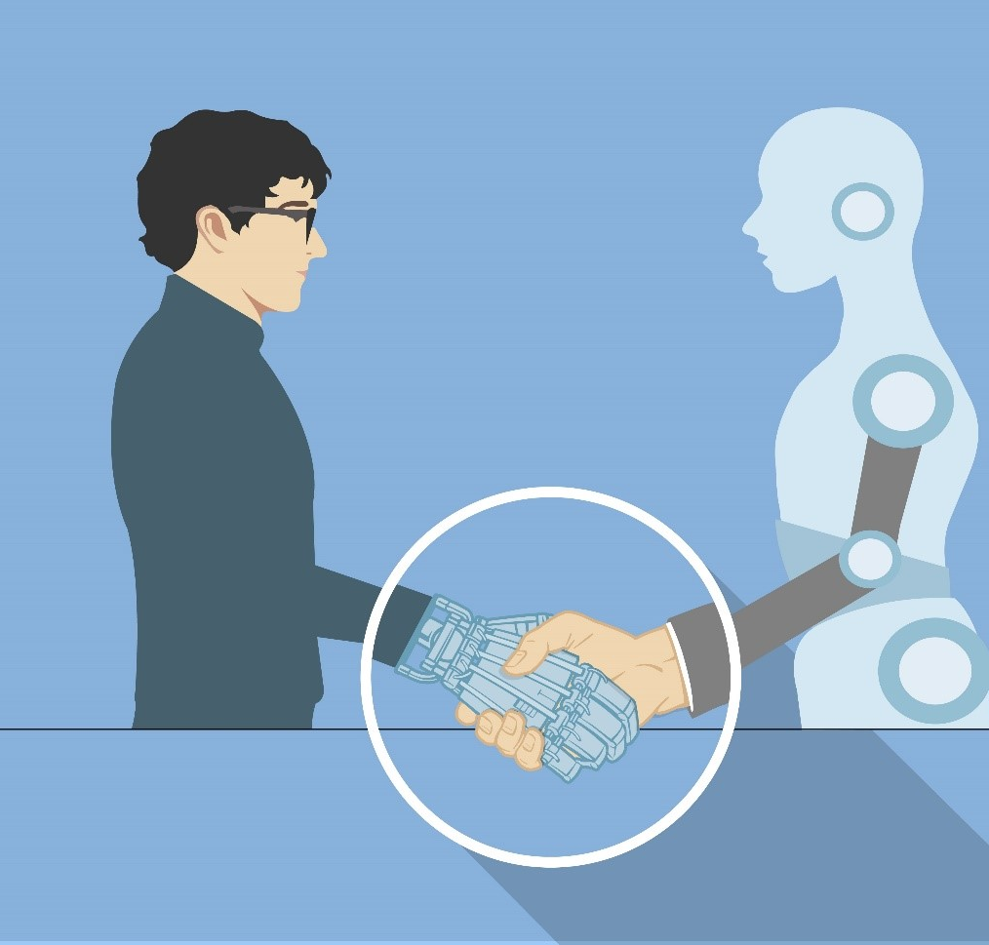
Blockchain in Improving Administrative Processes
It was reported in September 2014, that the United States spends roughly $218 billion per year on hospital's administration costs, which is equivalent to 1.43 percent of the total U.S. Economy.
Meet your new coworker, artificial intelligence
Utilizing artificial intelligence (AI) could help put the human touch back into health by reducing bureaucracy and administrative duties that can take time away from personalized care. Companies are bringing in AI to make administrative tasks a lot quicker, such as screening drug candidates, streamlining finance processes, adverse event reporting and more. AI BLOCKCHAIN ADMINISTRATION
HHS sees blockchain as a potential salve for ills that plague the increasingly complex world of digital health records.

Slide 22
Blockchain in a Value-Based Healthcare System
it’s always better to define a business by what consumers want than by what a company can produce. Kodak had built a successful enterprise producing cameras, film, and photographic paper and chemicals, but what people wanted was images, and so when a better way to get those images was found, Instagram, its customers followed.
The analogous situation in health care is that whereas doctors and hospitals focus on producing health care, what people really want is health. Health care is just a means to that end — and an increasingly expensive one. If we could get better health some other way, .

Slide 23
Value-Based Healthcare System
What would a blockchain-enabled, decentralized healthcare system look like?
One example is a healthcare coop in Switzerland named Healthbank.
Healthbank, a Swiss cooperative healthcare company, says their “core mission is the neutrality in managing personal health data – we believe that a lack of neutrality is one of the key reasons why national eHealth initiatives are slow and have severe problems in providing value to the patients as these initiatives are driven by several stakeholders in the healthcare industry. The main stakeholder, the patient, normally has no active role.”
Reto Schegg, CEO healthbank, states:
“We at healthbank, however, strongly believe in decentralized decision power and do this differently: through our unique structure of a Swiss cooperative, we can guarantee that no other stakeholders than the members (thus the people themselves) define and guide the strategy of healthbank. This decentralized power and decentralized trust are the most important design principles of healthbank.”

Slide 24
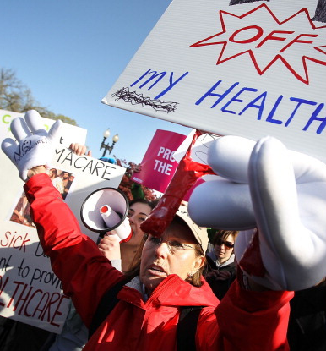
Value-Based Healthcare System
There will be an “increasing shift to a pricing model that is more dependent on quality and outcomes will be a major disruption to the health care industry, likely pressure sales growth and margins, and create new winners and losers."
S&P: 6 key healthcare trends to watch in 2019 Written by Alia Paavola | November 16, 2018

Slide 25
New Business Models in Healthcare and Role of Tokenization
Health care is a business. Like any other business, the healthcare industry stands to benefit from practices that drive innovation and growth.
No sooner does a newly minted MD hangs out a shingle, but he or she is hit squarely in the face with the reality that “Healing is an art, medicine is a profession, but healthcare is a business.”
Many hospitals could not stay fiscally sound in 2018, so they closed. From reimbursement landscape challenges to dwindling patient volumes, many factors lead hospitals to closing.

Slide 26
New Business Models in Healthcare and Role of Tokenization
Tokens can incentivize the business of healthcare. Healthcare is widely viewed as one of the largest Blockchain opportunities. But there are challenges, as Roger Boodoo, from CoinDesk stated on 1/17/2018 in the Economic Explorer:
“Let’s start with the problematic scenario.
“A medical researcher stands behind the podium at a prestigious healthcare conference and proclaims that the “Kill Cancer Blockchain” will revolutionize the clinical trials process. The audience erupts with enthusiasm and begins to believe in this new “blockchain” concept.
Most of the healthcare conference attendees are unfamiliar with the nuances of blockchain. Little do they know, the researcher holds 100,000 “Kill Cancer” tokens and other cryptos in a cold storage wallet.”
As blockchain efforts expand, the question of cryptocurrency holdings presents a potential conflict of interest to individuals and companies looking to further cryptocurrency’s role in healthcare.
Mr. Boodoo believes that crypto holdings should be disclosed when presenting any research and potential blockchain tech applications in any healthcare situation. This will allow the reception of information in an unbiased manner. He concludes that “radical transparency can only help further the adoption of blockchain applications.”
GBA states that they hold none of these Healthcare tokens.

Slide 27
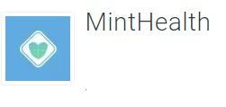
New Business Models in Healthcare and Role of Tokenization
A look at some of the big healthcare tokens and their characteristics.
The MintHealth Security Token (MHST)
The first Healthcare Security Token, MintHealth
Blockchain and Healthcare security token, providing financial sustainability related to healthful action.
With MintHealth, patients can be in control of their own health, be rewarded for good diet, exercise and medication adherence. They are also given a community to support them.
Patients set up and share their health data through mini-social networks with friends, family, physicians, insurance providers and others, who will encourage positive behaviors.
Patients can securely share data with hospitals and drug companies to support clinical trials.

Slide 28
New Business Models in Healthcare and Role of Tokenization
The Cryptonomist names their top 5 Medical cryptocurrencies:
Dentacoin (DCN) The aim to create a token for a network that connects dentists and patients
Medishares (MDS) the platform should provide insurance to protect against risks, such as major accidents, serious illnesses or diseases resulting from diving activities.
Timicoin (TMC) This project deals with the safe storage and sharing of customer data and the management of payments and receipts in the Medicare system.
MediBloc (MEDX) is an ERC20 token and aims to create a database in which patients voluntarily enter their data in exchange for tokens
Medicalchain (MTN)is a platform built to safely store and share electronic health data using blockchain technology (Hyperledger). Authorized users – such as doctors and pharmacists – can access the patient’s health records by recording each transaction on a distributed ledger.

Slide 29
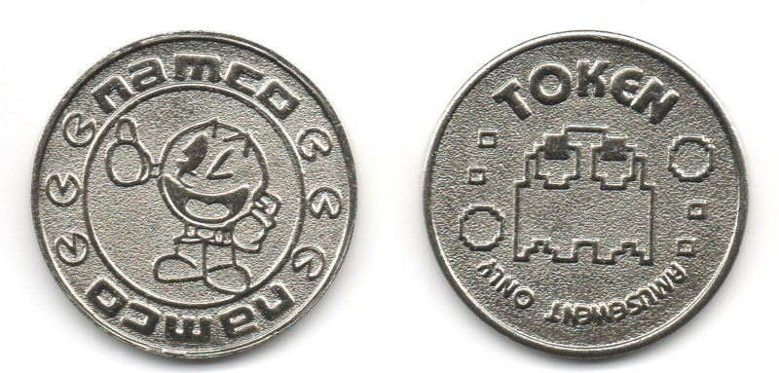
New Business Models in Healthcare and Role of Tokenization
Security tokens are digitized financial instruments that represent ownership in an asset (like stocks and bonds) and can be exchanged securely and instantaneously using blockchain technology.
Their advantage, beyond embedding legal and regulatory compliance into the token, is that a security token brings fractional ownership that can be traded 24/7 without intermediaries on a secondary platform (e.g. Open Finance Network, Templum). In addition, these tokens are trustless (no need for third party verification) and liquid.
Security tokens add an incentive where patients also own the very same health solution they engage with, in order to stay healthy. Thus, they become committed to the success of their company with their community of other patient-investors (‘skin in the game’).
What is a utility token?
Utility tokens represent access to a network, and your token purchase represents the ability to buy goods or services from that network — kind of like an arcade token like Space Invaders or Marvel vs. Capcom without owning the game. Utility tokens give you that same type of access. Chuck E Cheese.

Slide 30
New Business Models in Healthcare and Role of Tokenization
Why is a Healthcare Security Token important?
Healthcare Security Tokens Will Attract CryptoHealth Investment
$10.5B infused into the ICO market in 2018, only $150M was in Healthcare
If this money is invested into the Healthcare system, with sound blockchain practices protecting it from fraud waste and corruption, how many jobs, hospitals, lives will it save?
Unsustainable increases in cost and continuing decrease in life expectancy in the US, combined with technological advancements, system inefficiencies and shifts in consumer behaviors create a ‘perfect storm’ for blockchain to be the backbone of a new business model.

Slide 31
From Acute Care to Prevention, BC in 4P’s of Medicine
P4 Medicine is Predictive, Preventive, Personalized and Participatory. Its two major objectives are to quantify wellness and demystify disease. P4 medicine is the clinical face of systems medicine.
Health care as conventionally delivered explains only a small amount — perhaps 10% — of premature deaths as compared with other factors, including social context, environmental influences, and personal behavior. If health care is only a small part of what determines health, perhaps organizations in the business of delivering health need to expand their offerings.
we’re getting much better at identifying, measuring, reporting, and targeting health outcomes.
Employers focus on employee wellness, on one side, and disease management, on the other Health care financing is testing these pathways too. Payment systems that will not reimburse preventable readmissions or that bundle payments for goals or episodes of care rather than visits reflect a population approach to health focused on outcomes rather than processes.
If we can measure success, why pay for process?
In the future, successful doctors, hospitals, and health systems will shift their activities from delivering health services within their walls toward a broader range of approaches that deliver health.

Slide 32
Regulatory- HIPAA and GDPR
GDPR: The General Data Protection Regulation (EU) 2016/679 is a regulation in EU law on data protection and privacy for all individuals within the European Union (EU) and the European Economic Area (EEA).
HIPAA: Acronym that stands for the Health Insurance Portability and Accountability Act, a US law designed to provide privacy standards to protect patients' medical records and other health information provided to health plans, doctors, hospitals and other health care providers.
Take a look at what the GDPR regulations state.
Strict adherence to patient consent while acquiring their personal details. Organizations can no longer use sneaky opt-out strategies that assume patient consent by default.
Right to be forgotten — healthcare providers can no longer hold patient data indefinitely and must delete this information permanently upon request.
High security storage — it is mandatory for healthcare service providers to deploy adequate security, encryption, pseudonymization, redundancy, and intrusion detection mechanisms in order to ensure that patient data is not compromised in any way.
Similarities With HIPAA
If you are in the United States, a lot of these regulations may already be in place thanks to HIPAA. The HIPAA regulation mandates complete SSL protection for patient data that is transmitted through your hospital servers. Also, similar to GDPR, the HIPAA compliance requirements also make it mandatory for healthcare providers to adhere to stringent data security protocols and ensure compliance to the established protocols while disposing data.
In 2011 at the World Economic Forum, personal data was declared a new asset class.

Slide 33
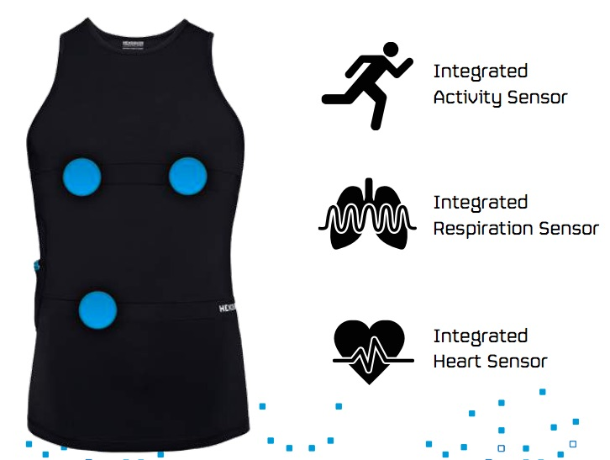
Technical Implementations and Challenges
Technology Acceleration and Transformative Market Impacts
PGHD meets wearables
Patient-generated health data (PGHD) has tremendous potential, but to-date hasn't delivered the promised value. Mainly, because this data never makes it to the patient.
Under Armour HealthBox, Bragi Dash, Hexoskin smart shirt, OMSignal OMbra all generate industry excitement but not yet reaching patient transformation. Wearable tech is exciting, hip, and a great conversation starter. But the real value will come at the intersection of wearable tech and medical records.

Slide 34
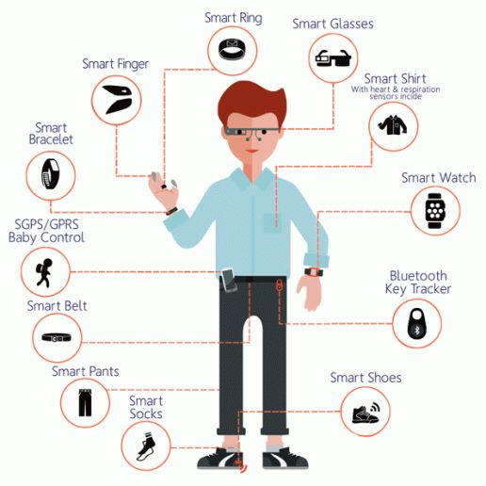
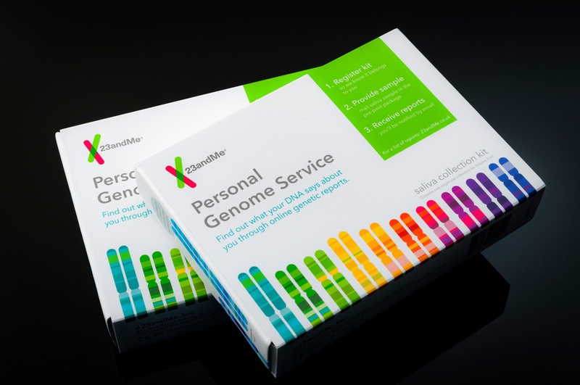
Technical Implementations and Challenges
Wearable sensors are small but crucial components of consumer technology that enables smart devices to track and monitor several parameters, such as movements, temperature, speed, muscle activity, and blood pressure. Sensors collect data about the physical and chemical properties of the body and local environment, which are used by algorithms to produce useful information.
Based on the application, the wearable sensor market can be segmented as wrist wear, eyewear, body wear, footwear, and others.
A recent article on wearable technology notes, “Innovative companies such as AiQ Clothing, Hexoskin and OMsignal are already paving the way with biometric garments that measure body vitals. Future wearables could be more hidden by adding a thin film inside your favorite jewelry to measure biometric data [and] activity levels.
Genomics companies like 23andMe , along with My Heritage.com are collecting DNA and Genomics data that has never before been available. This data should belong to the patient and not the Corporations. 23andMe will not sell a client’s personal data without permission. However, that data belongs to you, and these Corporations are making millions off of it.

Slide 35
Technical Implementations and Challenges
Wearable Devices Use Neuroscience to help Children and Adults Sleep
Wearable devices help with Parkinson’s Disease.
Wearable devices to help alleviate PTSD.
Seventy percent of adults in the United States have experienced some type of traumatic event at least once in their lives," says PTSD approximately 223.4 million people. Up to 20 percent of these people go on to develop PTSD. Today there are approximately 44.7 million people who were or are struggling with PTSD.
The annual cost to society of anxiety disorders? More than $42.3 billion, often due to misdiagnosis and undertreatment.

Slide 36
Business and Cultural Challenges
Despite the United States investing nearly one-fifth of the economy in health care, the system does not promote effective use of health care resources and fails to advance meaningful health outcomes.
A connected, informed, and effective system relies on data, actionable insights, care coordination, and value to enable innovation and advance high-quality care.
Investments in modern health care infrastructure, the utilization of data and information, and proven technology solutions are necessary to empower consumers and care providers, reduce costs, contribute to better health outcomes, and improve the consumer experience.

Slide 37
Business and Cultural Challenges
American Health Care Act of 2017
The American Health Care Act of 2017 often shortened to the AHCA
is a United States Congress bill to partially repeal the Patient Protection and Affordable Care Act, also known as Obamacare.
Act(s) affected: Patient Protection and Affordable Care Act, Medicare Access and CHIP Reauthorization Act of 2015, Social Security Act, Balanced Budget and Emergency Deficit Control Act of 1985, Public Health Service Act
The tax bill will be the most important health care legislation enacted since the Affordable Care Act (ACA) in 2010.

Slide 38
Cultural Challenges
Technology and culture are two forces that greatly influence one another. As new technology is introduced into a society, the culture reacts in a positive or negative way and is thus changed forever.
As cultures change, so does the technology they develop. As cultures evolve, they tend to create even more new technology. When a community has to change their traditions because of advances in technology, their culture is influenced; it even may be threatened entirely. Blockchain technology, AI, and many other new technologies, are causing workforce disruptions and changing the cultures that use them.

Slide 39
Cultural Challenges
Culture has changed, and influenced the development of new products. This is not just happening in North America, Europe or Asia, it is happening everywhere that technology and culture interact.
Religion, culture, beliefs, and ethnic customs can influence how patients understand health concepts, how they take care of their health, and how they make decisions related to their health. Without proper training, clinicians may deliver medical advice without understanding how health beliefs and cultural practices influence the way that advice is received. Asking about patients' religions, cultures, and ethnic customs can help clinicians and healthcare providers engage patients so that, together, they can devise treatment plans that are consistent with the patients' values.
We humans are social animals. Technology can’t replace human interaction. We need to combine the human and digital elements to communicate across our borders.

