Slide 1
Government Blockchain Association (GBA) Healthcare & Blockchain
Gerard Dache
November 13, 2018

Slide 2
Agenda
Challenges Facing Healthcare Industry
What is Blockchain
How Does Blockchain Apply to Healthcare
Healthcare Blockchain Use Cases
For More Information…

Slide 3
Challenges Facing Healthcare Industry

Slide 4
Rising Costs
Population living longer, more active lifestyles
Healthcare costs rising faster than inflation (and expected to continue)
US healthcare spending will grow at an annual rate of 5.8 % from 2015 to 2025
1.3 % higher than the GDP
Very troubling for healthcare leaders
Leaders must find alternative methods to combat the rising costs of care. Options include:
Grants & funding for research and setting up new programs to adapt to rapid change
The Health Services Research Information Central (HSRIC) provides a list of grants, funding and fellowships
Partner with innovative companies in proof of concept projects
Notes:
As more people strive to live longer, healthier and more active lifestyles, healthcare concerns increase and so does the costs. Research reveal healthcare costs and spending often rise at rates exceeding inflation, and is expected to increase in the future. The Society for Human Resource Management present that the Office of “1 the Actuary at the Centers for Medicare and Medicaid Services estimates that aggregate health care spending in the United States will grow at an average annual rate of 5.8 percent from 2015 through 2025, or 1.3 percentage points higher than the expected annual increase in the gross domestic product.” This causes a huge concern for leaders as they seek to provide coverage for their employees.
Leaders must find alternative methods to combat the rising costs of care. They must do the research to find funding, grants and contributors to help them conduct research, set up programs and implement processes at the pace of change. The Health Services Research Information Central (HSRIC) provides a list of “grants, funding and fellowships” leaders might consider helping them train staff members, open up public information sites or labs for processing paperwork and other initiatives.

Slide 5
Regulatory Challenges
Philosophical differences between major political parties combined with increasing financial pressures result in shifting legal and regulatory requirements.
The change in administrations or control over branches of government have profound impacts on national healthcare policy.
This causes changes in administrative rules to ripples through the healthcare system.
The existing regulatory framework is complex and results in strains on the healthcare system. These include requirements resulting from:
Health Insurance Portability and Accountability Act (HIPAA)
Centers for Medicare and Medicaid Services (CMS), and the
Joint Commission on Accreditation of Healthcare Organizations (JCAHO)
This highlights the need for document and records management systems that have integrity, are easy to verify and are unalterable.
Blockchain solutions may be excellent solutions to address many of these challenges
Notes:
Healthcare has taken center stage in the political arena under the Trump administration. As tension and uncertainties mound regarding Trump’s threats to repeal and replace Obamacare, insurance and medical executives scramble to determine “what business is going to look like in the years ahead” (Gomes, 2016). Larry Levitt, a senior executive with the Kaiser Family Foundation emphasized any transition from one program to the next will require time for insurers to adjust to the “reverse disruption” and “overhaul to how individuals buy policies” (Gomes, 2016). Healthcare leaders must inform themselves, and staff on how to handle the changes in coverage. Currently, there is a “noticeable gap between the belief that change is necessary and actual support for specific reform plans designed to achieve that change” (Wood, 2011). Leaders will be challenged to counter frustration and confusion from Americans, once deemed otherwise uninsurable, who have formed a sense of security their current coverage, argues Wood (2011).
Regulatory challenges drive up the cost of providing services and care. As the Trump administration strive to regulate Medicare and Medicaid eligible healthcare providers are overwhelmed by regulated “changes and new reporting requirements” (Brown, n.d.). Research provide that healthcare leaders are further burdened to comply with a variety of newly revised standards including the Health Insurance Portability and Accountability Act (HIPAA), Centers for Medicare and Medicaid Services (CMS), and Joint Commission on Accreditation of Healthcare Organizations (JCAHO). To combat these challenges, the healthcare provider needs actively engage in awareness and information sharing regularly. Studies suggest leaders must implement document control programs, compliance training, routine audits and address non-conformance incidents immediately utilizing integrated healthcare platforms.

Slide 6
Medicinal & Technological Challenges
Healthcare delivery methods are changing
Healthcare providers are facing physician shortages and need “low-cost alternatives to office visits” and in-patient care
Telemedicne
Cyber doctor interactions
Interactive technology like wearables, remote diagnostic equipment and wifi enabled devices supports virtual visits
Virtual visits works well for common conditions such as colds, flu, pink eye and sprains” and “more easily manages patient care for chronic illnesses that require daily interventions
Need for new procedures, tools and techniques
Explosion of patent data
Storage & security concerns
Privacy concerns
New opportunities for data aggregation for research (still privacy concerns)
The pressure and “growing influx of patient data, legal requirements for strict privacy and security, rapidly advancing clinical technology drives up costs, and other factors.
Blockchain technologies and artificial intelligence can support diagnosis and treatment of patients whild addressing privacy, security
Notes:
The practice of medicine and technology has created opportunity and challenges in the way providers practice medicine today and in the future. Today’s health organizations are facing physician shortages and need “low-cost alternatives to office visits” and in-patient care (Austin, Bentkover, & Chait, 2016). Five to ten years from now, leaders can expect more of a shift from the traditional office visits and prescreening in favor of virtual and cyber doctor patient interactions. Sanicola (2016) argue “telemedicine” – the use of “electronic communication” such as “two-way video, phone, email, wireless tools, and other forms of telecommunications technology.” Telemedicine “works well for treating common conditions such as colds, flu, pink eye and sprains” and “more easily manages patient care for chronic illnesses that require daily interventions” adds Sanicola (2016). The rapid change requires leaders to acquire and develop methods for maintaining and accessing private sessions and data of patients.
Saslow (2016) argue the pressure and “growing influx of patient data, legal requirements for strict privacy and security, rapidly advancing clinical technology increases costs, and other factors. At a minimum, leaders should explore innovative ways to manage and store the information adequately adds Saslow (2016). Heathfield, Pitty and Hanka (1998) posit leaders must “understand and predict the behavior of systems and provide important knowledge to inform further developments.” Once the leader understands the system, they can prepare training strategies for the staff and the patient. The leader’s training efforts must be a continuous initiative to keep up with the continual change of technology and medicine in the future.

Slide 7
Training & Education Challenges
The rate of new information concerning diagnosis, treating and monitoring is overwhelming
Fueled by genomic research
Personalized health
Increasingly comprehensive public health system
Exploding sources of healthcare data
Healthcare data integrity becoming increasingly important
Howe do we transmit trusted information to healthcare providers while maintaining the integrity of the information
Blockchain and related technologies can provide solutions in the collection, analysis, assembly, distribution and validation of healthcare information.
Notes:
Professional development is the key. Healthcare leaders must take steps to assess, develop and fine tune key personal and professional skills to remain proficient (Northouse, 2013). Most training initiatives, per Dunn (1995) remain centered around “traditional clinical interview with its focus on acute illness,” but healthcare providers will be challenged to change that dynamic. The future will require healthcare leaders to take more of a hands-off approach; involve patients more in personal care; offer alternatives to current practice and make themselves and staff available to forms of communicating with the patient without a trip into the office (Gomes, 2016).

Slide 8
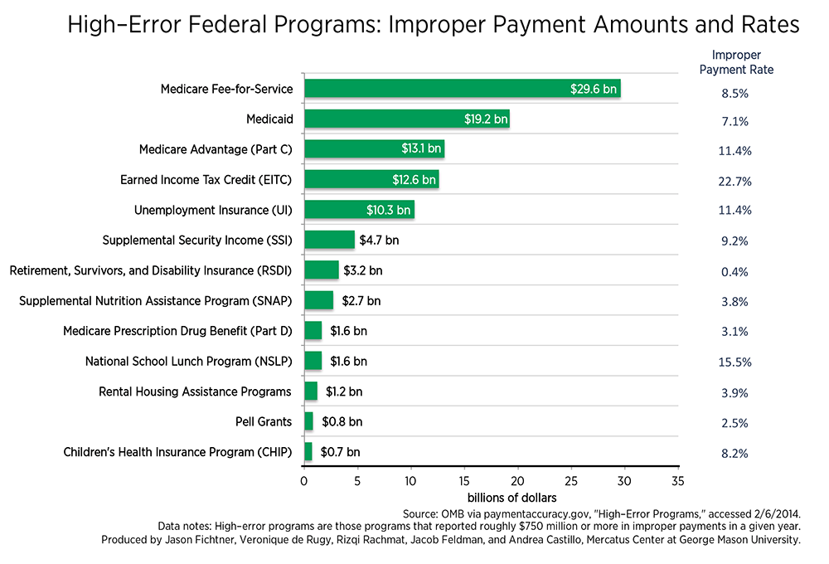
Ethical challenges
Healthcare fraud, waste & abuse
Insurance fraud
Counterfeit drugs & medical device knock offs
False medical credential
Falsified research data and conclusions
Compromised pharmaceutical supply chains
Many, many more….
Blockchain supports the providence, traceability and reliability of healthcare data
Notes:
Ethical challenges in healthcare is a big deal. Recent news stories support this claim with headlines about ethical violations of healthcare providers. In 2016 the British Broadcast Center (BBC) reports Dr. Paolo Macchiarini, was accused of providing misleading medical research which led to the deaths of seven patients (Kremer, 2016). More recently an Olympics Physical Therapy doctor, Larry Nassar was found guilty and sentenced for sexual misconduct. These incidents hurt the character and trust of the medical leaders. In addition, it creates legal costs and rise in malpractice insurance coverage for the agency.
Giving the very serious ramifications, healthcare leaders must ensure their behavior and their employees are above reproach. Bruning and Baghurst (2013) suggest “reform requires ethical decision-making from leaders” because these leaders influence “various relationships” and “creates fundamental successful changes in healthcare.” Sound “ethical principles to transformational leadership improves healthcare relationships and alleviates stress and tension produced by change” (Bruning & Baghurst, 2013). Leaders must understand the success of the organization; heavily rely on their ethical behavior. Building trust earns money and funding and reduces unnecessary liability costs for the agency.

Slide 9
What is Blockchain?

Slide 10
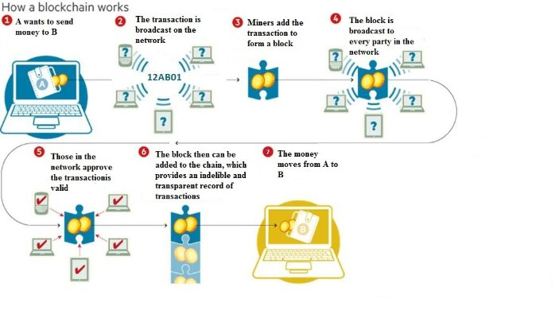
How Blockchains Work

Slide 11
Venn Diagram for Distributed Data
“Blockchains and distributed ledgers are types of distributed databases”
Distributed databases
1
.
ADVERSARIAL MODEL
Presence of malicious nodes assumed
Distributed ‘ledgers’ (DLT)
2
.
DATA STRUCTURE AND DIFFUSION
Chain of cryptographically linked blocks,
and/or global data broadcast
Blockchains
3
.
PERMISSION MODEL
-
:
public vs. private
Read
-
:
Write/Commit
permissionless vs. permissioned
Permissioned
blockchains

Slide 12
How Does Blockchain Apply to Healthcare?

Slide 13
Healthcare Blockchain Use Cases

Slide 14
Blockchain Applications in Healthcare

Slide 15
Dhonor Blockchain
Our mission is to assist millions of patients with deficient organs around the world by safely giving them access to organs from drivers deceased in traffic accidents and assisting the families of the deceased through this everyone wins ecosystem.
Our vision is to become an organ bank that is transparent and 100% verified, spreading life and happiness to humanity

Slide 16
Dhonor cont..
2.5 million lives are lost every year to traffic accidents
8 million organ deficient patients are waiting to be matched with an organ
Dhonor wants to match these two realities by using Blockchain technology
Dhonor secures organs for patients in addition to blood management
Dhonor prevents ay trading in organs with secure DNA signature verification stored on the blockchain anonymously
Dhonor supplies drivers and patients around the world a platform to subscribe to annonymously
Dhonor
In Humanity We Trust

Slide 17
Doc.AI
Doc.AI
AI-powered, blockchain-enabled platform for quantified biology.
What problem does this service solve?
Doc.AI is using blockchain and AI to ena.ble consumers to control their biological and medical profile
Doc.AI
AI-powered, blockchain-enabled platform for quantified biology.
What problem does this service solve?
Doc.AI is using blockchain and AI to enable consumers to control their biological and medical profile
Doc.AI is a platform that secures biological and medical data through blockchain technology. It generates insights from this data with the help of artificial intelligence.
Doc.AI hopes to empower individuals to take advantage of their medical, anatomic, and genetic data. They are launching NEURON, a decentralized artificial intelligence platform that will allow anyone to perform a data trial.
Doc.AI hopes to empower individuals to take advantage of their medical, anatomic, and genetic data. They are launching NEURON, a decentralized artificial intelligence platform that will allow anyone to perform a data trial.

Slide 18
Hashed Health
Blockchain consulting services for the healthcare industry
What problem does this service solve?
Hashed Health is working to use blockchain-based systems to improve inefficiencies in healthcare transactions.
Hashed Health is focused on advancing the development of blockchain and distributed ledger technologies in the healthcare industry.
Hashed Health provides a variety of different blockchain-related services, such as consulting, community development, product management, and tech support.
Hashed Health works with healthcare providers to create and manage blockchain solutions for a variety of problems that the industry faces.

Slide 19
Health Nexus
Blockchain-based medical data management platform
What problem does this service solve?
A blockchain solution for managing healthcare data.
Health Nexus and ConnectingCare are products being developed by SimplyVital Health. They're hoping to bring together providers from different medical organizations onto the same platform, where they can view the same data for shared patients.
Financial and clinical algorithms powered by artificial intelligence will provide actionable information to all parties.
The platform powered by blockchain, enables users to follow-up on patients as well as to reduce the cost of care. Health Nexus will be compatible with HIPAA (Health Insurance Portability and Accountability Act).

Slide 20
DentaCoin
A Token for the dental Community.
What problem does this service solve?
Dentacoin aims to use blockchain to make dental care more affordable.
Dentacoin wants to make dental car more affordable and provide greater access to preventive dental care.
The platform is powered by the DCN token that will enable users to pay for dental insurance, treatments, and oral care products.
Dentacoin also plans on developing a decentralized database of all patient health records. Patient data will be accessible exclusively by patients or by dentists, upon a given permission.
Token Stats: Dentacoin (DCN)
Rank 95 Market Cap $66.08 MIL

Slide 21
Iryo
Blockchain enabled healthcare ecosystem
What problem does this service solve?
Iryo is developing a unified blockchain platform for tracking healthcare records.
Iryo's goal is to create a dedicated and unified platform for tracking healthcare records.
Iryo’s solution is meant to store data securely and allow patients to share their medical history anywhere in the world.
Iryo Token is designed as a gateway cryptocurrency that will enable patients and healthcare professionals to participate in Iryo’s global healthcare network. The token will encourage collaboration and promote medical research.

Slide 22
Nebula Genomics
Solving big data problems related to identifying and sequencing genes
What problem does this service solve?
Nebula Genomics wants to use blockchain technology to address the challenges of genomic big data.
Nebula Genomics is working to use blockchain to improve the process of identifying and sequencing genes.
Genome sequencing is becoming easier and more affordable and is very likely that this technology will become accessible on a large scale in the near future.
Nebula Genomics aims to use blockchain to create a genomic data market which would potentially be worth billions of dollars.

Slide 23
Patientory
A blockchain-based platform for securing data for patients and healthcare professionals
What problem does this service solve?
Patientory is developing a blockchain based dAPP that will enable patients to track their medical information.
Patientory is developing a blockchain-based platform for storing healthcare data.
It allows users to create a patient profile to keep track of their medical history and be in control of their information.
The software provides patients with an easy way of tracking doctor visits, medical bills, personal medical information, insurance, immunizations and pharmacy medications.
Patientory will run on their token.
Token Stats Patientory (PTOY) Rank 670 Market Cap 2.66 MIL

Slide 24
For More Information…

Slide 25
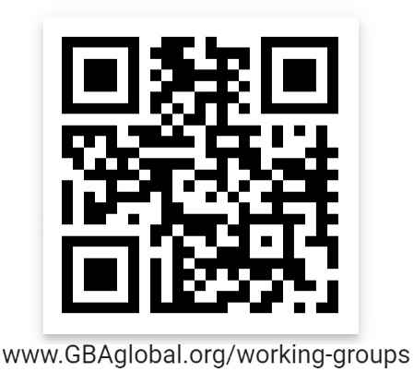

Slide 26
