Slide 1

GBA Smart Cities WG
IEEE Blockchain Standards Review

Slide 2
Section A
Overview

Slide 3
Relevant Blockchain Standards Overview
Industry Connection
IC17-002-01: Digital Inclusion through Trust and Agency (DITA)
IC17-012-01: Supply Chain & Trials Standardized Technology and Implementation (PDF, 626 KB)
IC17-017-01: Blockchain Asset Exchange (PDF, 386 KB)
IC20-005: Global Initiative on Blockchain-based Omnidirectional Pandemic Surveillance

Slide 4
Relevant Blockchain Standards Overview
Published (excluding cryptocurrency related standards):
• 2142.1-2021 - IEEE Approved Draft Recommended Practice for E-Invoice Business Using Blockchain Technology
• 2144.1-2020 - IEEE Standard for Framework of Blockchain-based Internet of Things (IoT) Data Management
• 2418.2-2020 - IEEE Approved Draft Standard Data Format for Blockchain Systems Under Development
• 2142.1-2021 - IEEE Approved Draft Recommended Practice for E-Invoice Business Using Blockchain Technology
• 2144.1-2020 - IEEE Standard for Framework of Blockchain-based Internet of Things (IoT) Data Management
• 2418.2-2020 - IEEE Approved Draft Standard Data Format for Blockchain Systems

Slide 5
Relevant Blockchain Standards Overview(I)
Under Development (excluding cryptocurrency related standards)
-P2140.4 - Standard for Distributed/Decentralized Exchange Framework using DLT (Distributed Ledger Technology)
-P2141.2 - Standard for Transforming Enterprise Information Systems from Centralized Architecture into Blockchain-based Decentralized Architecture
-P2141.3 - Standard for Transforming Enterprise Information Systems from Distributed Architecture into Blockchain-based Decentralized Architecture
-P2144.2 - Standard for Functional Requirements in Blockchain-based Internet of Things (IoT) Data Management
-P2144.3 - Standard for Assessment of Blockchain-based Internet of Things (IoT) Data Management
-P2145 - Standard for Framework and Definitions for Blockchain Governance
-P2146.1 - Standard for Entity-Based Risk Mutual Assistance Model through Blockchain Technology
-P2146.2 - Standard for External Data Retrieval of Blockchain for Risk Mutual Assistance Model
-P2418.1 - Standard for the Framework of Blockchain Use in Internet of Things (IoT)

Slide 6
Relevant Blockchain Standards Overview(II)
  Under Development (excluding cryptocurrency related standards)
    P2418.8 - Standard for Blockchain Applications in Governments
• P2418.10 - Standard for Blockchain-based Digital Asset Management
• P3201 - Standard for Blockchain Access Control
• P3202 - Standard for Capability Evaluation Requirements of Blockchain Practitioners
• P3203 - Standard for Blockchain Interoperability Naming Protocol
• P3204 - Standard for Blockchain Interoperability - Cross Chain Transaction Consistency Protocol
• P3205 - Standard for Blockchain Interoperability - Data Authentication and Communication Protocol
• P3206 - Standard for Blockchain-based Digital Asset Classification
• P3207 - Standard for Blockchain-based Digital Asset Identification
• P3208 - Standard for Blockchain-based Digital Asset Exchange Model
• P3209 - Standard for Blockchain Identity Key Management
• P3210 - Standard for Blockchain-based Digital Identity System Framework
• P3211 - Standard for Blockchain-based Electronic Evidence Interface Specification
• P3212 - Standard for Blockchain System Governance Specification

Slide 7
Section B
Details

Slide 8
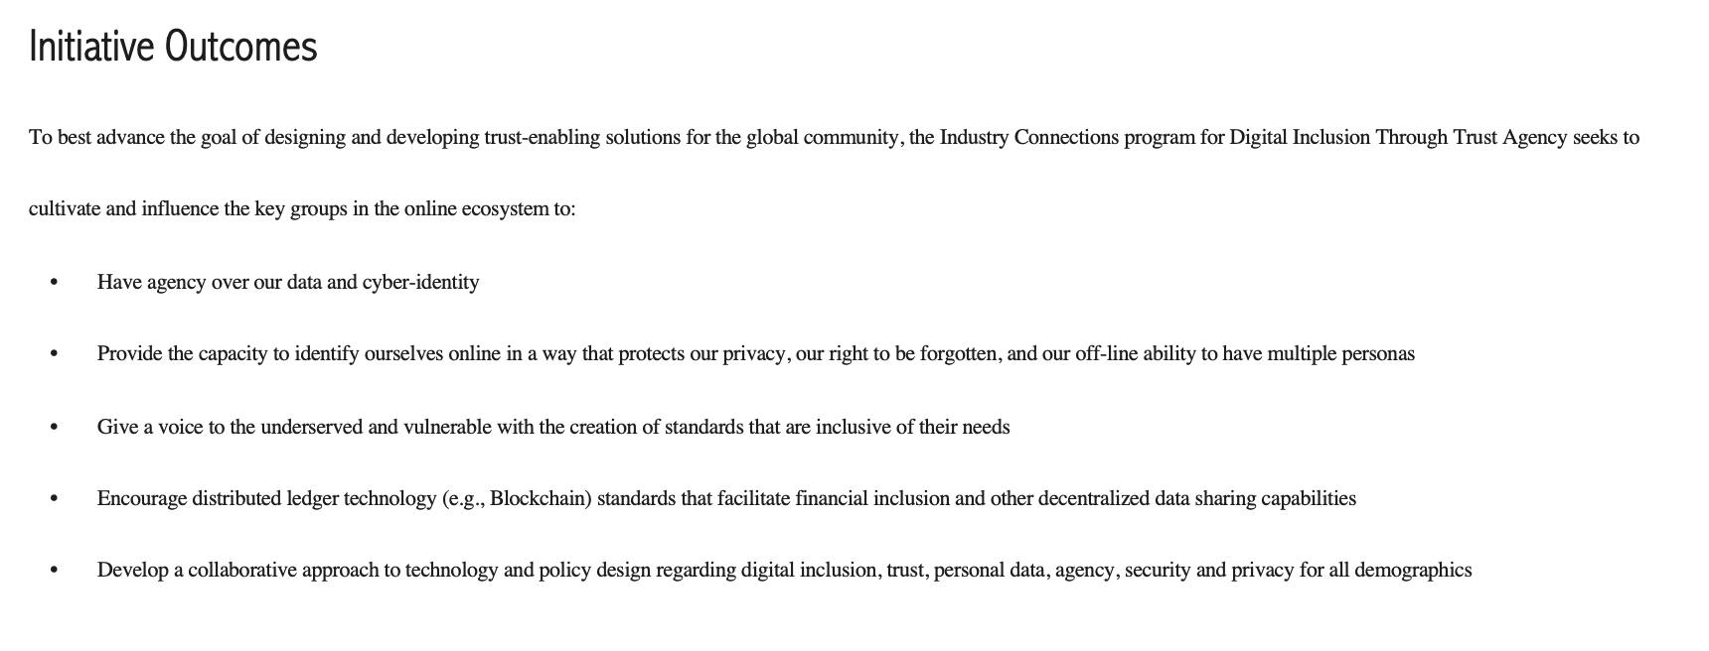
http://standards.ieee.org/develop/indconn/digital_inclusion/

Slide 9
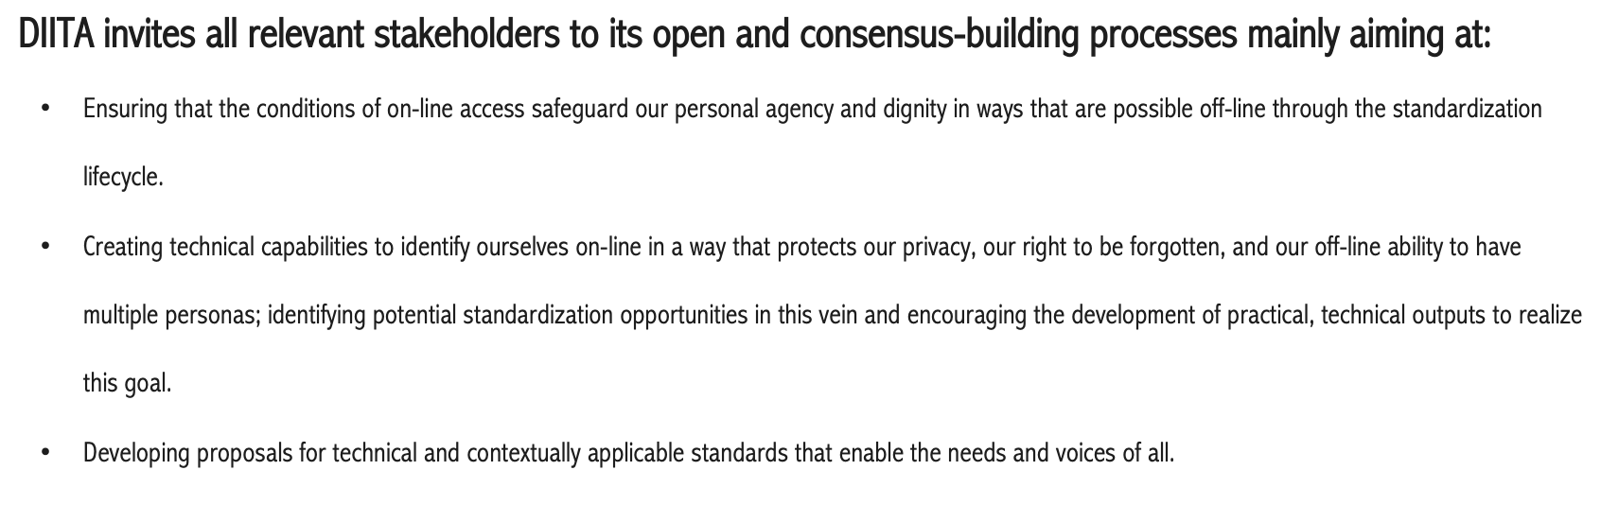
http://standards.ieee.org/develop/indconn/digital_inclusion/

Slide 10
IC17-017-01: Blockchain Asset Exchange (PDF, 386 KB)
Exchange Platform based on Open Source blockchain code development; Conformity programs, certification authorities and license trademarks: • IEEE-SA Token Registry • IEEE-SA Asset Exchanger Rating
Aim: decentralized trading platform where entities and individuals could collaborate on creating, transferring, and capitalizing intellectual properties
Role:
smart contracts will play the role of endorsing and ensuring every trading operation on the platform
assets can be transacted for value-based tokens bringing together entities and individuals to maximize longtail opportunities and enabling open innovation
neutral entity to ratify exchange tokens & engage in the default token ecosystem

Slide 11
IEEE 2418.2-2020
IEEE Standard for Data Format for Blockchain Systems
STANDARD by IEEE, 12/23/2020
Scope
This standard establishes data format requirements for blockchain systems. This standard addresses data structures, data types, and data elements.
Purpose
This standard provides data format reference for organizations planning to use blockchain technology for constructing blockchain systems, while guiding blockchain service organizations on building data structures in blockchain system(s), and provides references about data formats for middleware service organizations during constructing blockchain systems(s).

Slide 12
• P2140.4 - Standard for Distributed/Decentralized Exchange Framework using DLT (Distributed Ledger Technology)
Smart Contract mechanism to process transactions on an exchange, to replace the role of exchange operators.
Cryptographic solutions to provide "data privacy" and "data protection" are defined
Defines a series of extensible interfaces for the exchange scenario, enabling support of third-party financial derivatives using tokens.

Slide 13
• P3209 - Standard for Blockchain Identity Key Management
• P3210 - Standard for Blockchain-based Digital Identity System Framework
Key generation and storage modes that support multiple asymmetric encryption schemes
Derivation and use of multi-level hierarchical accounts used by root keys on different blockchain systems
Protocol specifications for mutual identity anchoring of public keys/addresses generated between different cryptography

Slide 14
• P3214 - Standard for Testing Specification of Blockchain Systems
defines definitions, types, test specifications, test methods and test processes for blockchain systems
defines the test architecture of blockchain systems, including but not limited to functional testing, performance testing, security testing, stability testing, and compliance testing
defines definitions, types, test specifications, test methods and test processes for blockchain systems.
functional testing, performance testing, security testing, stability testing, and compliance testing.

Slide 15
• P2141.2 - Standard for Transforming Enterprise Information Systems from Centralized Architecture into Blockchain-based Decentralized Architecture
• P2141.3 - Standard for Transforming Enterprise Information Systems from Distributed Architecture into Blockchain-based Decentralized Architecture
Other Relevant Standards
• P3206 - Standard for Blockchain-based Digital Asset Classification
• P3207 - Standard for Blockchain-based Digital Asset Identification
• P3208 - Standard for Blockchain-based Digital Asset Exchange Model
P3203 - Standard for Blockchain Interoperability Naming Protocol
P3205 - Standard for Blockchain Interoperability - Data Authentication and Communication Protoco
P2145 - Standard for Framework and Definitions for Blockchain Governance

