Slide 1
ISO Blockchain and DLT Standards
GBA- Smart Cities Work Group
Presented by: Sean Kurzweil, 4/28/21

Slide 2
Overview
20 ISO Blockchain and DLT Standards Available
Very few “Published”
Many in various stages of “Under Development”
Abstracts available for purchase.
Wide range of standardized topics (see reference slides)
ISO standards will generally be categorized into the following:
General Information Resource
Specific Educational Resource
Technical specifications for an application
Themes of Blockchain/DLT standards
General Vocabulary and Terminology
Identity Management
Smart Contracts
Security

Slide 3
Blockchain and DLT Standards: Categorized
General Information
Overview of DLT Systems for ID mgmt
Specific Education
Vocabulary/terminology
Technical Spec
Governance Guidelines
Data Flow Models for specific Use Cases
Use Cases
Legally Binding Smart Contracts
Subject/object Identification
Security Management of Digital Asset Custodians
Privacy and PII protection considerations
Overview of Smart Contracts- Security Best Practices
Security Techniques for DLT/BC in Financial Services
Applying ISO 800-115 standard to Quality Blockchains
Security Risks, Threats, and Vulnerabilities
Trust Anchors for DLT ID Mgmt (TADIM)
Taxonomy and Ontology
Overview of Smart Contracts and their interactions
Reference Architecture

Slide 4
Recommended GBA Workgroup Focus
Use of consistent Vocabulary/Terminology
Identity Management
Quality

Slide 5
REFERENCE
List of available standards

Slide 6
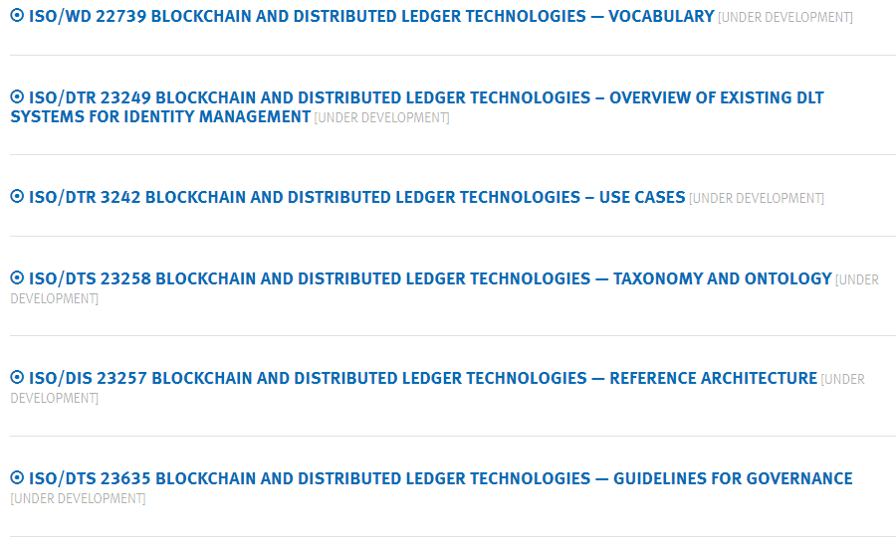

Slide 7
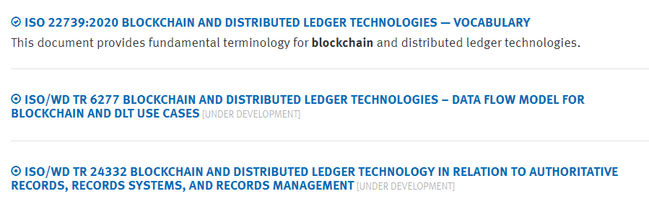

Slide 8
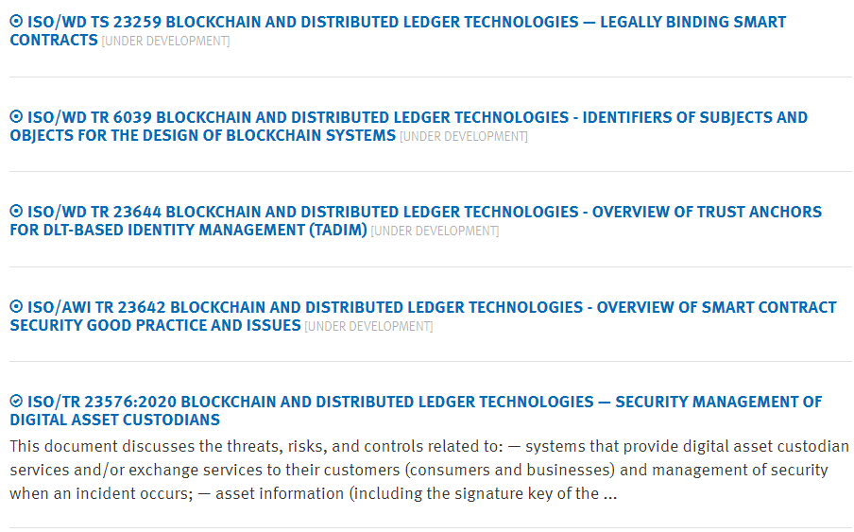

Slide 9
