Slide 1
OECD Smart Cities
Key Highlights
From White Paper published by
OECD Centre for Entrepreneurship, SMEs, Regions and Cities
https://www.oecd.org/cfe/cities/OECD_Policy_Paper_Smart_Cities_and_Inclusive_Growth.pdf

Slide 2
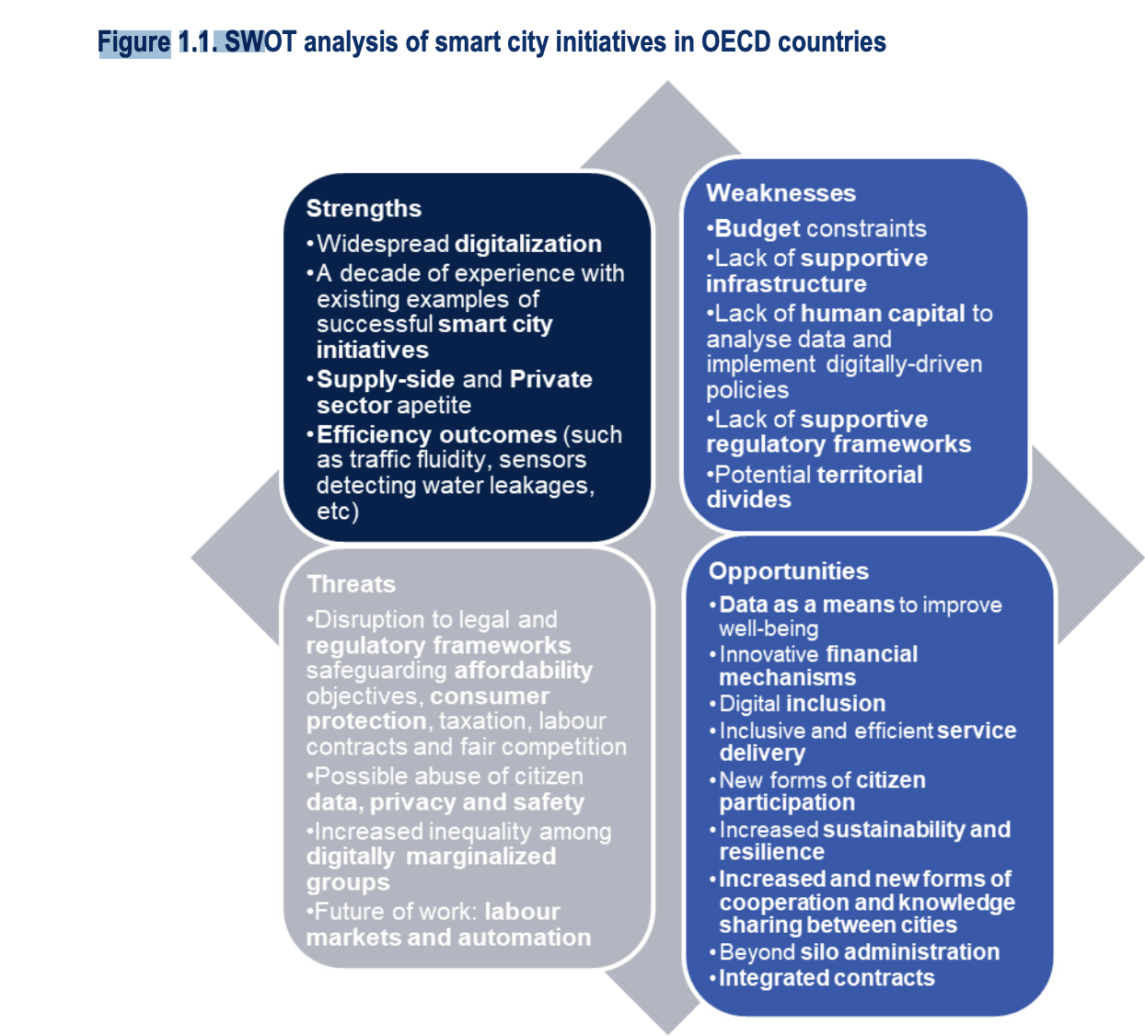
SWOT

Slide 3
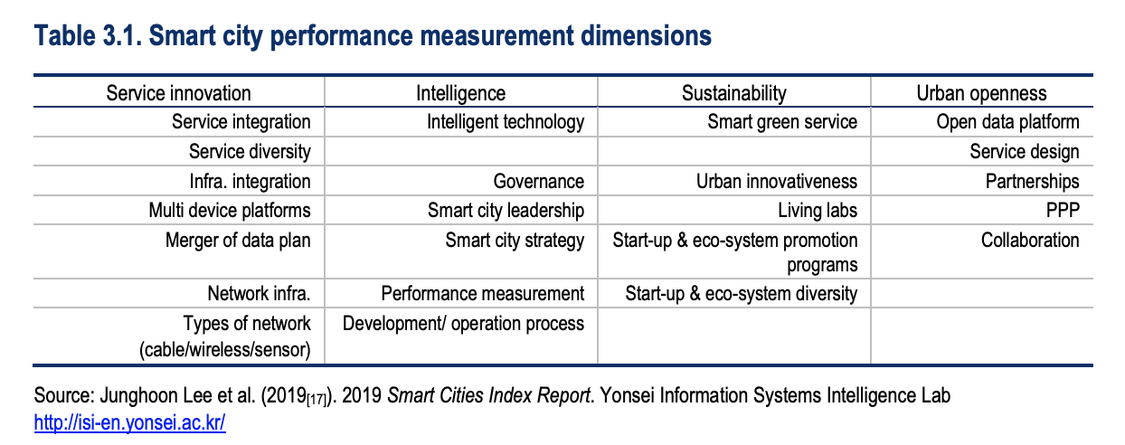
Measurements

Slide 4
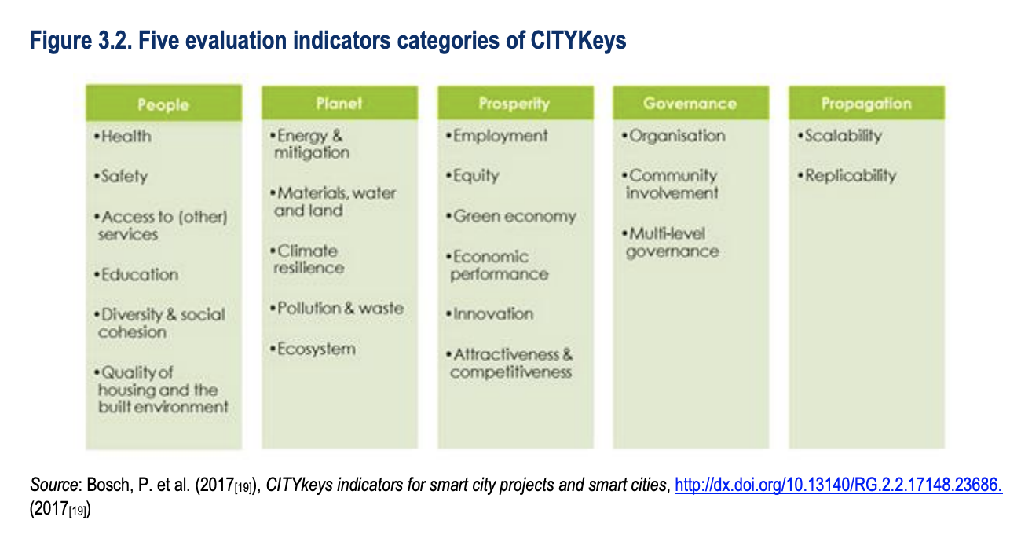
Indicators

Slide 5
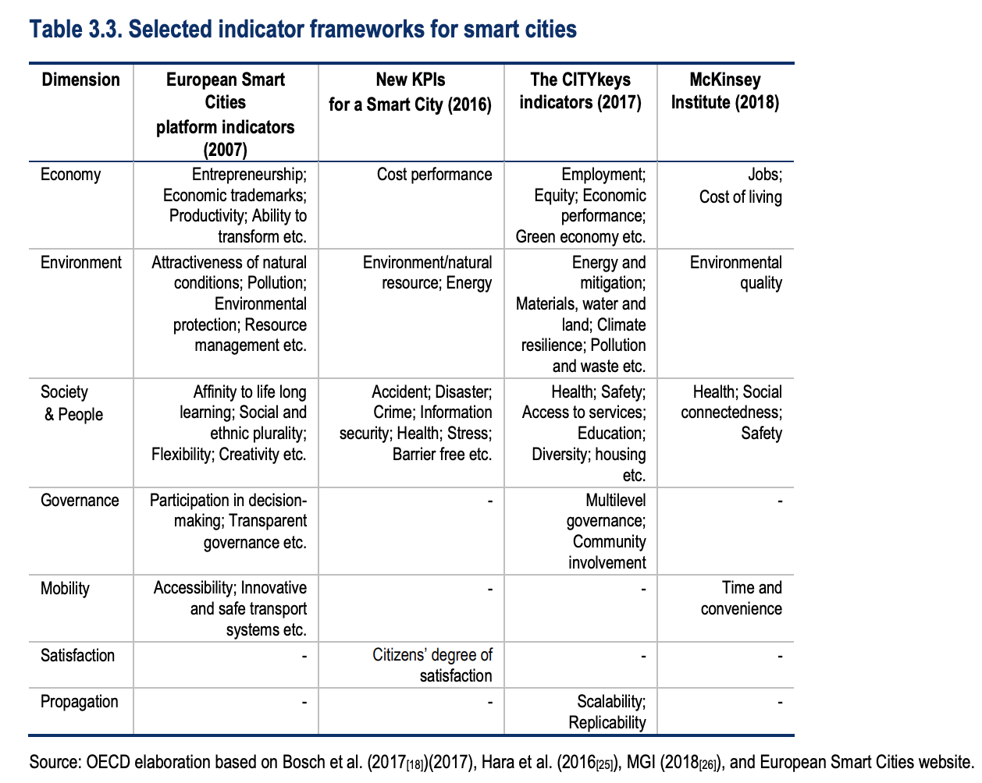
KPIs

Slide 6
Scalability

Slide 7
Sustainability
Measure digital transformation impact on social goals and people’s wellbeing
Design new inter-disciplinary approaches to data collection
Monitor foundational technologies deployment & diffusion
Up-skilling and re-skilling of the workforce
Imapct assessment frameworks for digital government

Slide 8
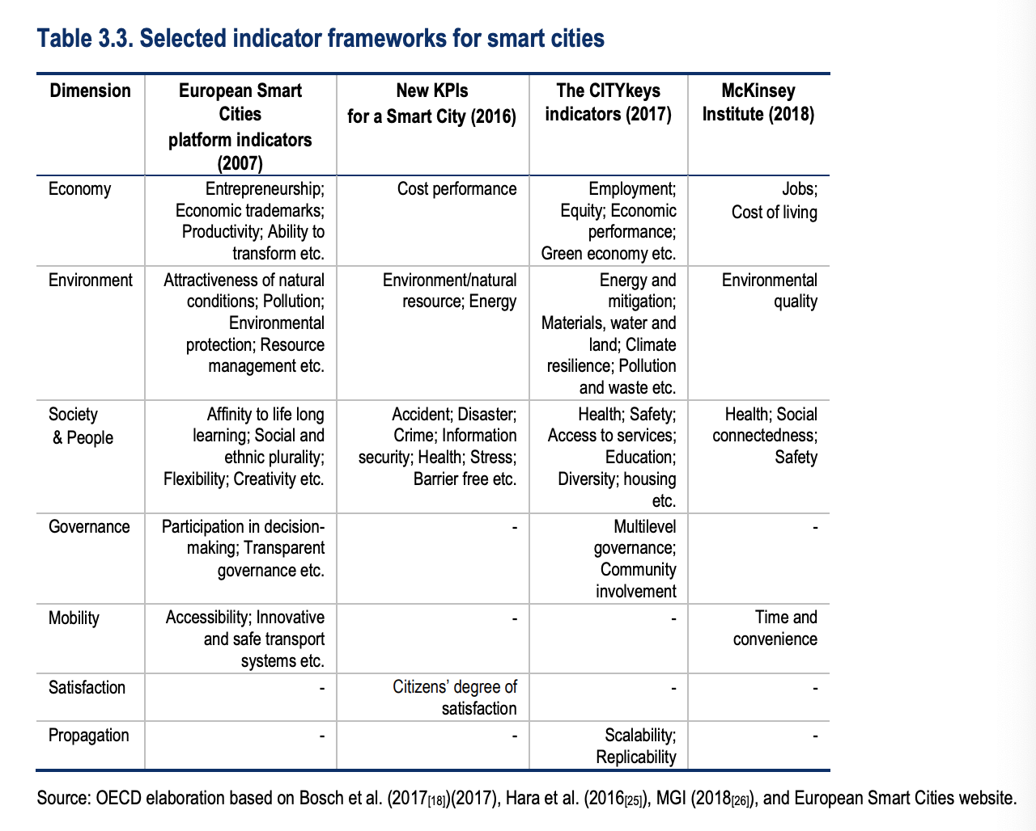
Frameworks

Slide 9
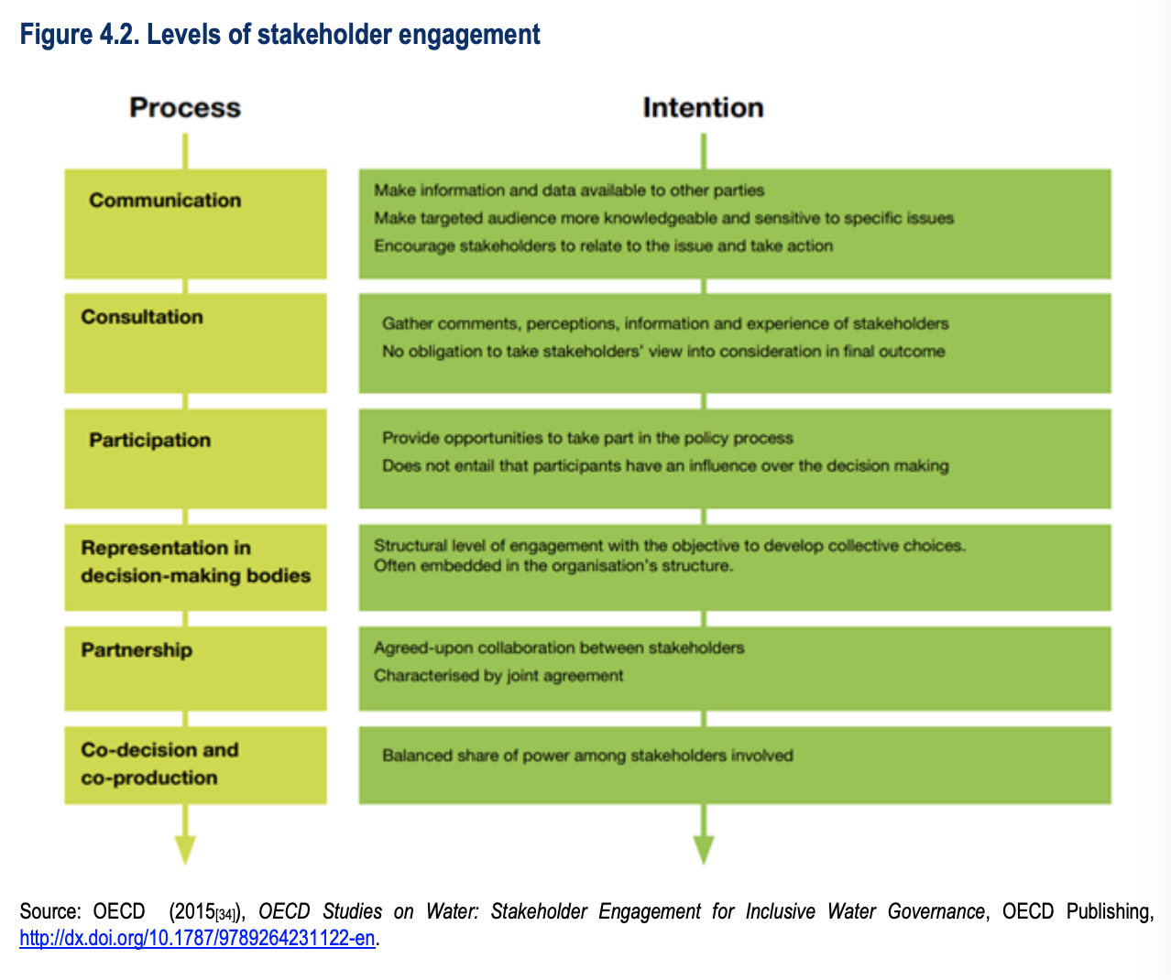
Strategic partnerships -Engagment Models

