Slide 1

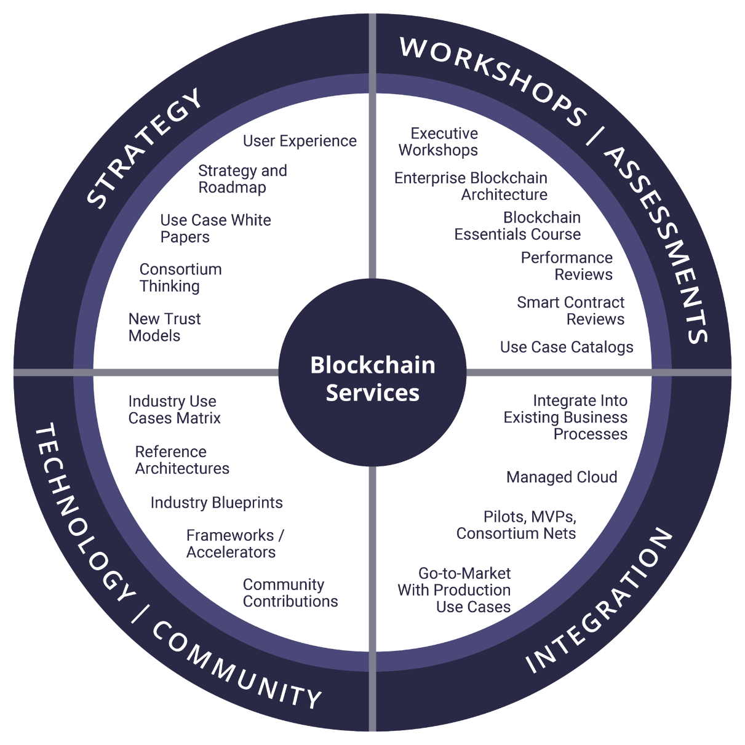










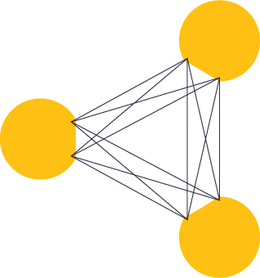
Chainworks- Our Mission is to Enable Adoption of Blockchain in the Enterprise
Our Blockchain journey began in earnest in 2013 with Elevondata (Chainworks’s parent company). In 2017 when Blockchain went mainstream, we decided to spin-off Chainworks from Elevondata for acute focus to enable the adoption of Blockchain in Enterprise (Ideation Workshops, Advisory, Development and IP/Frameworks), while serving the needs of the nascent ICO industry (Advisory and Development Services). Given the early days in Blockchain as a technology we believe that everyone is learning together for now. Hence, we like to think of ourselves as innovating with the customers (Professional Services) or internally (Product Development).
Our Services
Our Expertise
Professional Services
Product Development
ICO Advisory/Development
Community & Affiliations
Multiple products under development in the Enterprise space
Nodalytics- a multichain, Blockchain Analytics and CEP(complex event processing) product launched in 2019
Financial Services
Founder serves as Chief Blockchain Advisor on the ICO to put real-assets such as Futures & Commodities on Blockchain. Development partner.
Government Blockchain Association
Our Locations
Enterprise Software
North America
  Chicago, HQ
  Austin, TX
  New York, NY
APAC
  Delhi, India
  Bangalore, India
MEA
  Chainworks Africa, Nairobi, Kenya
  Dubai – opening in June 2019
Planned
  Kiev, Ukraine (coming soon)
Advisor & Strategic Development Partner. Enterprise Relationship Management on Blockchain
AI/IoT
Lifetime Member since 2013
Advisory. AI/M2M economy on Blockchain – data driven computing at end points.
Our Contact
Ping@Chainworks.com

